Slide 1

TALON PV’s Technology Pathway: From PVD-TOPCon to Perovskite-Silicon Tandem
PV CellTech USA - 2025

Slide 2
TALON PV – Driving Advanced Manufacturing in Solar Technology
TALON PV is redefining solar manufacturing by combining American scale with European precision and sustainability.
4.8 GW PVD-TOPCon G12 / G12R / Custom Solar Cell Manufacturing Facility with commercialization beginning early 2027.
Integrating best-in-class Western technology partners including Fraunhofer ISE, ASYS, RENA, Von Ardenne, ISRA Vision, and Fortix into a single, state-of-the-art U.S. production site.
Technology roadmap advancing from 25% TOPCon efficiency to 31.6% tandem efficiency (Fraunhofer ISE-verified efficiency).
Designed to set a new global benchmark in advanced photovoltaic manufacturing.
Confidential – TALON PV © 2025

Slide 3
Mission and Vision
Mission Statement:
To advance U.S. energy independence by designing and manufacturing the most efficient, fully domestic, and non-FEOC photovoltaic cells, integrating world-class Western technology, American innovation, and smart-factory automation to power the clean-energy future.
Vision Statement:
To establish TALON PV as the benchmark for next-generation solar-cell manufacturing in North America, setting new standards in efficiency, transparency, and domestic content, while creating sustainable industrial ecosystems that strengthen America’s energy supply chain and workforce for decades to come.
Confidential – TALON PV © 2025

Slide 4
TALON PV’s Technology Roadmap
Key roadmap topics for discussion
IT / OT / Automation and Security
Wet Processing
Metallization Advancements
Copper Paste Testing and Implementation
PVD Deposition Advantages
Tandem and Perovskite Commercialization
Confidential – TALON PV © 2025

Slide 5
Strategic Partnerships
Our ecosystem connects the best of Western technology, research, and U.S. execution.
Highlighted benefits:
Fraunhofer ISE – 31.6 % certified tandem IP & R&D collaboration.
ASYS – 36,000 cells/day @ M12 format; 4.8 GW annual capacity.
RENA – 50 % lower water & chemical use; no peroxide chemistry.
Von Ardenne – precision PVD & sputter tools, ± 1 % uniformity.
ISRA Vision – Advanced metrology across all equipment
Bert Thin Films – CuBert™ copper paste → 85 % less silver, DOE-backed.
Rice University – Perovskite development 2D + 3D
Confidential – TALON PV © 2025

Slide 6
IT / OT / Automation
"Make it happen, keep it moving, maintain security”

Slide 7
Factory Cybersecurity in the age of Cyber Warfare
Highlighted benefits:
No access to the Internet
But still connected
Zero Trust
Whitelist only
Authentication, authorization, encryption, segmentation
Template for future factories
Inline with NIST CSF & SP 800-53 and EU Cyber Resilience Act
Repeatable, easy to maintain and to expand
Increased cyber resilience – increased reliability – increased ROI
Confidential – TALON PV © 2025

Slide 8
Industry 4.0 Automation
A digital MES backbone ensures precision, predictability, and near-perfect yield.
Full Kontron + Oracle MES integration for closed-loop control.
ISRA Vision & Wavelabs IV testing detect < 0.1 % variance.
600+ sensor network enables predictive maintenance.
Yield > 98 %, downtime ↓ 35 %.
80 %+ automation coverage → less labor, higher repeatability.
Confidential – TALON PV © 2025

Slide 9
Wet Processing
"We Have Chemistry”

Slide 10
Gigawatt Wet Processing
RENA’s Gigawatt line delivers precision cleaning with major resource savings.
Throughput > 9,000 wafers/hour with ± 2 % uniformity.
No H₂O₂, ≤ 1 % KOH → safer, cleaner chemistry.
Heat recovery raises DI-water ΔT 42 °C.
>97 % uptime; integrated cleaning + drying.
Standard for sustainable, high-volume cell processing.
Confidential – TALON PV © 2025

Slide 11
Sustainability Advantages
RENA Cleaner chemistry. Less waste. Lower energy — measurable ESG results.
Water ↓ 50 %, chemicals ↓ 35 %, waste ↓ 40 %.
110 MWh energy saved / line / year, ~75 t CO₂ offset.
HF recovery 70 %, no hazardous wastewater.
Industry’s greenest wet-processing technology.
Confidential – TALON PV © 2025

Slide 12
Metallization Advancements
“Heavy Metal Rocks! Conductive Metals Rock!”

Slide 13
Multi-Track Metallization Line
ASYS High-speed automation ensures unmatched throughput and uptime.
Each track: 36,000 cells/day → 4.8 GW annual total (4 lines).
Supports M12 wafers, full + half-cut formats.
Inline drying, firing, inspection & IV testing.
Screen change 20 → 5 min → downtime ↓ 74 %.
Built for continuous, zero-interruption production.
Confidential – TALON PV © 2025

Slide 14
Efficiency and OPEX Metrics
ASYS automation reduces footprint, labor, and energy costs setting new efficiency benchmarks.
Operators ↓ 30–45 %, Power ↓ 48 %, Footprint ↓ 26 %.
Screen life extended → 15 % cost reduction.
Yield + 0.3 % abs via real-time defect detection.
Delivers the lowest cost-per-cell platform in the U.S.
Confidential – TALON PV © 2025

Slide 15
Copper Paste Innovation
“Don’t Be Scared, No Cross Contamination Here”

Slide 16
CuBert™ Metallization Innovation
TALON PV’s CuBert™ copper paste eliminates silver costs and material risk — a DOE-backed breakthrough.
Co-developed with Bert Thin Films + Fraunhofer ISE.
DOE Award DE-EE0009638 for copper metallization innovation.
Air-fired Cu paste — no inert gas or new tools needed.
24 % efficiency, VOC 729 mV, FF 79.9 %.
Replaces silver ($700/kg → $9/kg) → 85 % material cost reduction.
Confidential – TALON PV © 2025

Slide 17
CuBert™ Performance and Results
Validated for durability, performance, and mass production.
Fired in air (520–640 °C) → no oxidation or delamination.
1,000-hour aging @ 85 °C/85 % RH → < 1 % efficiency loss.
Rs 0.84 Ω·cm², Rsh 3.6 × 10³ Ω·cm², Cu depth 1.2 µm.
10 % cost of ownership (CoO) reduction per module.
Commercial-ready for gigawatt-scale production.
Confidential – TALON PV © 2025

Slide 18
Advanced PVD Deposition
“Big Tools, Big Wins”

Slide 19
PVD TOPCon Architecture
Von Ardenne - Replacing chemical deposition with PVD delivers a safer, smarter, and more flexible process.
Magnetron PVD replaces PECVD/LPCVD → no PH₃/SiH₄ gases.
Deposits 1–2 nm SiO₂ + 40 nm a-Si(n) at 200–300 °C.
Single-cluster platform coats both sides; tools ↓ 40 %.
Compatible with tandem HTL/ETL layers for future scalability.
U.S. first to commercialize tandem-ready TOPCon production.
Confidential – TALON PV © 2025

Slide 20
PVD Process Advantages
Von Ardenne PVD transforms cost, safety, and uptime across the production floor.
CAPEX ↓ 20 %, OPEX ↓ 18 % via gas-free architecture.
Cleanroom area ↓ 25 %, Power ↓ 12 % – leaner infrastructure.
Uptime > 98 % from reduced chemical downtime.
Film uniformity ± 1 nm improves cell consistency & efficiency.
Accelerated permitting → faster project delivery.
Confidential – TALON PV © 2025

Slide 21
Von Ardenne Deposition Tools
Precision PVD tools enabling scalable tandem production.
HISS600 Evaporation: 40,000 M12 wafers / 8 h, ± 1 % uniformity.
Sputter chamber ± 2 °C temp control, cross-contamination ↓ 95 %.
Target utilization > 90 % → low waste, high throughput.
Seamless transfer from R&D to gigawatt-scale production.
Confidential – TALON PV © 2025

Slide 22
Tandem and Perovskite
“Let's face it, it's why you’re here”

Slide 23
Fraunhofer Pero-Si SCALE Introduction
Fraunhofer’s tandem platform bridges R&D innovation to TALON PV’s production lines.
G12 and G12R wafers @ TRL > 5.
Process flow: HTL → coating → anneal → ETL / TCO sputter.
Humidity ≤ 1 % RH, production-ready at industrial scale.
31.6 % certified tandem cell efficiency (Vienna 2024).
Confidential – TALON PV © 2025

Slide 24
Fraunhofer Perovskite-Silicon Tandem Process
Hybrid perovskite-on-silicon process sets new performance records.
FA₀․₈₅Cs₀․₁₅Pb(I₀․₇₈Br₀․₂₂)₃ absorber (Eg = 1.68 eV).
150 °C anneal, conformal on micro-textured Si.
VOC 1.806 V, FF 82 %, η 31.6 % (M12 scale).
Δη < 2 % after 500 h @ 85 °C — proven durability.
Confidential – TALON PV © 2025

Slide 25
Stability and Certification
Fraunhofer-certified reliability makes TALON PV’s cells bankable for global deployment.
IEC 61215-2 tests: TC200, damp-heat, UV, mechanical.
η loss < 1 %, ionic charge ↓ 6.5 × 10¹⁷ → 3 × 10¹⁵ cm⁻³.
PLQY decay < 2 % after 500 h, 25-year modeled lifetime.
Proven durability = confidence for EPC and financing.
Confidential – TALON PV © 2025

Slide 26
Rice University Partnership
TALON PV is working with Rice University on further Perovskite development
Rice 3D and 2D Perovskites
Rice (Dr. Mohite) Group Chemistries
1.50 eV (optimized for single junction and 4T) Greater than 25% PCE at 0.35 cm²
1.67-1.9 eV (optimized for 2T) Greater than 23% PCE at 0.35 cm²
Deterministic Perovskite Heterostructures for multijunction Si/perovskite/perovskite tandems
Application of 2T Silicon-Perovskite Tandem
Integrated Photoelectrodes with 22% Solar to Hydrogen Efficiency
Confidential – TALON PV © 2025

Slide 27
Closing Statement: Building the Future of U.S. PV
TALON PV merges innovation, policy, and scale — the future of American solar manufacturing.
Embodiment of innovation.
First non-FEOC, TOPCon, tandem-ready cell platform in North America.
31.6 % efficiency, scalable to 8 GW+.
U.S. Supply Chain Integration
Competitive Benchmark – TALON vs Legacy
Scalability Engineered for performance — built for independence.
Confidential – TALON PV © 2025

Slide 28
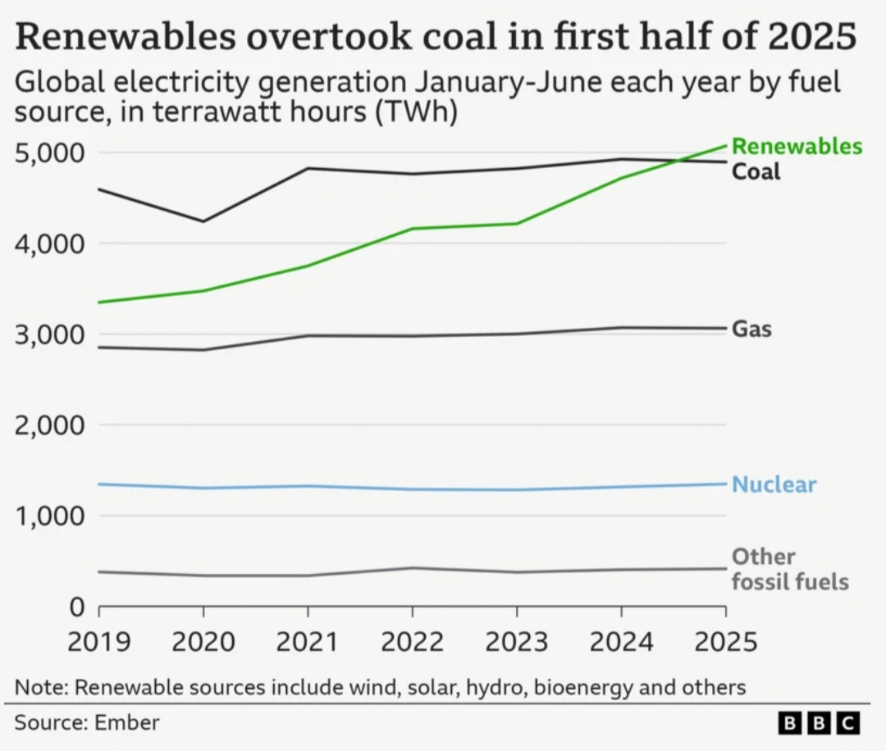
Thank You – Q&A

