Slide 1

Agenda
FlexGen Overview
#1 - Stop Staring at Your Feet and Look Up!
#2 - Stop Studying Your Sites and Operate Them!
Notes:
We hope you find these discussions insightful and engaging.

Slide 2
What is your level of experience with utility-scale assets?
  No batteries or in the first planning process
  1-3 sites
  3-10 sites
  10+ sites
Who has a problem site?
What does that problem site mean to you?
Who is in the room today?
Notes:
Do you dare to tell me about it. What does that problem site mean to your life?
You’re not alone. I love to use this graph to explain what we’re seeing out there.

Slide 3






Ken Rahn
VP Marketing and Customer Solutions
www.LinkedIn.com/in/KenRahn
Notes:
To introduce myself, I started my career about 25 years ago in the Navy running nuclear power plants on aircraft carriers for about 8 years. I consider this my workboots and hardhat phase.
I then transitioned into the world of residential solar with Sunrun and NRG Energy, doing the 20-person to 1000’s of people run for about 8 years, before I l
I wanted to align on why we’re all in this room today. When I was leaving software and tech, moving back into energy…eft the energy industry completely and joined the rest of San Francisco doing the software thing for about 8 years. This was my sneakers and T-shirts phase.
And now I’m standing back here in the energy space… so why did I choose Utility-Scale-Storage instead of doubling-down on my solar experience, or leveraging my nuclear power experience and getting into Small Modular Reactors…
And it’s because I believe the same that FlexGen believes.

Slide 4

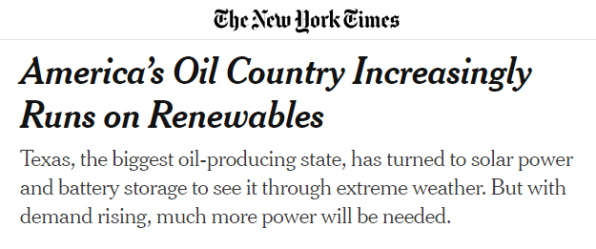
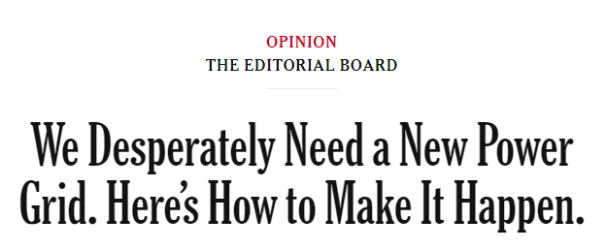
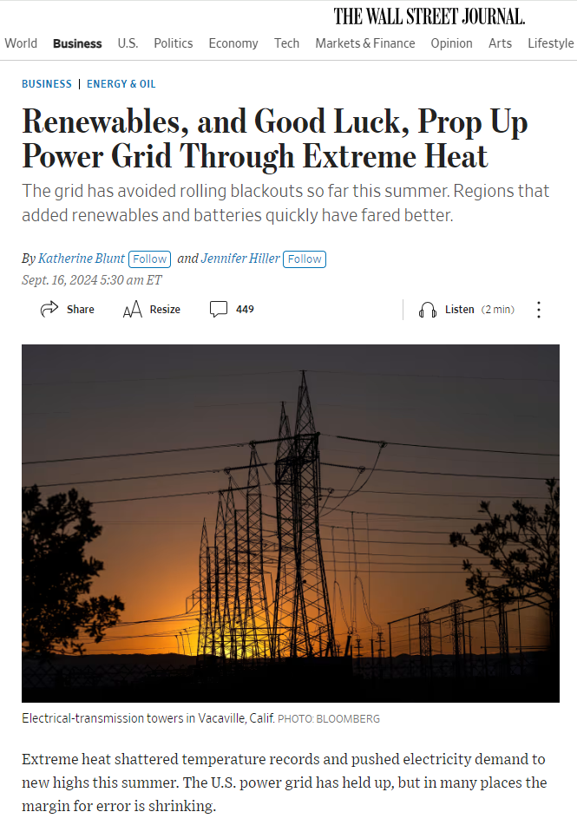
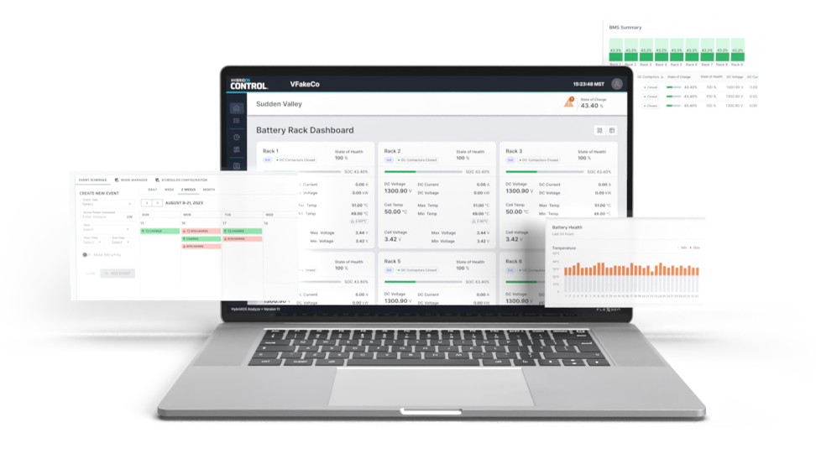

Battery Storage can be both a solution for the grid we have and a bridge to the grid we want
WE BELIEVE
“We built this behemoth haphazardly and yet we rely on it absolutely. Now we must fix it.”
– Eric Siegel, Forbes
Notes:
That batteries and the software powering those batteries are the key to handling today’s grid problems… and are also the bridge to whatever the future grid turns out to be.
[TODAY]
More specifically, batteries have the ability to:
push power, pull power
Raise frequency, lower voltage, inject reactive power…
And do all of that in a distributed, local fashion which makes them the Swiss army knife the grid needs to evolve and transition
[FUTURE]
And whether the future is solar, wind, geothermal, small modular reactors, fission, fusion, whatever… Batteries are the adaptable technology that unlock our ability to have all of those sources playing nicely together! Let me explain how FlexGen has been attacking this problem for 15 years…
-------------------------------
And that ability means that
You can handle solar and wind creating mismatching supply and demand during the day
You can be more resilient to increasing extreme whether events
You can help these new hyperscale data centers shift their load in whatever fashion works for the local grid
------------------

Slide 5


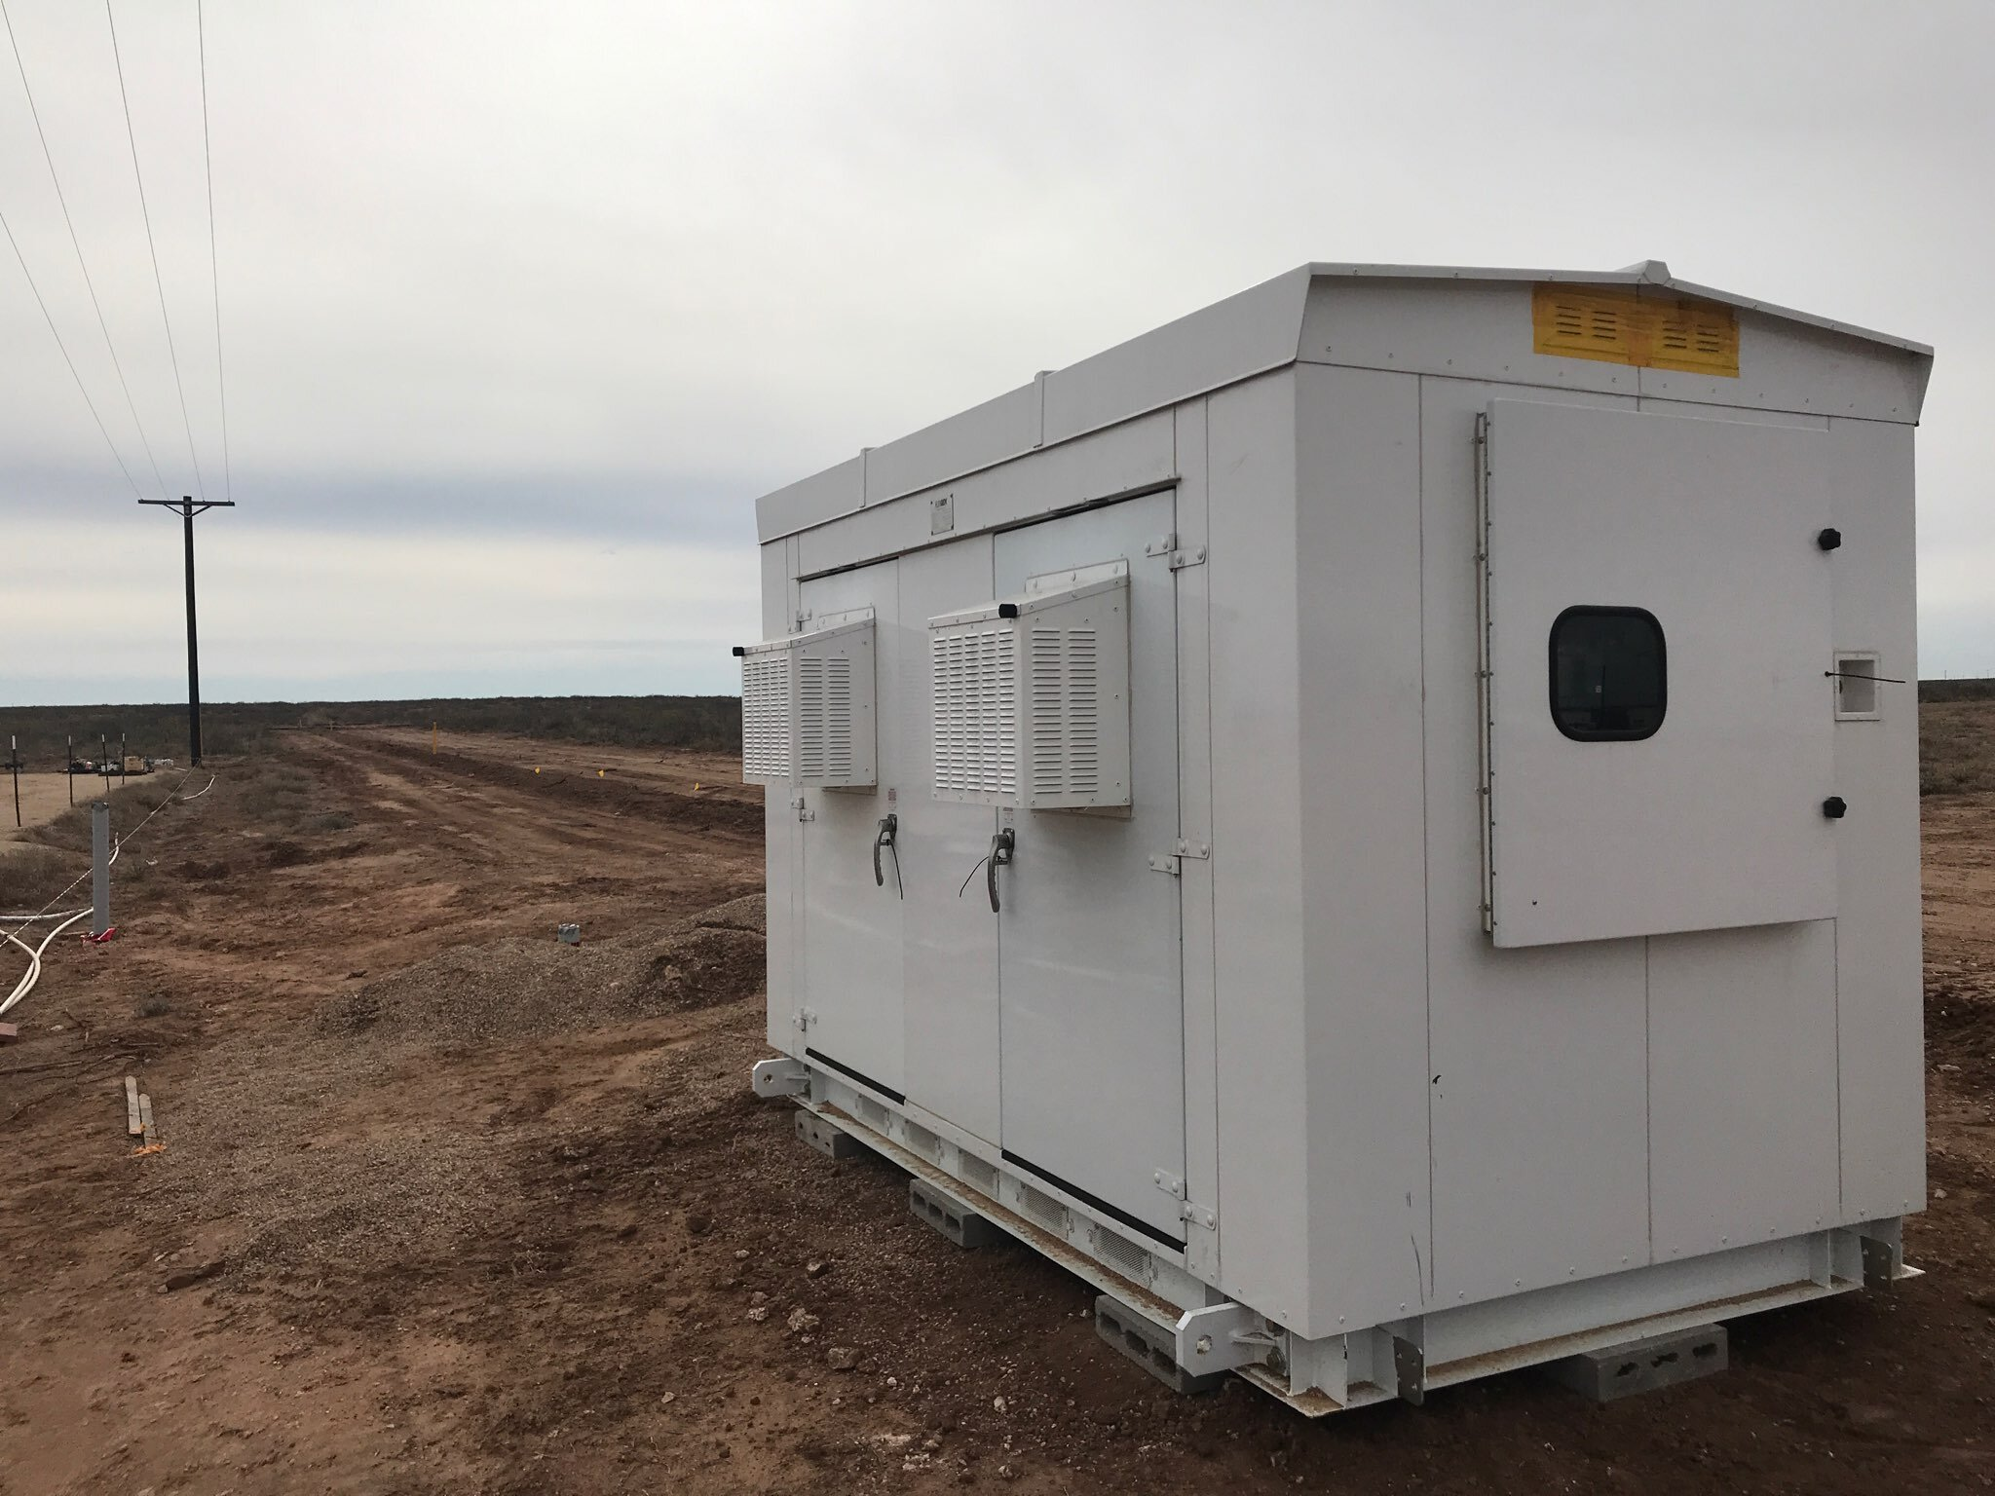
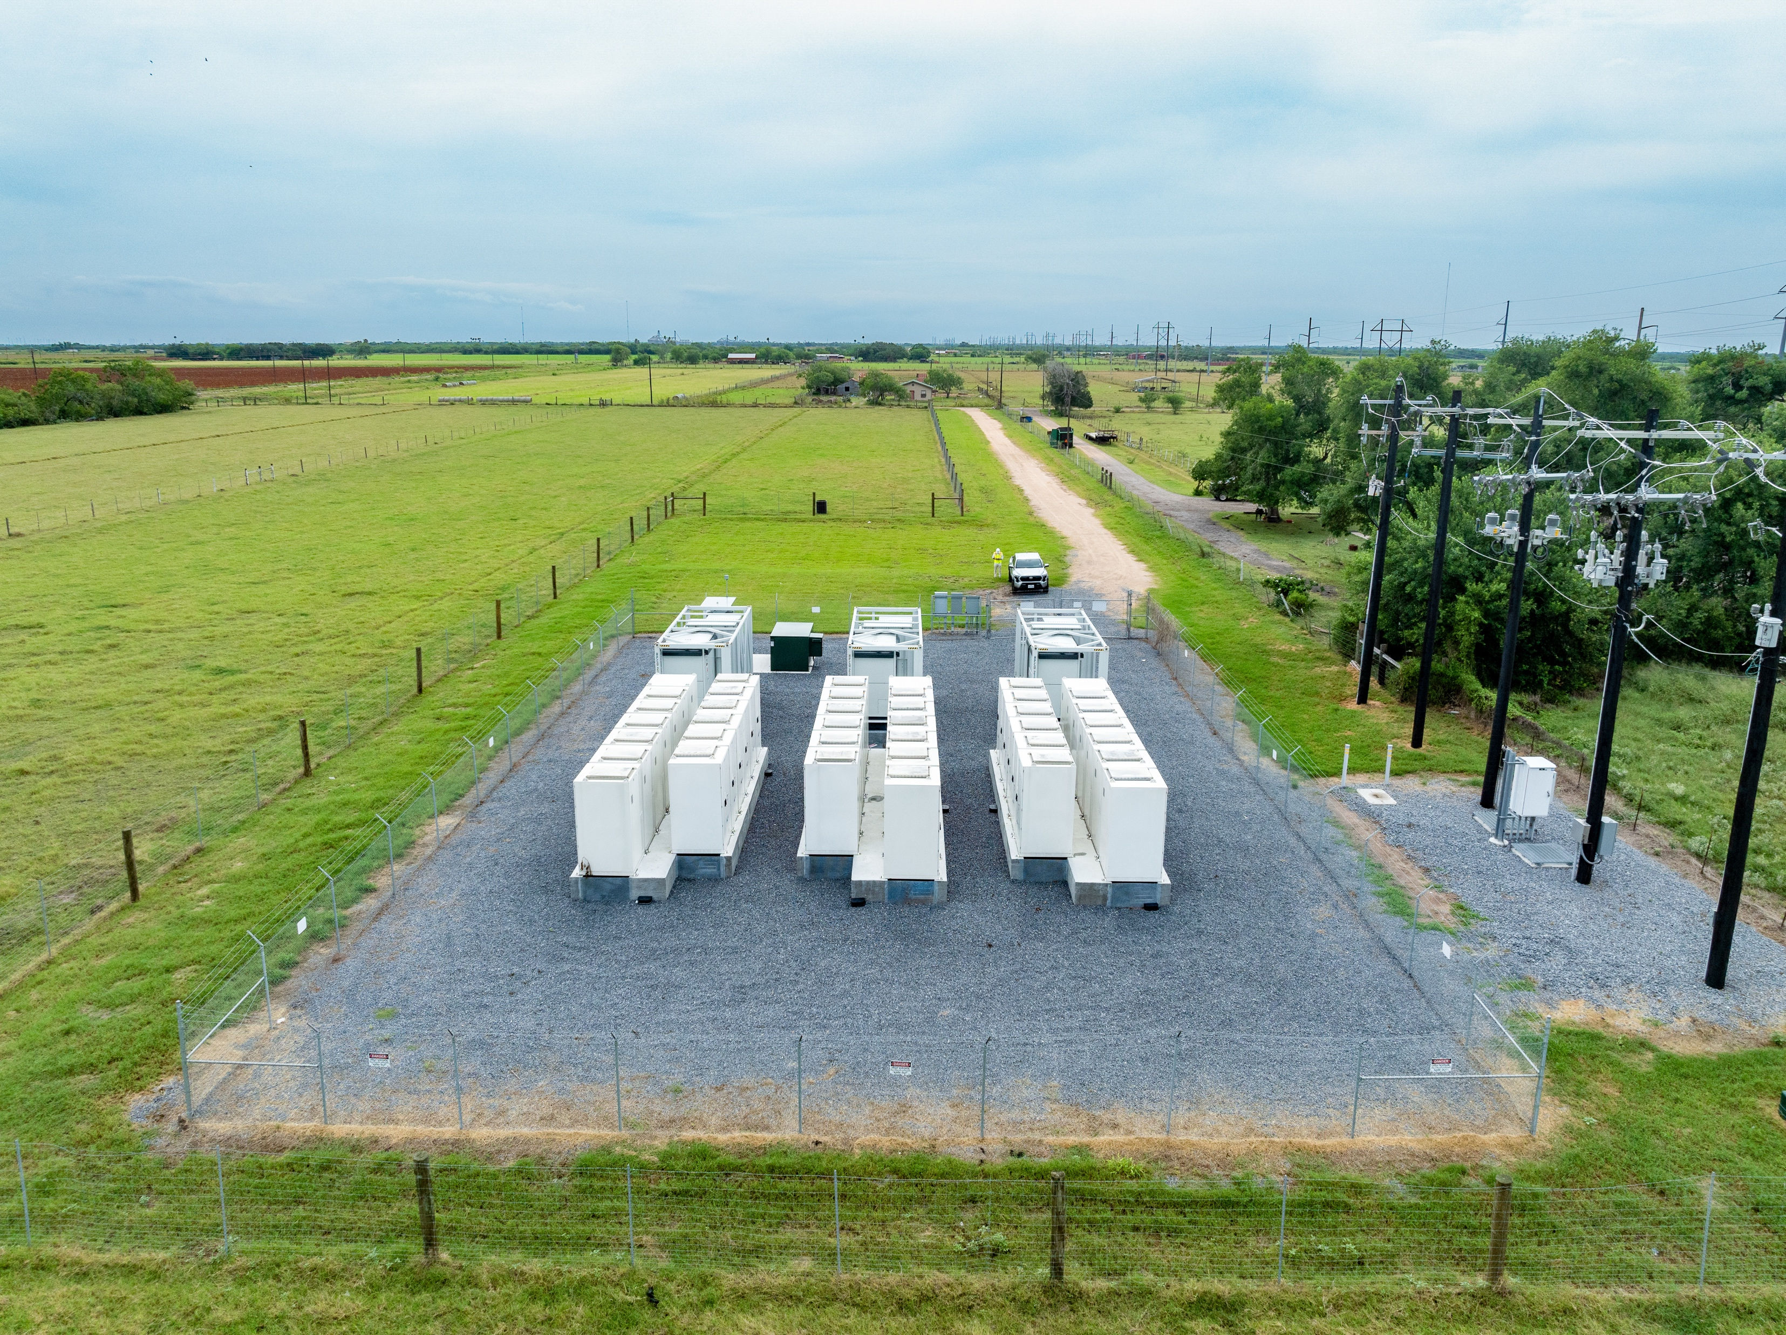
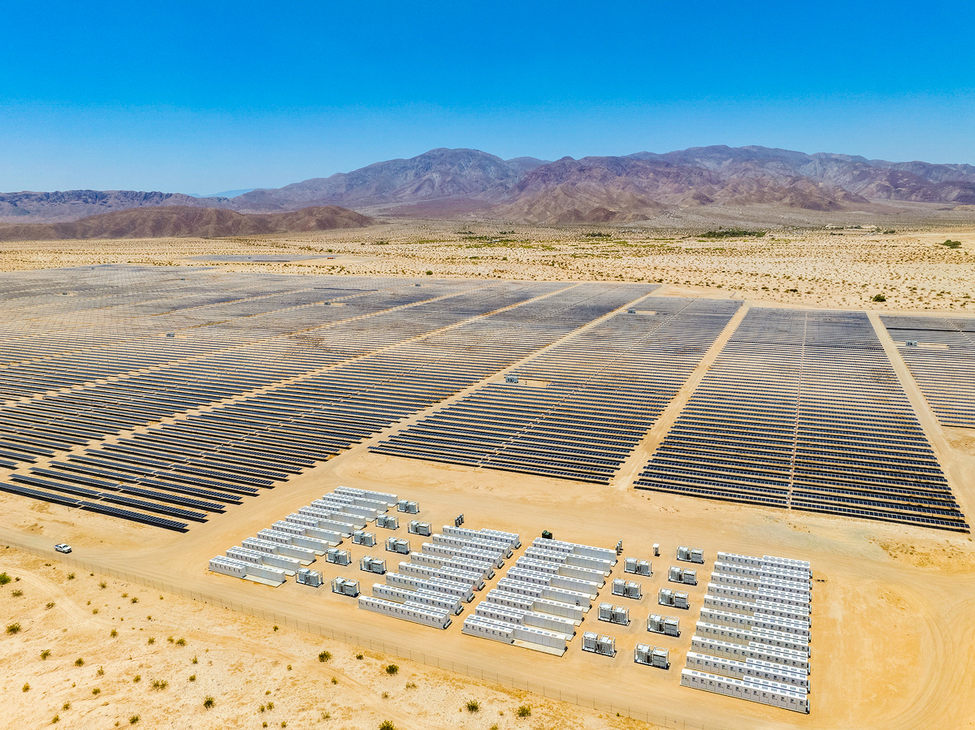
Attacking toughest challenges for 15 years
HOW WE DO IT
Turning Batteries On | Keeping Batteries On
100+ Projects
We’ve completed over 100 energy storage projects in 10 US markets.
First Projects
Military Microgrids & Power Plant Black Starts
Medium Scale Energy Storage
Large Scale Energy Storage
2009
2012
2017
2019
2024
6+ GWh
Installed and/or contracted
That’s the equivalent of 6 nuclear power plants, enough to power Manhattan.
$250M Funding
Where 125 of 250 Employees
work for FlexGen’s CTO and are
driving a 3-year, AI-enabled
software and services roadmap.
We’ve been transferring our field-tested expertise into millions of lines of code to deliver powerful software solutions that deliver the industry’s highest availability.
Notes:
Since 2009, we’ve been running head-strong into the storage industry’s harshest environments and most difficult use cases, and outperforming the industry standard doing 2 things
Turning batteries on with our Activation Services, and
Keeping batteries on with our HybridOS Software and our Lifecycle Solutions.
If you look at the timeline and images…
We’ve been taking that field-tested experience in workboots and hardhats, and continuously pouring it into millions of lines of code, written and tested by our T-shirt and sneakers engineers in Durham, NC. They’ve been building what we now call HybridOS, FlexGen’s software platform which powers 20% of the utility scale storage in the US.
In fact, we’ve done that for 100+ projects and have 6GWh of capacity, or 6 nuclear power plants powering Manhattan.
And we believe it’s important to note that we’ve raised $250M of capital and are profitable, with the intention of standing behind our HybridOS software and services for 20+ years.

Slide 6
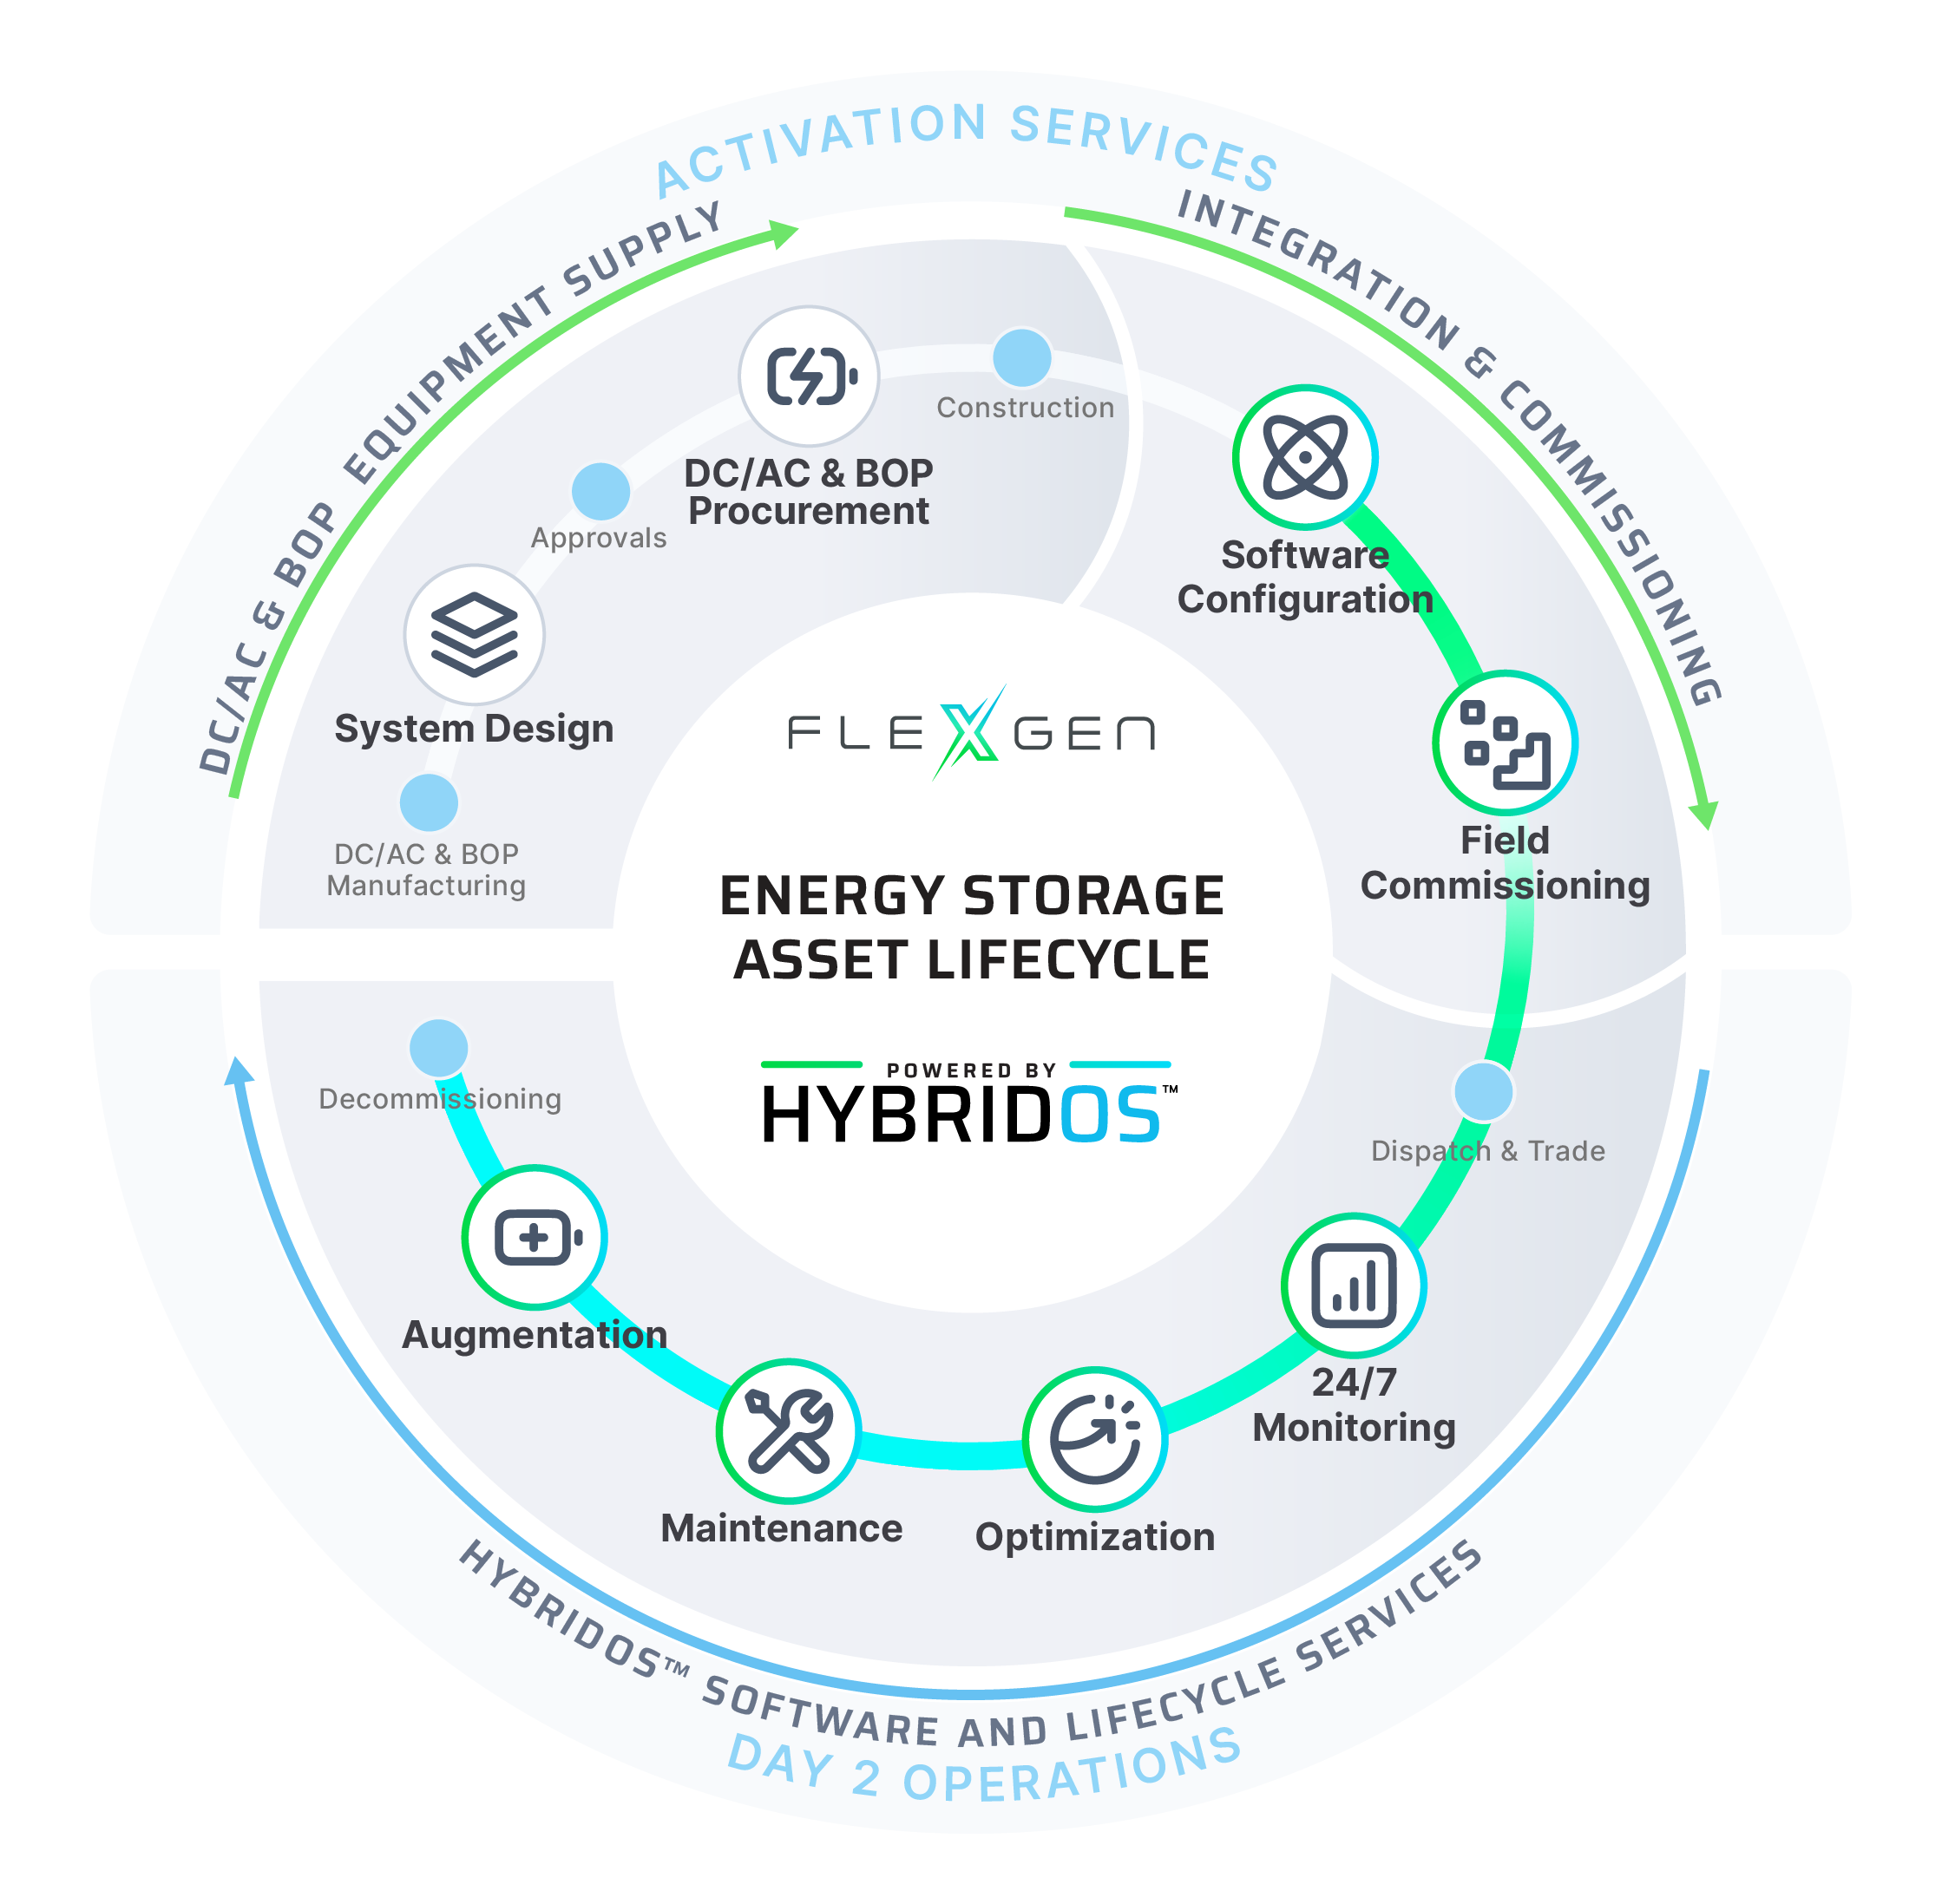
3 key moments in the energy storage lifecycle
WHAT WE DELIVER
1
First revenue dollar
Optimizing performance
Augmentation
2
3
1
3
2
Notes:
To lay that out on the Asset Lifecycle… let’s describe what FlexGen does, and what FlexGen does NOT do.
All the icons are services we provide. All the blue dots are areas that we partner.
In the top half of the circle are Activation Services, turning batteries on; everything from System Design to Procurement to Integration in our Lab in Durham, NC to Commissioning in the field.
In the bottom half of the circle are Day 2 Operations, Keeping Batteries On, powered by a combination of HybridOS Software and Lifecycle Services.
And I wanted to bring this image to you today to make my first point:
FlexGen makes money on the top half of the circle, turning batteries on. We love that revenue stream.
FlexGen makes money on the bottom half of the circle, keeping batteries on. We love that revenue stream.

Slide 7
3 key moments in the energy storage lifecycle
WHAT WE DELIVER
1
First revenue dollar
Optimizing performance
Augmentation
2
3
1
Activation
Services
3
$11 Million
Value capture in high ticket summer months
Aug 2023 ERCOT
90 ^{Days faster}
2
Notes:
To lay that out on the Asset Lifecycle… let’s describe what FlexGen does, and what FlexGen does NOT do.
All the icons are services we provide. All the blue dots are areas that we partner.
In the top half of the circle are Activation Services, turning batteries on; everything from System Design to Procurement to Integration in our Lab in Durham, NC to Commissioning in the field.
In the bottom half of the circle are Day 2 Operations, Keeping Batteries On, powered by a combination of HybridOS Software and Lifecycle Services.
And I wanted to bring this image to you today to make my first point:
FlexGen makes money on the top half of the circle, turning batteries on. We love that revenue stream.
FlexGen makes money on the bottom half of the circle, keeping batteries on. We love that revenue stream.

Slide 8
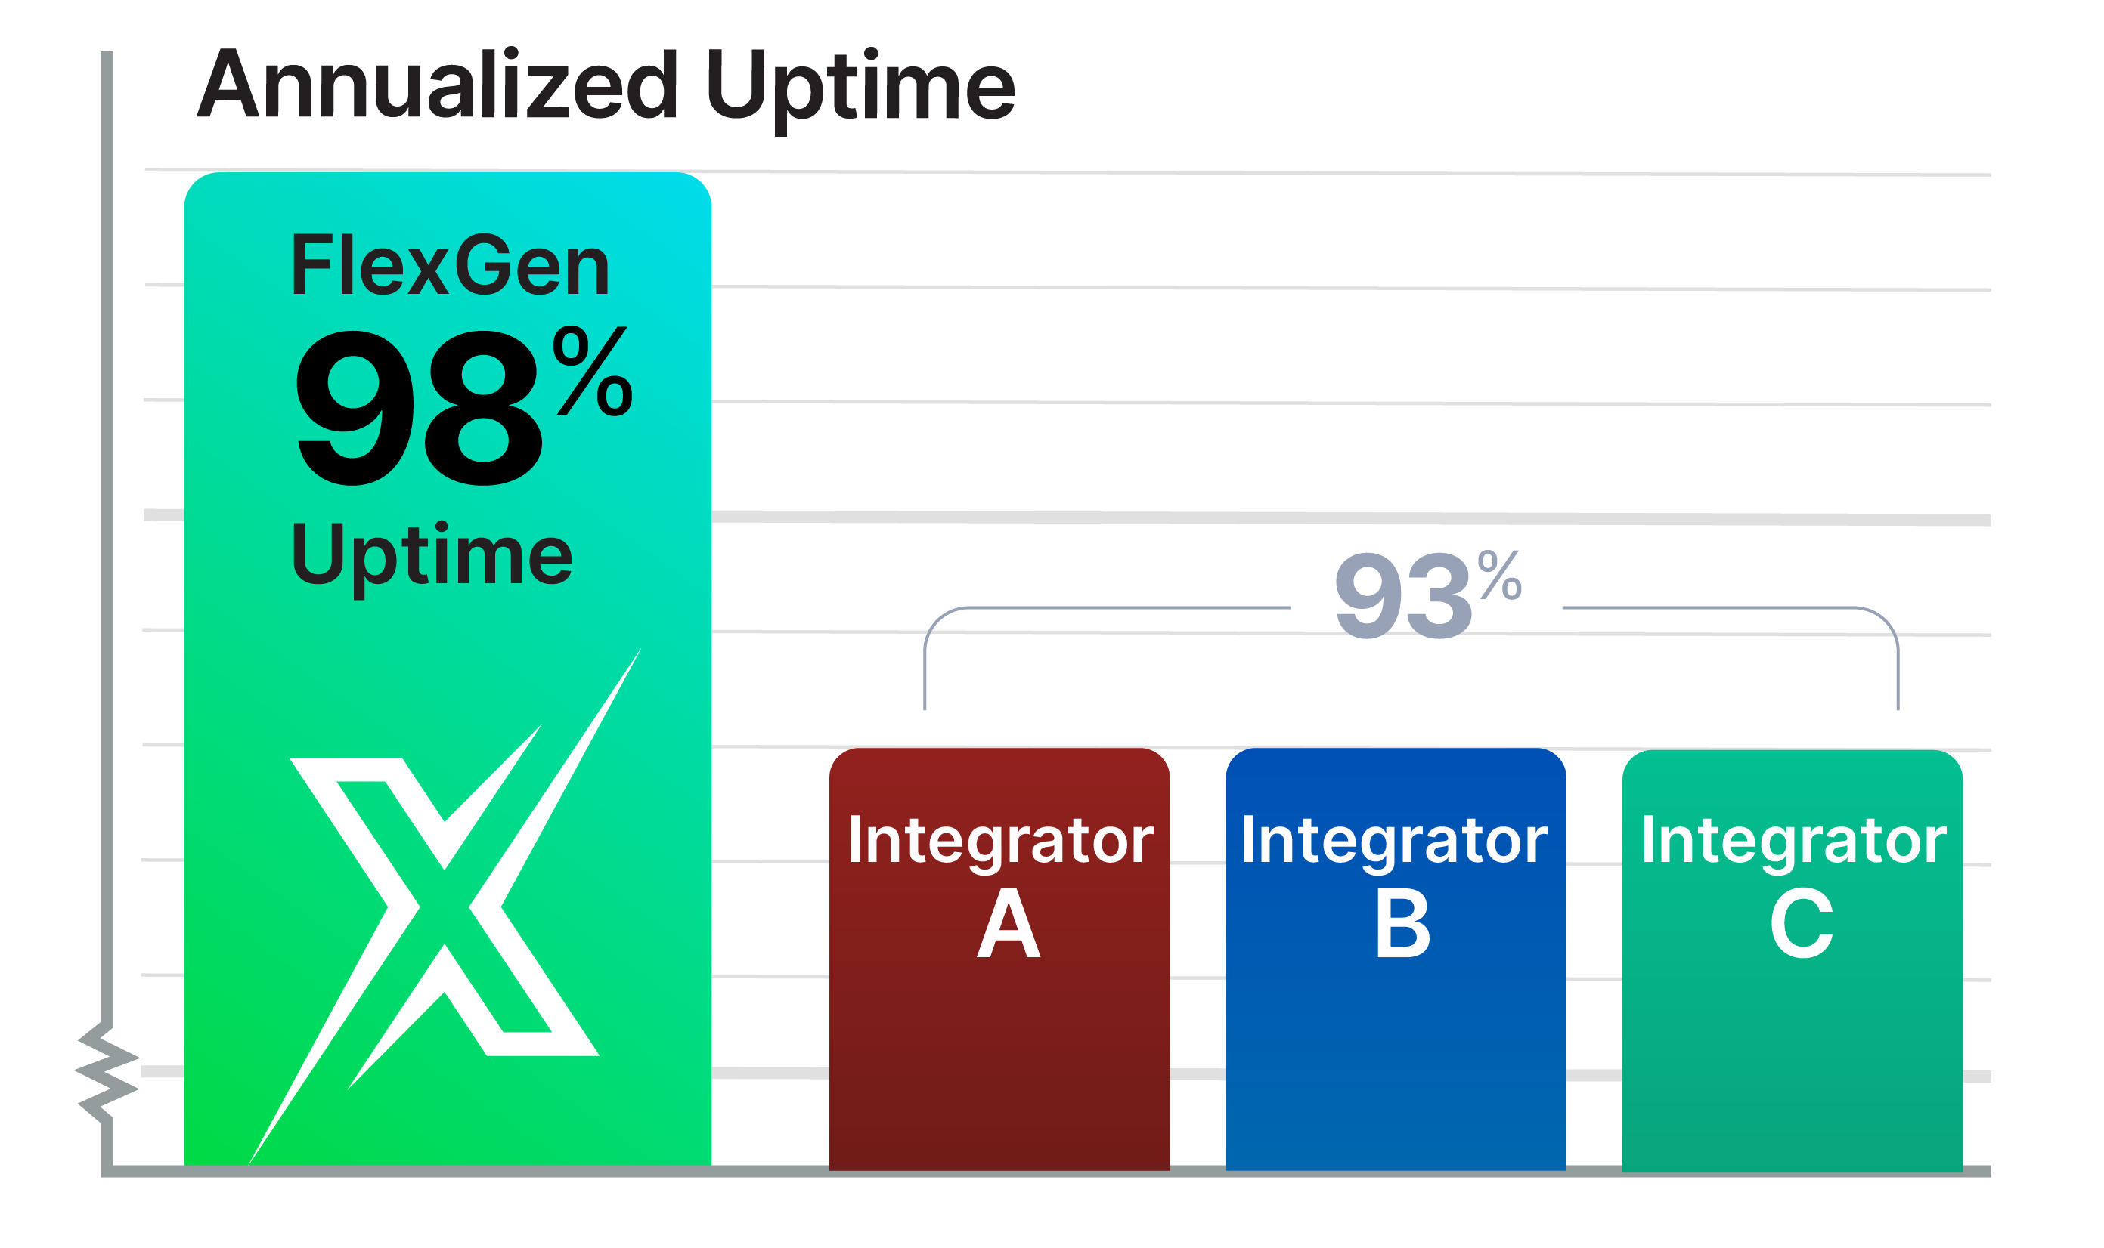
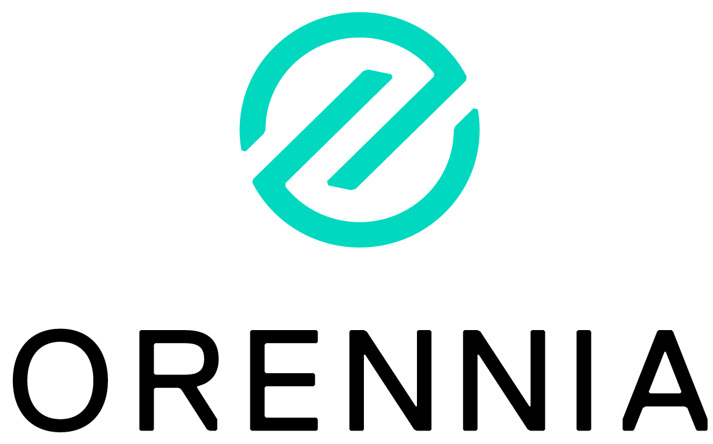
3 key moments in the energy storage lifecycle
WHAT WE DELIVER
Day 2
Operations
1
First revenue dollar
Optimizing performance
Augmentation
2
3
1
3
2
Notes:
To lay that out on the Asset Lifecycle… let’s describe what FlexGen does, and what FlexGen does NOT do.
All the icons are services we provide. All the blue dots are areas that we partner.
In the top half of the circle are Activation Services, turning batteries on; everything from System Design to Procurement to Integration in our Lab in Durham, NC to Commissioning in the field.
In the bottom half of the circle are Day 2 Operations, Keeping Batteries On, powered by a combination of HybridOS Software and Lifecycle Services.
And I wanted to bring this image to you today to make my first point:
FlexGen makes money on the top half of the circle, turning batteries on. We love that revenue stream.
FlexGen makes money on the bottom half of the circle, keeping batteries on. We love that revenue stream.

Slide 9
Message #1 for the Industry:
Please Stop Looking at Your Feet
Focus on the horizon and what has the most impact on your long-term value trajectory
Notes:
But wow… the industry is staring at its feet here, and not looking up! (soccer ,basketball, skiing, surfing, biking… have to look where you’re going)
THIS IS WHAT I MEAN:

Slide 10
3 key moments in the energy storage lifecycle
WHAT WE DELIVER
1
First revenue dollar
Optimizing performance
Augmentation
2
3
1
3 Years
99% Capital
3
2

Slide 11
3 key moments in the energy storage lifecycle
WHAT WE DELIVER
1% Capital
20-Year Impact
1
First revenue dollar
Optimizing performance
Augmentation
2
3
1
3
2
Notes:
98% versus 93% is a $15M NPV on a 100MWh project.
Operating your asset between 10% and 90% versus 0% to 100% is a $57M difference!

Slide 12
Q1: How many of you have a comprehensive understanding of your Availabilty and all issues affecting it?
Q2: Is it meeting your expectations?
Q3: Have you tried to do an analytical engagement to fix it?
Who is in the room today?
Notes:
Have you done any analytical engagements to try to fix it? Did you fix everything?

Slide 13
Message #2 for the Industry:
Don’t Study Your Sites. Operate Them.
Top performing site owners are focused on the people, process, and software to Detect-Evaluate-Act.

Slide 14
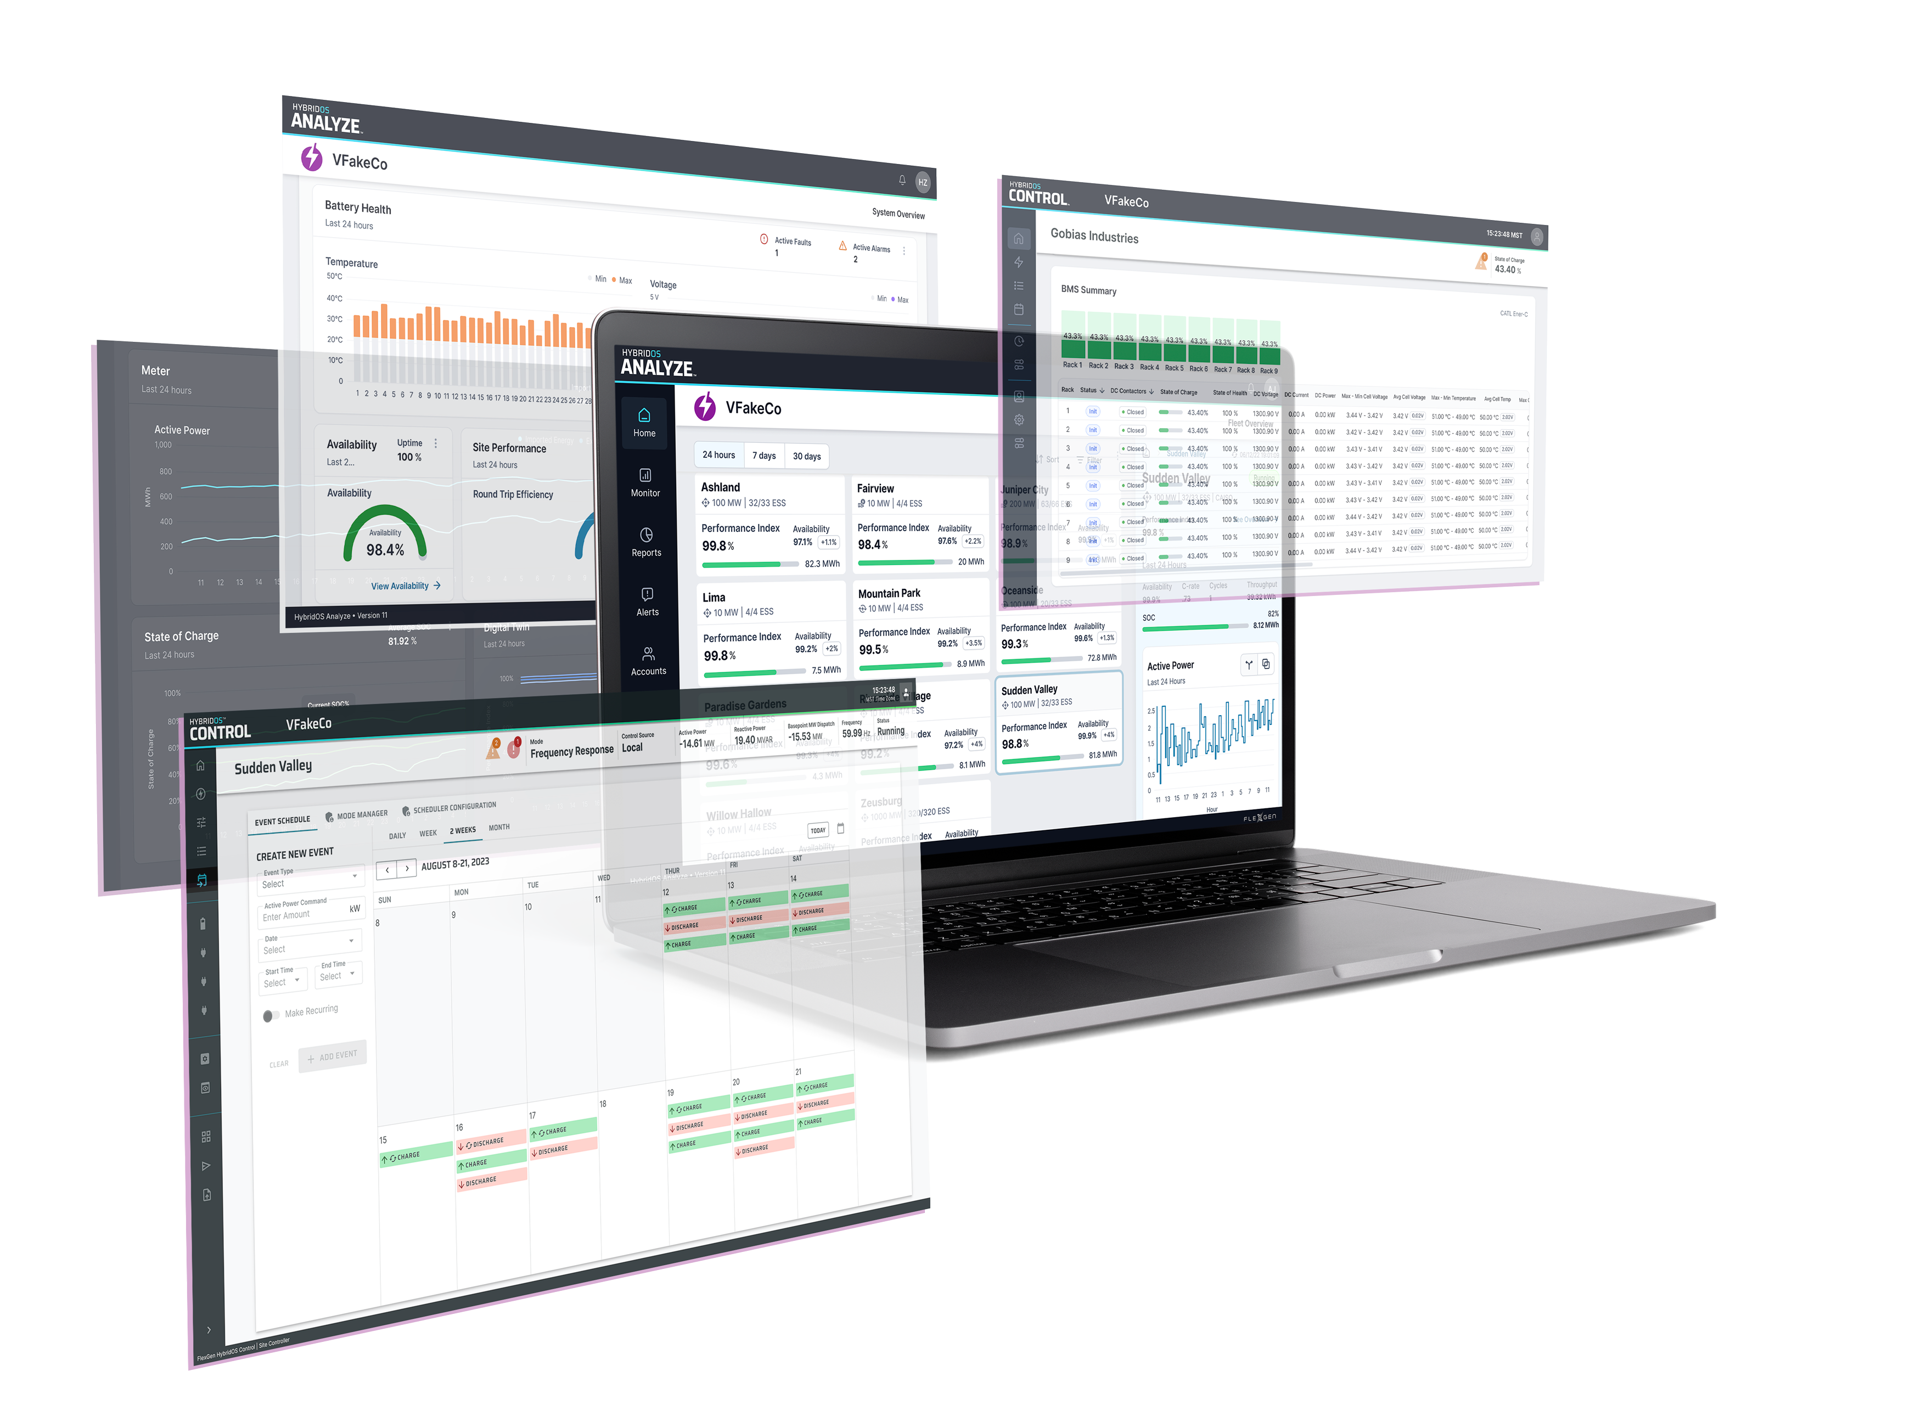
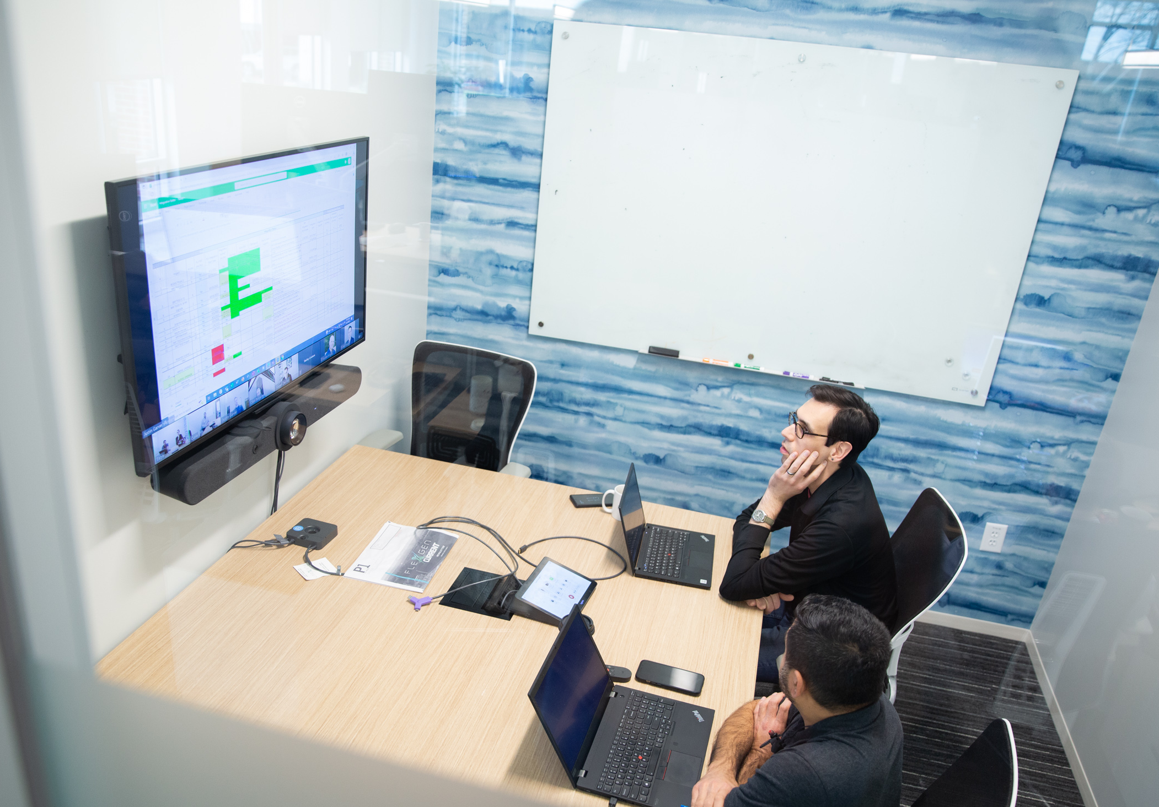
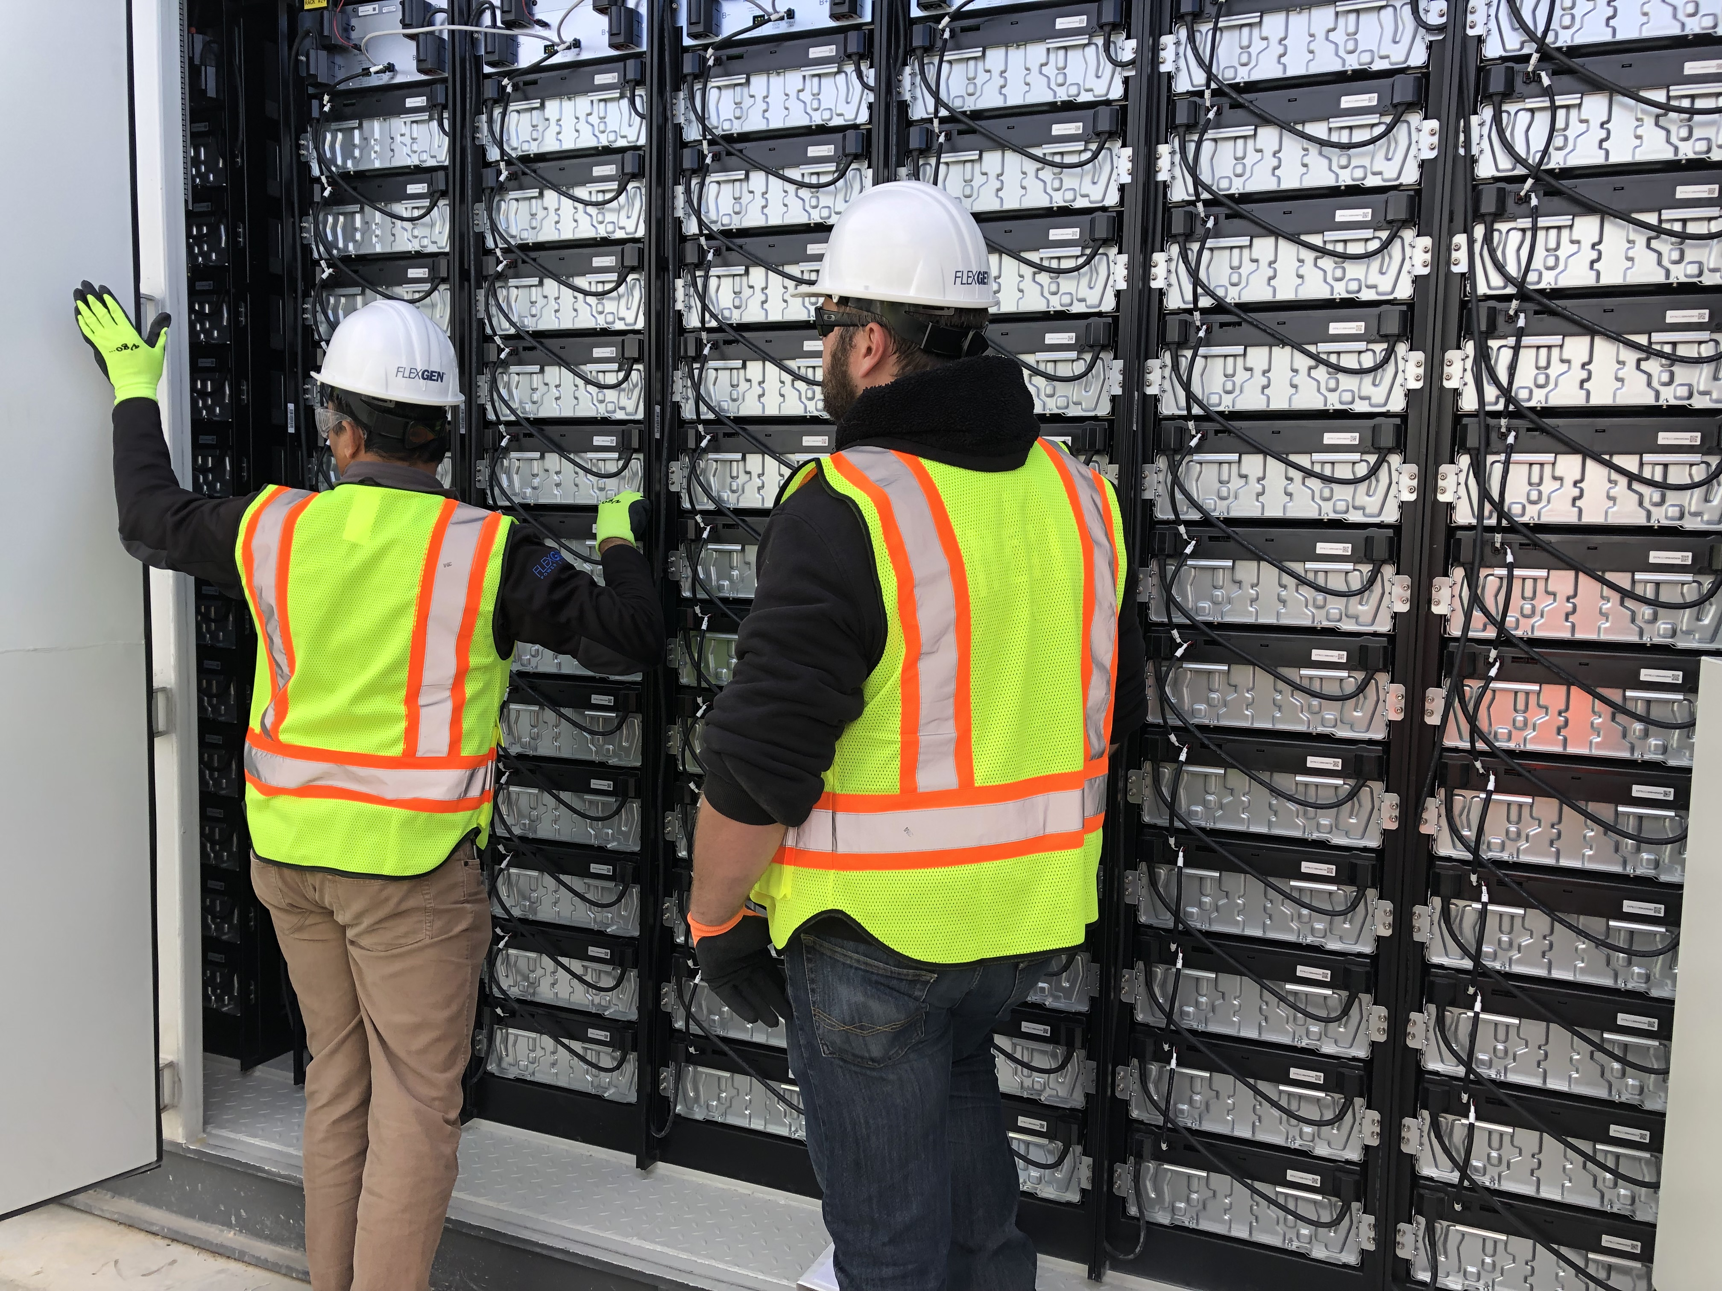
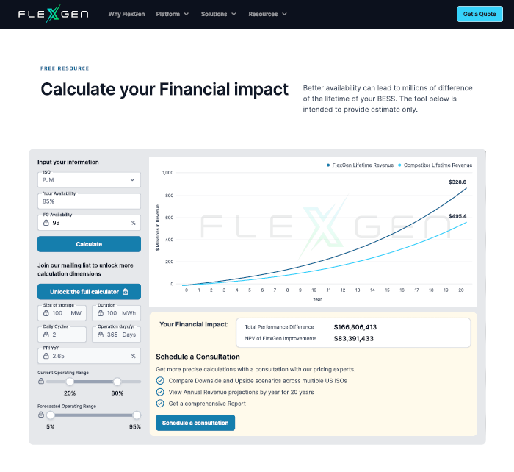
Evolution of Our Analytics Engagement
HybridOS Analyze – real-time analytics solution that can be used for moment-in-time analytical engagements
Quickly Find
Bad BMU Card
Voltage Imbalance
Current Imbalance
Temperature (HVAC)

Slide 15
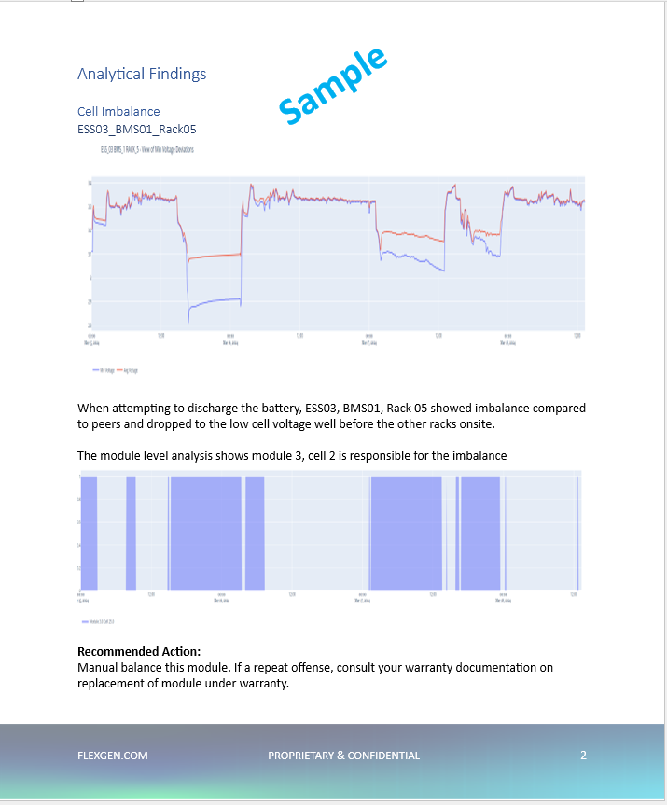
Evolution of Our Analytics Engagement
Performance Engineers: 4GWh-Experienced ROC Operators
to help Evaluate and Coach on Operational Norms

Slide 16
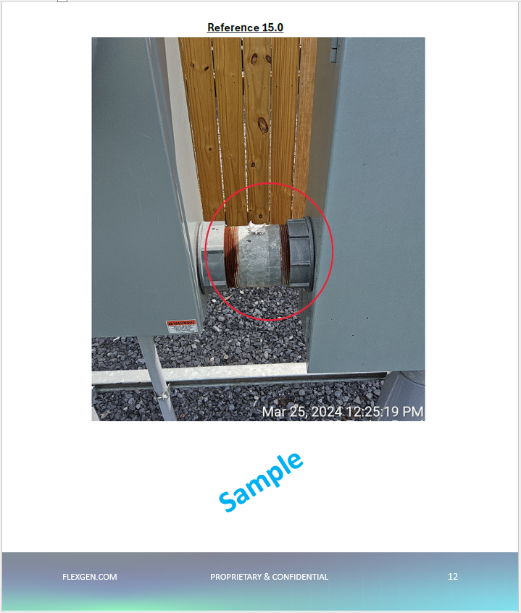
Evolution of Our Analytics Engagement
Field Engineers with 100+ installations go on site to find physical discrepancies to help fine-tune

Slide 17

Evolution of Our Analytics Engagement
Calculate the Financial Impact of Your Actions

Slide 18
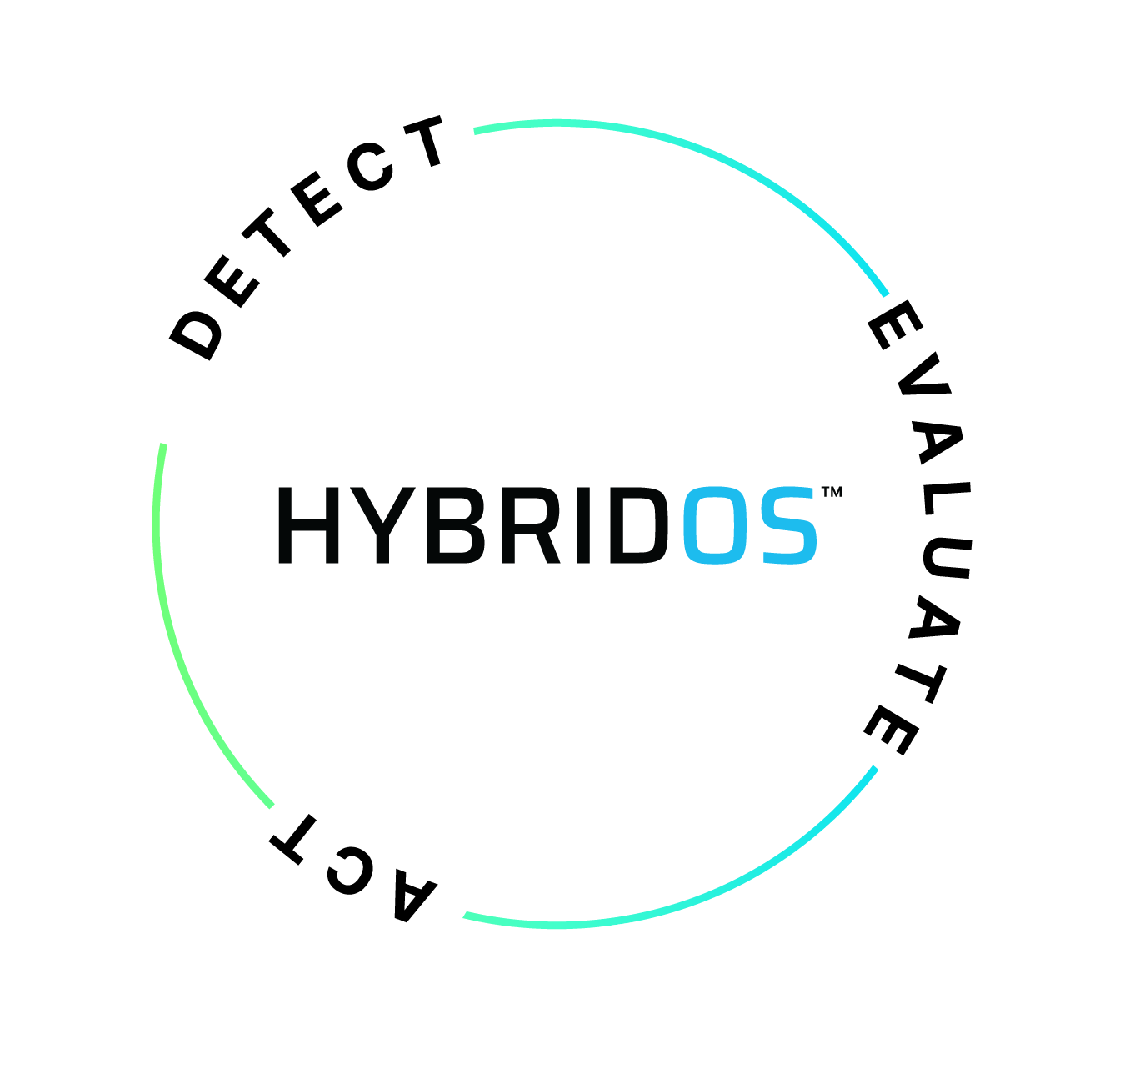
DAY 2 OPERATIONS – NOT A SINGLE MOMENT
Detect
Digital Twin for At-a-Glance Detection of Rack-Level Anomalies by Operators
Auto-Detection of Four Common Anomalies
Custom Conditional Alerts
Evaluate
Proprietary State-of-Charge
Proprietary State-of-Health
Custom Reporting and Dashboards
Act
Detailed Information for OEM Claims, Rolling Trucks, or Conducting Remote Balancing
Automated Maintenance Actions
Notes:
98% versus 93% is a $15M NPV on a 100MWh project.
Operating your asset between 10% and 90% versus 0% to 100% is a $57M difference!

Slide 19
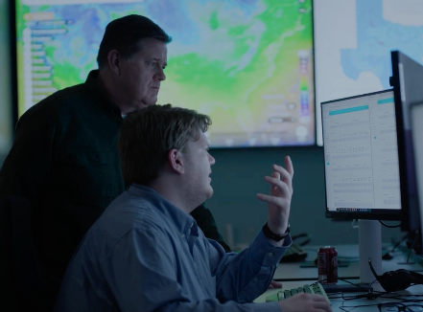

DAY 2 OPERATIONS – NOT A SINGLE MOMENT
Detect
24/7 Proactive Monitoring from ROC
Evaluate
Performance Engineers with 4GWh of operating experience focused on storage
Act
24/7 Dispatch from our ROC
Warranty Management
Remote Balancing
Field Service for Preventative & Corrective
Learn
Notes:
98% versus 93% is a $15M NPV on a 100MWh project.
Operating your asset between 10% and 90% versus 0% to 100% is a $57M difference!

Slide 20
Message #3 for the Industry:
Why Choose FlexGen

Slide 21
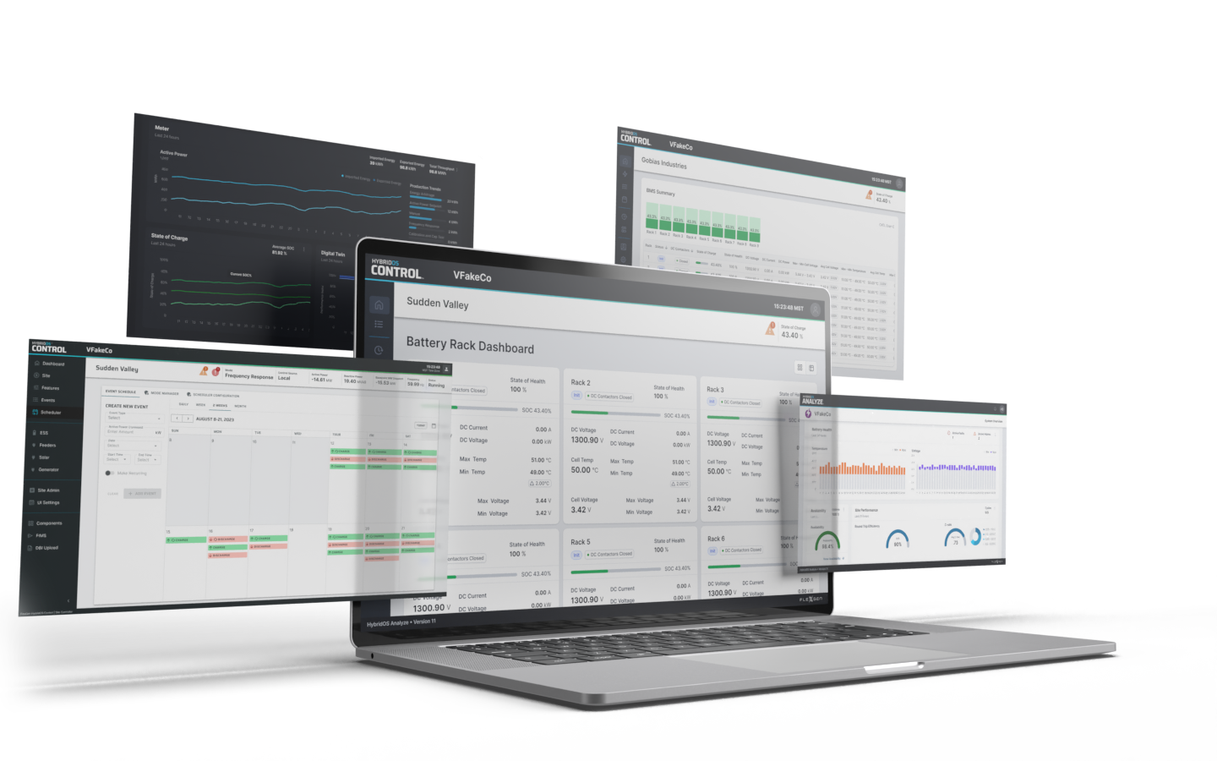

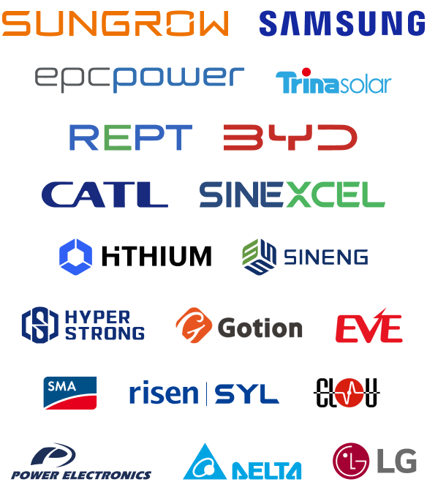
Strength in adaptability
WHY CHOOSE FLEXGEN
Our problem-solving mindset is in our culture
Software-First
FlexGen’s cutting-edge features promote agility and rapid market responsiveness as needs evolve.
Hardware-Compatible
FlexGen’s lab-tested solutions ensure an
optimal match for each use case with the latest technology and leading brands.
Customer Obsessed
Our team provides 24/7 proactive monitoring, direct customer access, and our product roadmap is guided by a customer advisory board.
24/7
^{Monitoring &}
^{Dispatch}
Notes:
The entire time, we’ve believe in maintaining three strategic differences:
Be Software-First
Hardware-compatible and
Customer-obsessed.

Slide 22
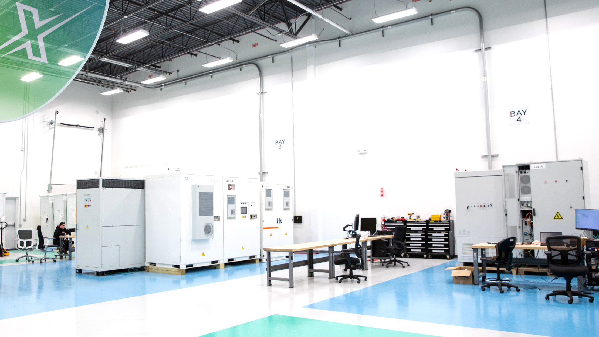

TURNING BATTERIES ON → ACTIVATION SERVICES
Derisk field commissioning and
get to the first revenue dollar faster through lab integration
90 ^{Days faster}
$11 Million
Value capture in high ticket summer months
Aug 2023 ERCOT
System Design
DC/AC Procurement
Software Configuration
Field Commissioning
Notes:
Getting our customers to their first revenue dollar faster through lab integration
Link: https://my.matterport.com/show/?m=1bYqMsV81Zr
44
the differentiators – 10 years = top of the linw eqipmemt best price,
Minimizing risk, field faster
Let me
Trina story
$11 M – August 2023

Slide 23


98%
^{Availability}
$15
^{Million NPV}
KEEPING BATTERIES ON → DAY 2 OPERATIONS
Operators
Power Traders
Asset Owners
Maximize asset performance with remote monitoring and field services
24/7 Monitoring
Optimization
Maintenance
Augmentation
+differentiator
+impact
Notes:
Keeping batteries on longer and operating at maximized performance with our Software.

Slide 24
Thank you
Ken Rahn
Vice President, Marketing
www.LinkedIn.com/in/KenRahn

Slide 25

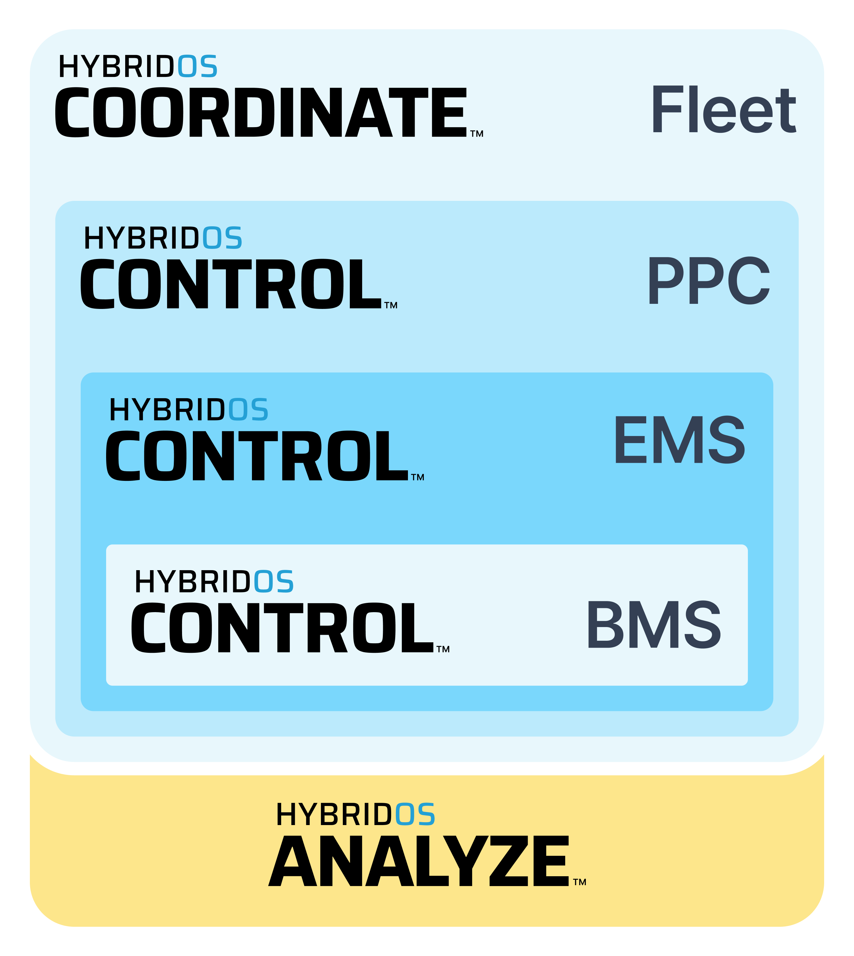
Ways to work with FlexGen
Partnering to meet you where your needs are
Equipment Supply Agreement
Engineering Services
System Engineering Design
Procurement Services
PCS Procurement
BESS Procurement
In-Lab Integration and
Field Commissioning Services
Commissioning hardware
Networking
Cold Commissioning
Energization
Hot Commissioning
Market Testing
Software License
Long-Term Service Agreement
Remote Operations Center
Software Tech Support
(included with software license)
24/7 Proactive Monitoring & Field Dispatch
Performance Engineering
OEM Warranty Management
Field Services
Periodic Onsite Inspections
Preventative Maintenance
Corrective Maintenance
Availability Guarantee
Notes:
Things NOT included on here:
Manufacturing of AC/DC or Balance of Plant, but we have vetted Tier 1 partners, and we can introduce you.
Approvals = interconnection, permitting, financing… and we can guide you
Construction = EPC partners, and we can introduce you.
Optimizing / Trading = partnerships and we can introduce you. The key is that we bring the highest equipment availability to them, and they optimize the financials based on that
Decommissioning = we have great partnerships to do that.

Slide 26
FlexGen’s Scope
WHAT WE DELIVER
1
Activation Services
Day 2 Operations:
HybridOS Software
Lifecycle Services
2
1
2
Notes:
Some people still get very confused by what FlexGen actually does and does not do…
So to orient the room… All the icons are services we provide. All the blue dots are areas that we partner.
In the top half of the circle are Activation Services, turning batteries on; everything from System Design to Procurement to Integration in our Lab in Durham, NC to Commissioning in the field.
In the bottom half of the circle are Day 2 Operations, Keeping Batteries On, powered by a combination of HybridOS Software and Lifecycle Services.
And I wanted to bring this image to you today to make my first point:
FlexGen makes money on the top half of the circle, turning batteries on. We love that revenue stream.
FlexGen makes money on the bottom half of the circle, keeping batteries on. We love that revenue stream.

Slide 27
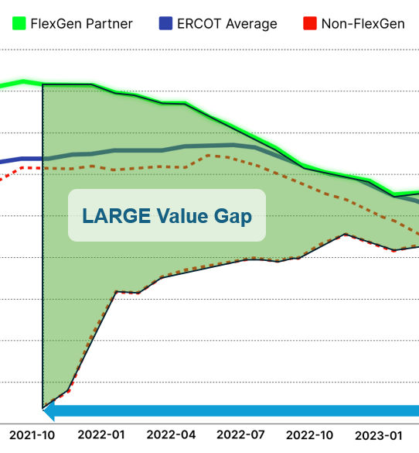
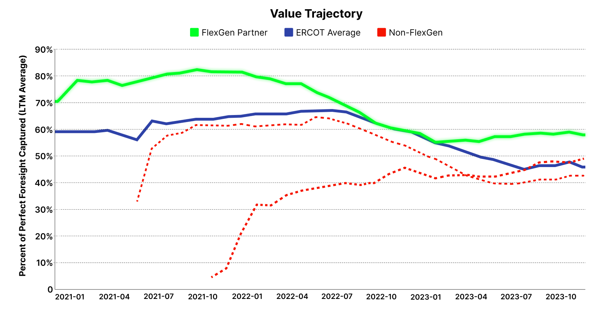
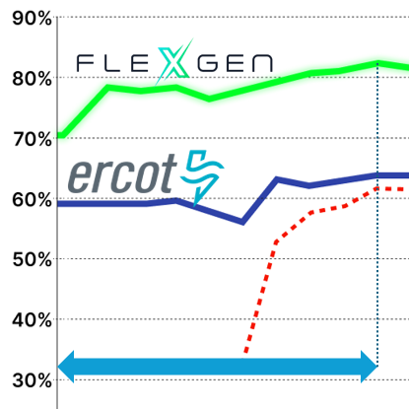

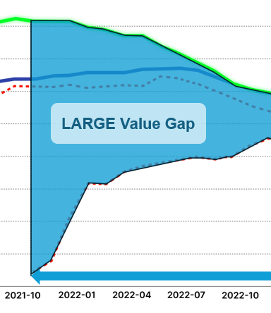
TURNING BATTERIES ON
KEEPING BATTERIES ON
Notes:
We leaned a lot on financials there.
And we talked about 4000 homes for 1 year…
But sometimes we forget what’s inside those homes.

Slide 28
Value Gap
LARGE Value Gap
We talk a lot about revenue.
We talk a little about # of homes impacted.
And we talk rarely of what’s inside those homes.
TURNING BATTERIES ON
KEEPING BATTERIES ON
Notes:
We leaned a lot on financials there.
And we talked about 4000 homes for 1 year…
But sometimes we forget what’s inside those homes.

Slide 29


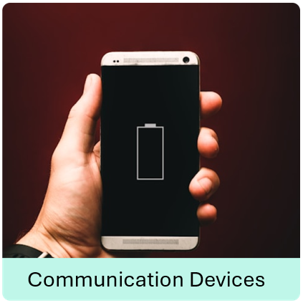
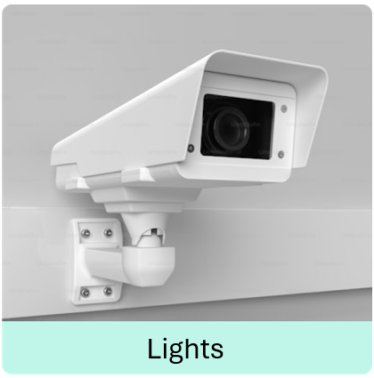
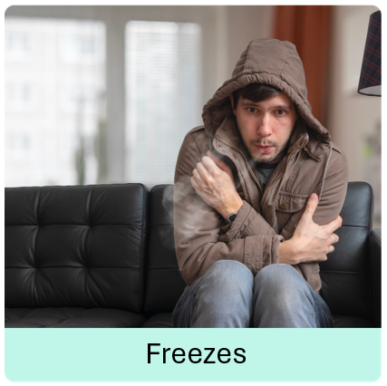
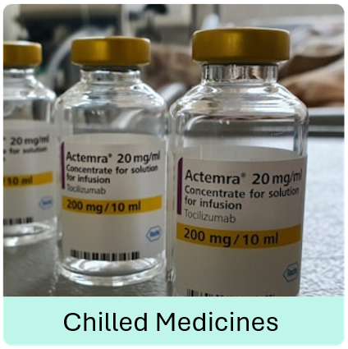
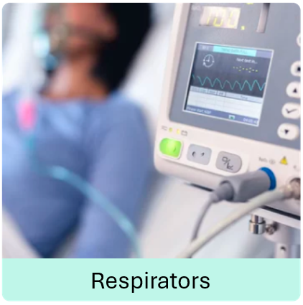
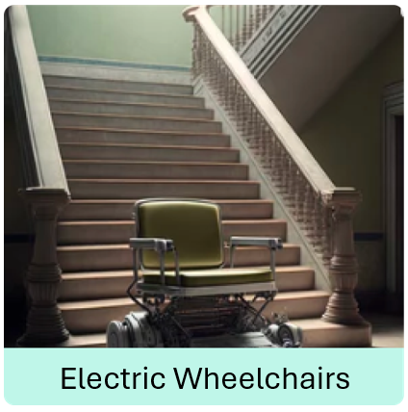
TURNING BATTERIES ON
KEEPING BATTERIES ON
Notes:
0:11

