Slide 1


The role of competition in the Italian BESS market
Battery Asset Management Summit Europe
Rome, 4 november 2024

Slide 2

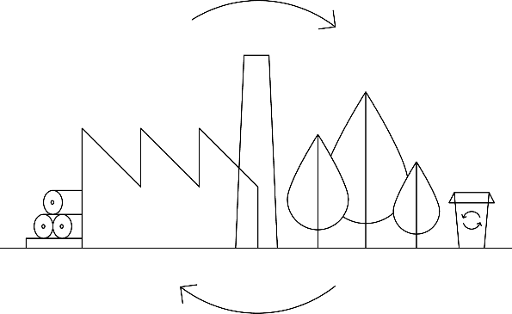






Sector specific engineering, design, and advisory services around the world
About AFRY
EMPLOYEES GLOBALLY
AFRY TRANSFORMING SEGMENTS
~ 19,000
(2023)
NET SALES
> € 2.3 bn
BIOINDUSTRY
FOOD AND LIFE SCIENCE
CLEAN ENERGY
INFRASTRUCTURE
(2023)
AFRY CORE EXPERTISE
NUMBER OF COUNTRIES
WITH OFFICES
> 50
NUMBER OF COUNTRIES
WITH PROJECTS
> 100
ADVISORY SERVICES
ENGINEERING
DESIGN
DIGITALISATION
Notes:
Rechte Seite jetzt zu überladen

Slide 3











The Management Consulting Division is positioned as the leading advisor for the transition of the energy sector
ABOUT Afry management consulting
In numbers¹
>800 management consultants
5 continents
33 offices
Offering
Strategic advice and business planning
Forward looking market analysis
Operational and digital transformation
M&A² and Transaction Services
Close cooperation with the engineering, design, and digitalisation teams at AFRY
Expertise clusters
Power & Heat Generation
Networks
Hydrogen & Low
Carbon Gases
Future Cities &
Mobility
Thermal generation (coal, gas, nuclear...)
Grid scale renewables (wind, solar, bioenergy)
Hydro power & storage
Waste to energy
(green) district heating
PPAs
Transmission (electricity)
Distribution
Smart- grids and metering
EV infrastructure
System operation
Market operation
Production of green hydrogen
International trade and transport of green hydrogen
Hydrogen storage
CCS / CCU
Ammonia & methanol
Biomethane
EV charging​
Decarbonization of cities and transport​
New mobility services​
Smart city solutions and efficient Buildings​

Slide 4
The Italian BESS market is very attractive, with ambitious targets for storage development driven by renewables objectives
The role of competition in the Italian BESS market
Res targets - 2030 (GW)
Additional storage in 2030 based on TARGETS (GWH)
+14
+49
71
Utility scale
Distributed
0
Today
¹
2030
Capacity mkt (already awarded)
2030
Solar PV
Onshore wind
Offshore wind
Note: 1) Latest historical values updated in March 2024 | Sources: NECP 2024, Snam-Terna scenario 2024, Terna
Notes:
Chiudere dicendo: But how will this new 50 GWh enter the system? How do they make money?

Slide 5
Profitability of BESS on a merchant basis is insufficient, therefore access to MACSE or Capacity Market is crucial to support BESS in Italy
The role of competition in the Italian BESS market
BESS merchant economics in italy (illustrative)
INCENTIVE SCHEMES
OPEX
Capacity Market
Missing
money
MSD+MB
CAPEX
Shorter-duration BESS mainly rely on MSD-MB revenues, while longer duration on MGP
CAPEX are majorly impacted by the battery stack and the electrical power infrastructure
MACSE
MGP
Notes:
As all incentives will be awarded through competitive auctions, competition will be key to understand

Slide 6



The role of competition in the Italian BESS market
Batteries developed with the Capacity Market mechanism are still exposed to market risk, but still can count on a ~30% fixed remuneration
ILLUSTRATIVE REVENUE stacking
30%
Fixed remuneration
Awarded storage plants will receive a 15 years fixed remuneration based on marginal price resulting from CM auction
Fixed remuneration covers only 30% of revenues, leaving greater market exposure to the investors
40%
Ancillary Services market
MSD/MB revenues constitute a relevant share of merchant gross margins, followed by the DA market
BESS assets operate redispatching on MSD market and activating volumes for real-time balancing
Most suited for operators with large portfolios, which can leverage on portfolio synergies
30%
Day-Ahead market
BESS assets operate on the MGP through arbitrage, capturing the spread between the sell and the buy prices
Source: AFRY Management Consulting

Slide 7
AFRY estimates there will be little room under Capacity Market, and space for new entrants will depend on the willingness to lower bidding prices
The role of competition in the Italian BESS market
New entrant DERATED capacity (CDP) in 2025 auction
New Entrant derated capacity (CDP) in 2026 auction as a function of bidding price - INDICATIVE
+175 MW
MW
If bidding at price ≈ existing price (ca. 45 k€/MW)
North
Total
1.000
+233 MW
~900
59 MW have retired after the auction
800
600
Space for new entrants will depend on willingness of operators to lower price received
+14 MW
South
400
+44 MW
Sardinia
200
~50
If bidding at price levels similar to 2025 auction (ca. 65 k€/MW)
0
Source: AFRY MCD internal analysis on Terna data. Auction for 2026 will be held in December 2024
Notes:
Available MW for new entrants will strongly depend on the willingness to lower the price offered in the auctions
Poco spazio in generale
Tanta competizione
Pressione a scendere sul Prezzo di offerta
Dare più spazio al valore estraibile (quindi al nord)

Slide 8

The role of competition in the Italian BESS market
The batteries developed with MACSE have minimal exposure to market risk, as ~90% of the revenues are fixed
ILLUSTRATIVE REVENUE stacking
90%
Fixed remuneration
Awarded storage plants will receive a fixed remuneration for each month of the delivery period equal to the product of the awarded capacity and the offered premium
Fixed remuneration represents almost all the revenues, minimizing market risk exposure
The participation to ancillary services might provide an interestingg upside to owners
10%
Ancillary Services market
Plants can also benefit of some revenues from ancillary services participation on which the scheme envisages a severe revenue sharing (80% to Terna; 20% to market operators¹)
Caps on upward/downward offers will further reduce achievable margins
Possible merchant operation before and after the delivery period constitutes an upside, as well as participation to capacity market as existing plant after MACSE contract expiration
Source: AFRY Management Consulting

Slide 9
The MACSE auctions will allocate ca. 50 GWh of BESS, all in the Southern regions
The role of competition in the Italian BESS market
BESS CONTINGENTS UNDER MACSE – 2030 (GWh)
South
Center-South
MACSE
MACSE
Sicily
Sardinia
MACSE
Calabria
MACSE
MACSE
Source: Snam-Terna scenario 2024

Slide 10
BESS under permitting in many regions can already cover the total MACSE expected contingents, so that auctions will likely show strong competition
The role of competition in the Italian BESS market
AutHorised and under permitting BESS VS MACSE CONTINGENTS (GWH)¹
South
Center-South
MACSE
Authorised
Under permitting
MACSE
Authorised
Under permitting
Sicily
Sardinia
Calabria
MACSE
Authorised
Under permitting
MACSE
Authorised
Under permitting
MACSE
Authorised
Under permitting
Note: 1) GW of Authorised and under permitting BESS are based on public information available on Regional and Ministerial websites. GWh have been calculated assuming 6 hours duration storage | The data are the result of AFRY mapping on the various regional and national sites and may be not exhaustive. Projects under the simplified procedure PAS are not mapped. Data updated at December 2024.

Slide 11
In this highly competitive market, it is crucial for operators to leverage on CAPEX and portfolio synergies, and adapt target IRR to access the schemes
The role of competition in the Italian BESS market
Three levers of intervention to increase probability to access auctions through competitive bids
MACSE
Capacity Market
1
Reduce cost: CAPEX
Deploy brownfields
Prefer large size projects
Deploy brownfields
2
Increase revenues:
portfolio synergies
Assets are operated by the TSO, so synergies are limited
Synergies with RES plants: reduction of exposure to market and operational risks
3
Return expectations /
risk-control
Lower return expectations for low-risk diversification
Accept risk on MSD/MB revenues or on capacity market after the end of MACSE contract
Accept lower share of fixed revenues on total stack
Prefer small size projects to reduce the risk of partial acceptance

Slide 12

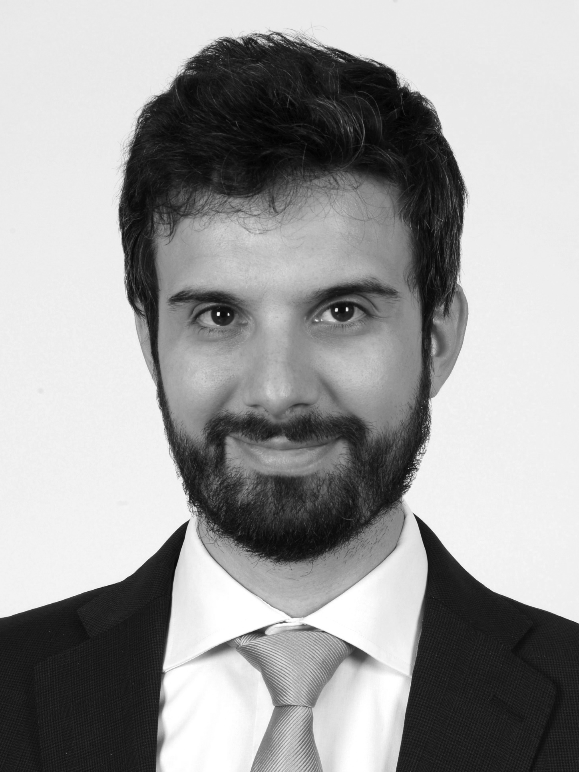
Thank you
Paolo Pacciarini
Principal
paolo.pacciarini@afry.com

Slide 13
Disclaimer and Rights
This Document has been prepared by AFRY Management Consulting (“AFRY”).​
While the information provided herein is believed to be accurate and reliable, AFRY makes no representations or warranties, expressed or implied, as to the accuracy or completeness of such information. In no circumstances whatsoever does AFRY or any of their respective directors or officers accept any responsibility for the information contained in this Document. In furnishing this Document, AFRY reserves the right to amend or replace the Document at any time and undertakes no obligation to provide the Recipients with access to any additional information.​
Nothing contained within this Document is or should be relied upon as a promise or representation as to the future. The estimated financial information contained herein has been prepared expressly for use herein and is based on specific assumptions and analysis of information available to AFRY at the time this Document was prepared. Neither AFRY nor any of its directors or officers make any representation or warranty, express or implied, or give any other assurance, express or implied, that any of the estimates or valuations contained herein will be realized. The Recipient should conduct their own investigation and analysis of the business, data and property described herein. Any liability for any direct, indirect or consequential loss or damage suffered by any person arising there from is expressly disclaimed.​
All material in this document is copyright © AFRY Management Consulting 2024. All rights reserved.​

