Slide 1
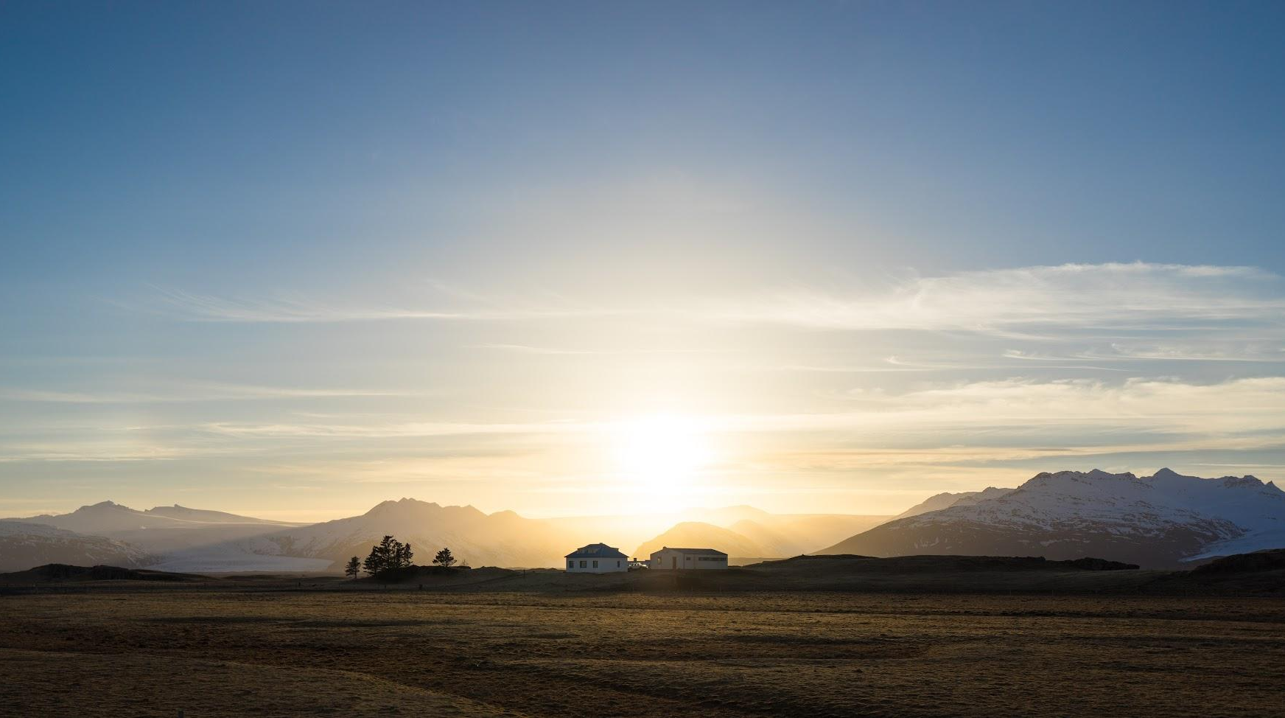

Battery Asset Management Summit Europe Rome 2024-12-03
Notes:
Vind/Sol
Elbil

Slide 2
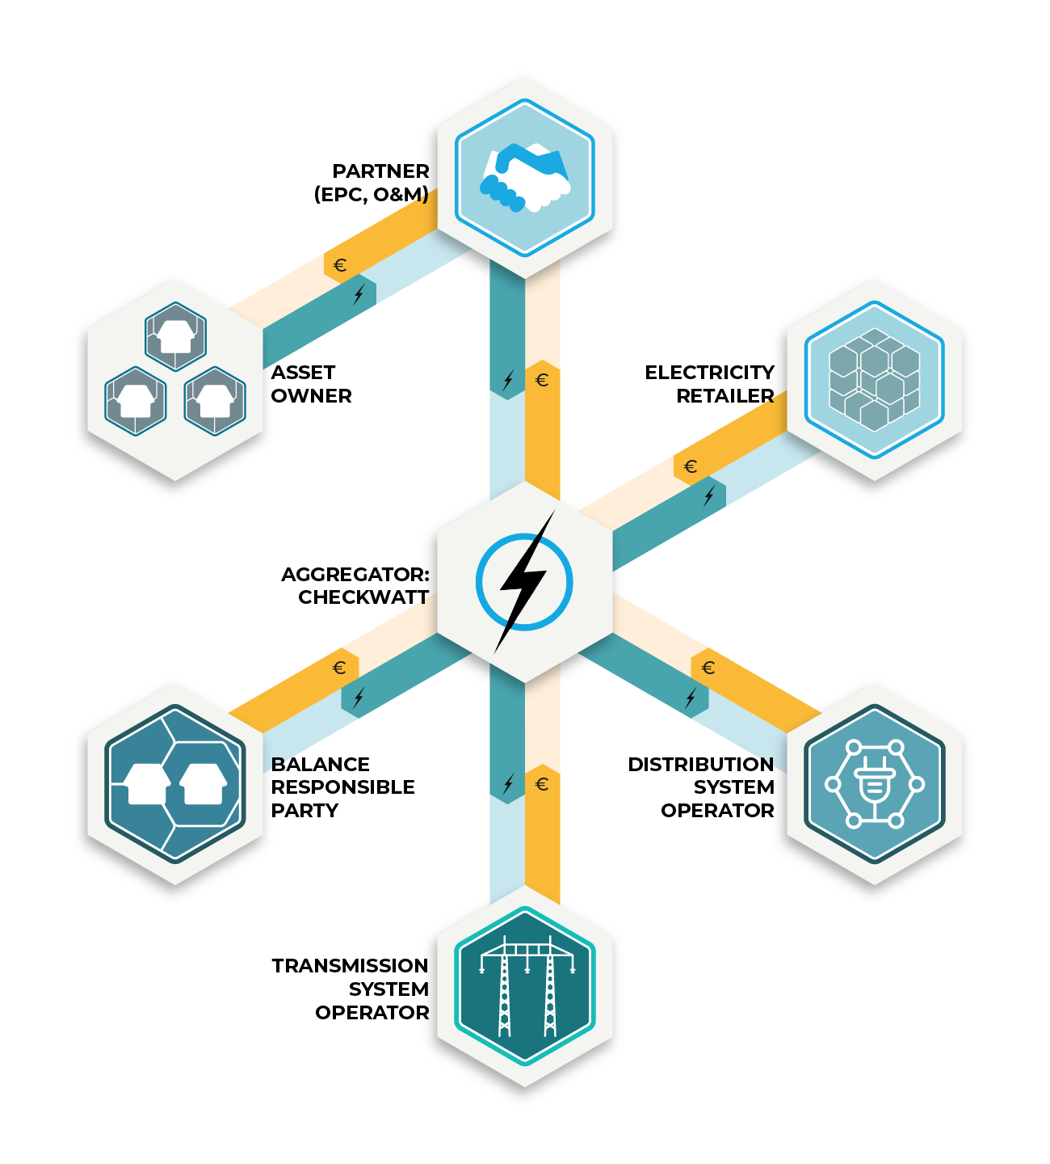
What does CheckWatt offer?
CheckWatt enables a 100% renewable energy system
through measurement, analysis, visualization and control.
Every household and every company wants to be part of and contribute to a stable, resilient energy system based on renewable electricity generation affordable to everyone.

Slide 3
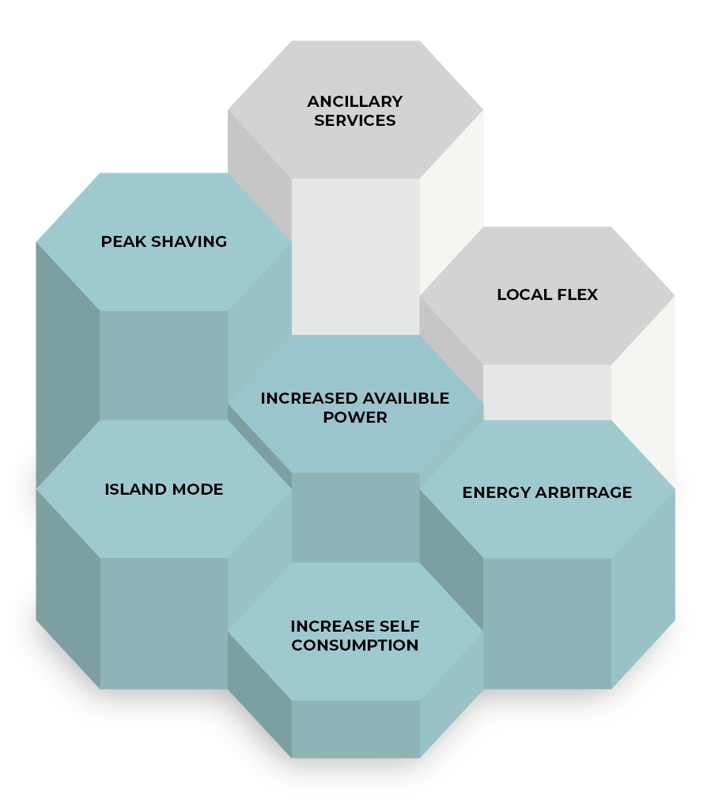
Services for flexible energy resources
CheckWatts Virtual Power Plant (VPP) solution and control unit enables flexible energy resources to deliver a wide range of services. Our unique solution not only support different assets but has the capability to combine several different assets and services at the same time or at different times during the day.
There are many possibilities and with CheckWatt expertise we find the combination of services that brings the best value.
Some examples
Deliver grid ancillary frequency stabilization services with your BESS, EV charger or solar PV
Store excess solar PV production to your BESS and use or sell later.
Enable a number of DERs to function jointly and synchronized in a microgrid.
Use you BESS to get increased available power for you business at peak consumption hours.

Slide 4

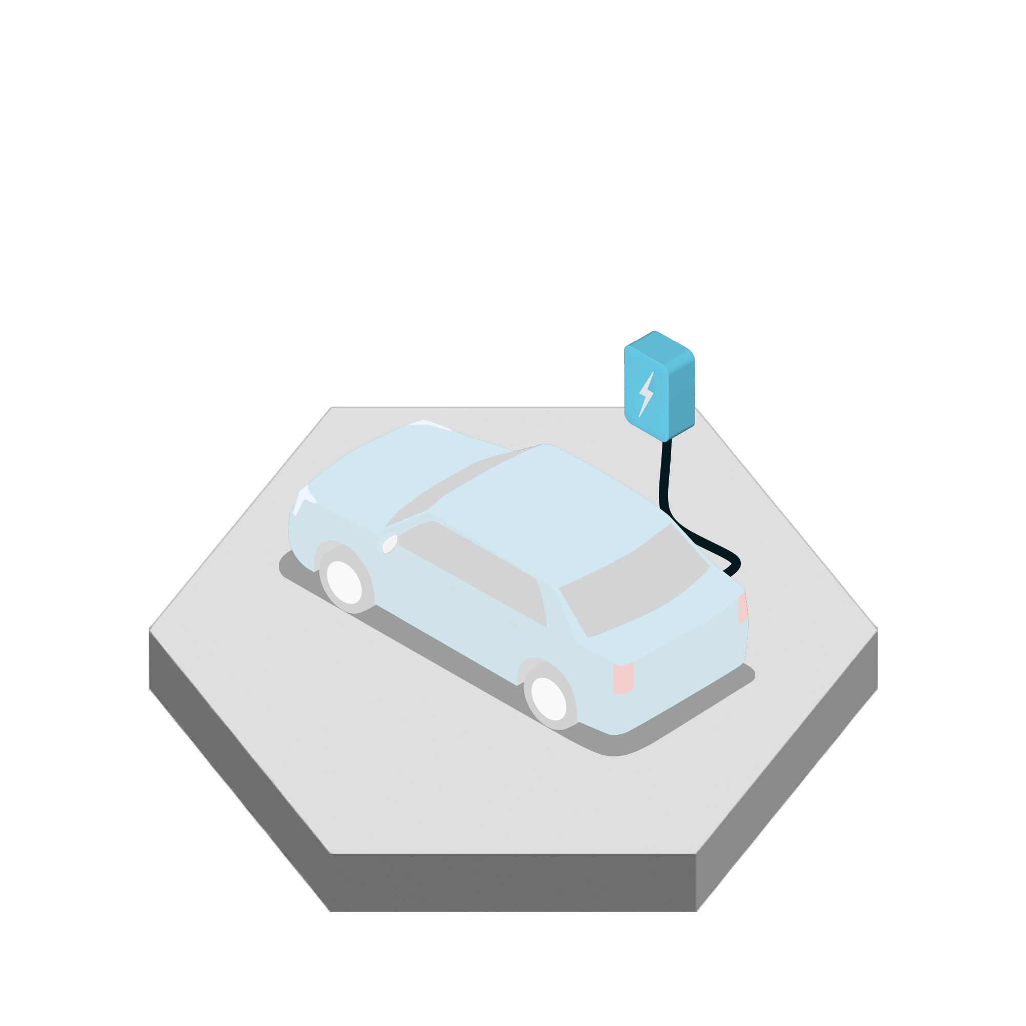
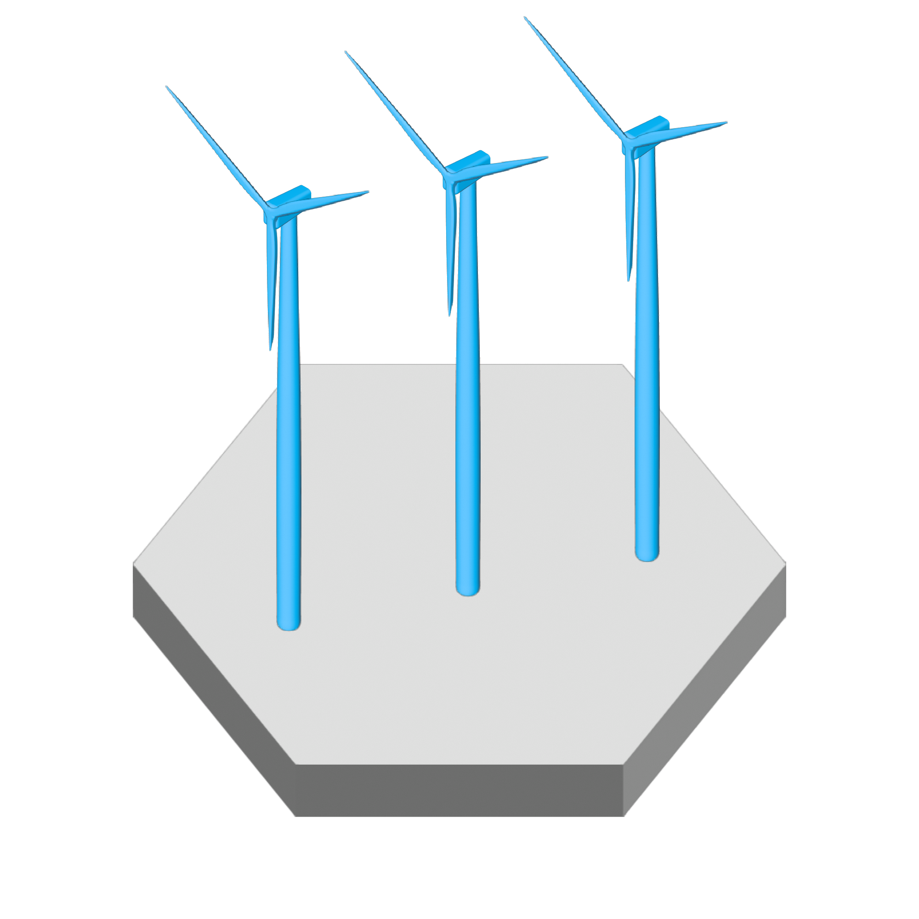

Portfolio
300 MW
15 MW
1000 MW
250 MW

Slide 5
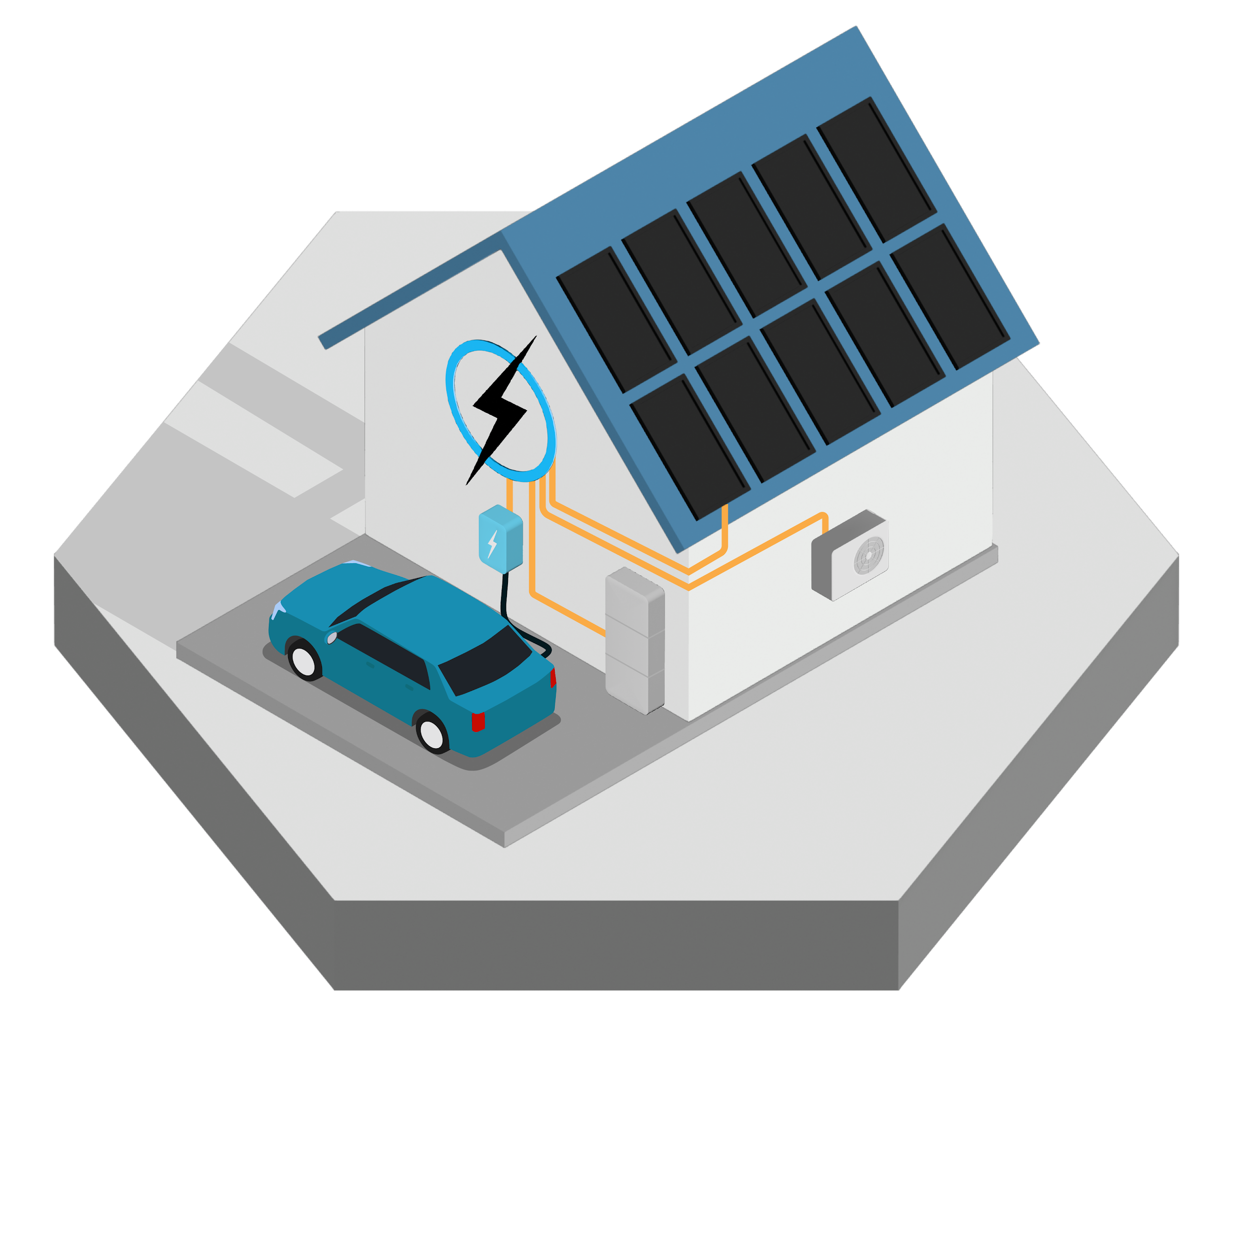
Residential
Maximize the benefits of energy assets such as solar PV, BESS, EV charger and air conditioning installed in a home. Monitor performance and get notifications of possible faults.
Furthermore, through VPP services gain additional revenue from these assets while at the same time improve the distribution and transmission grid operation.

Slide 6
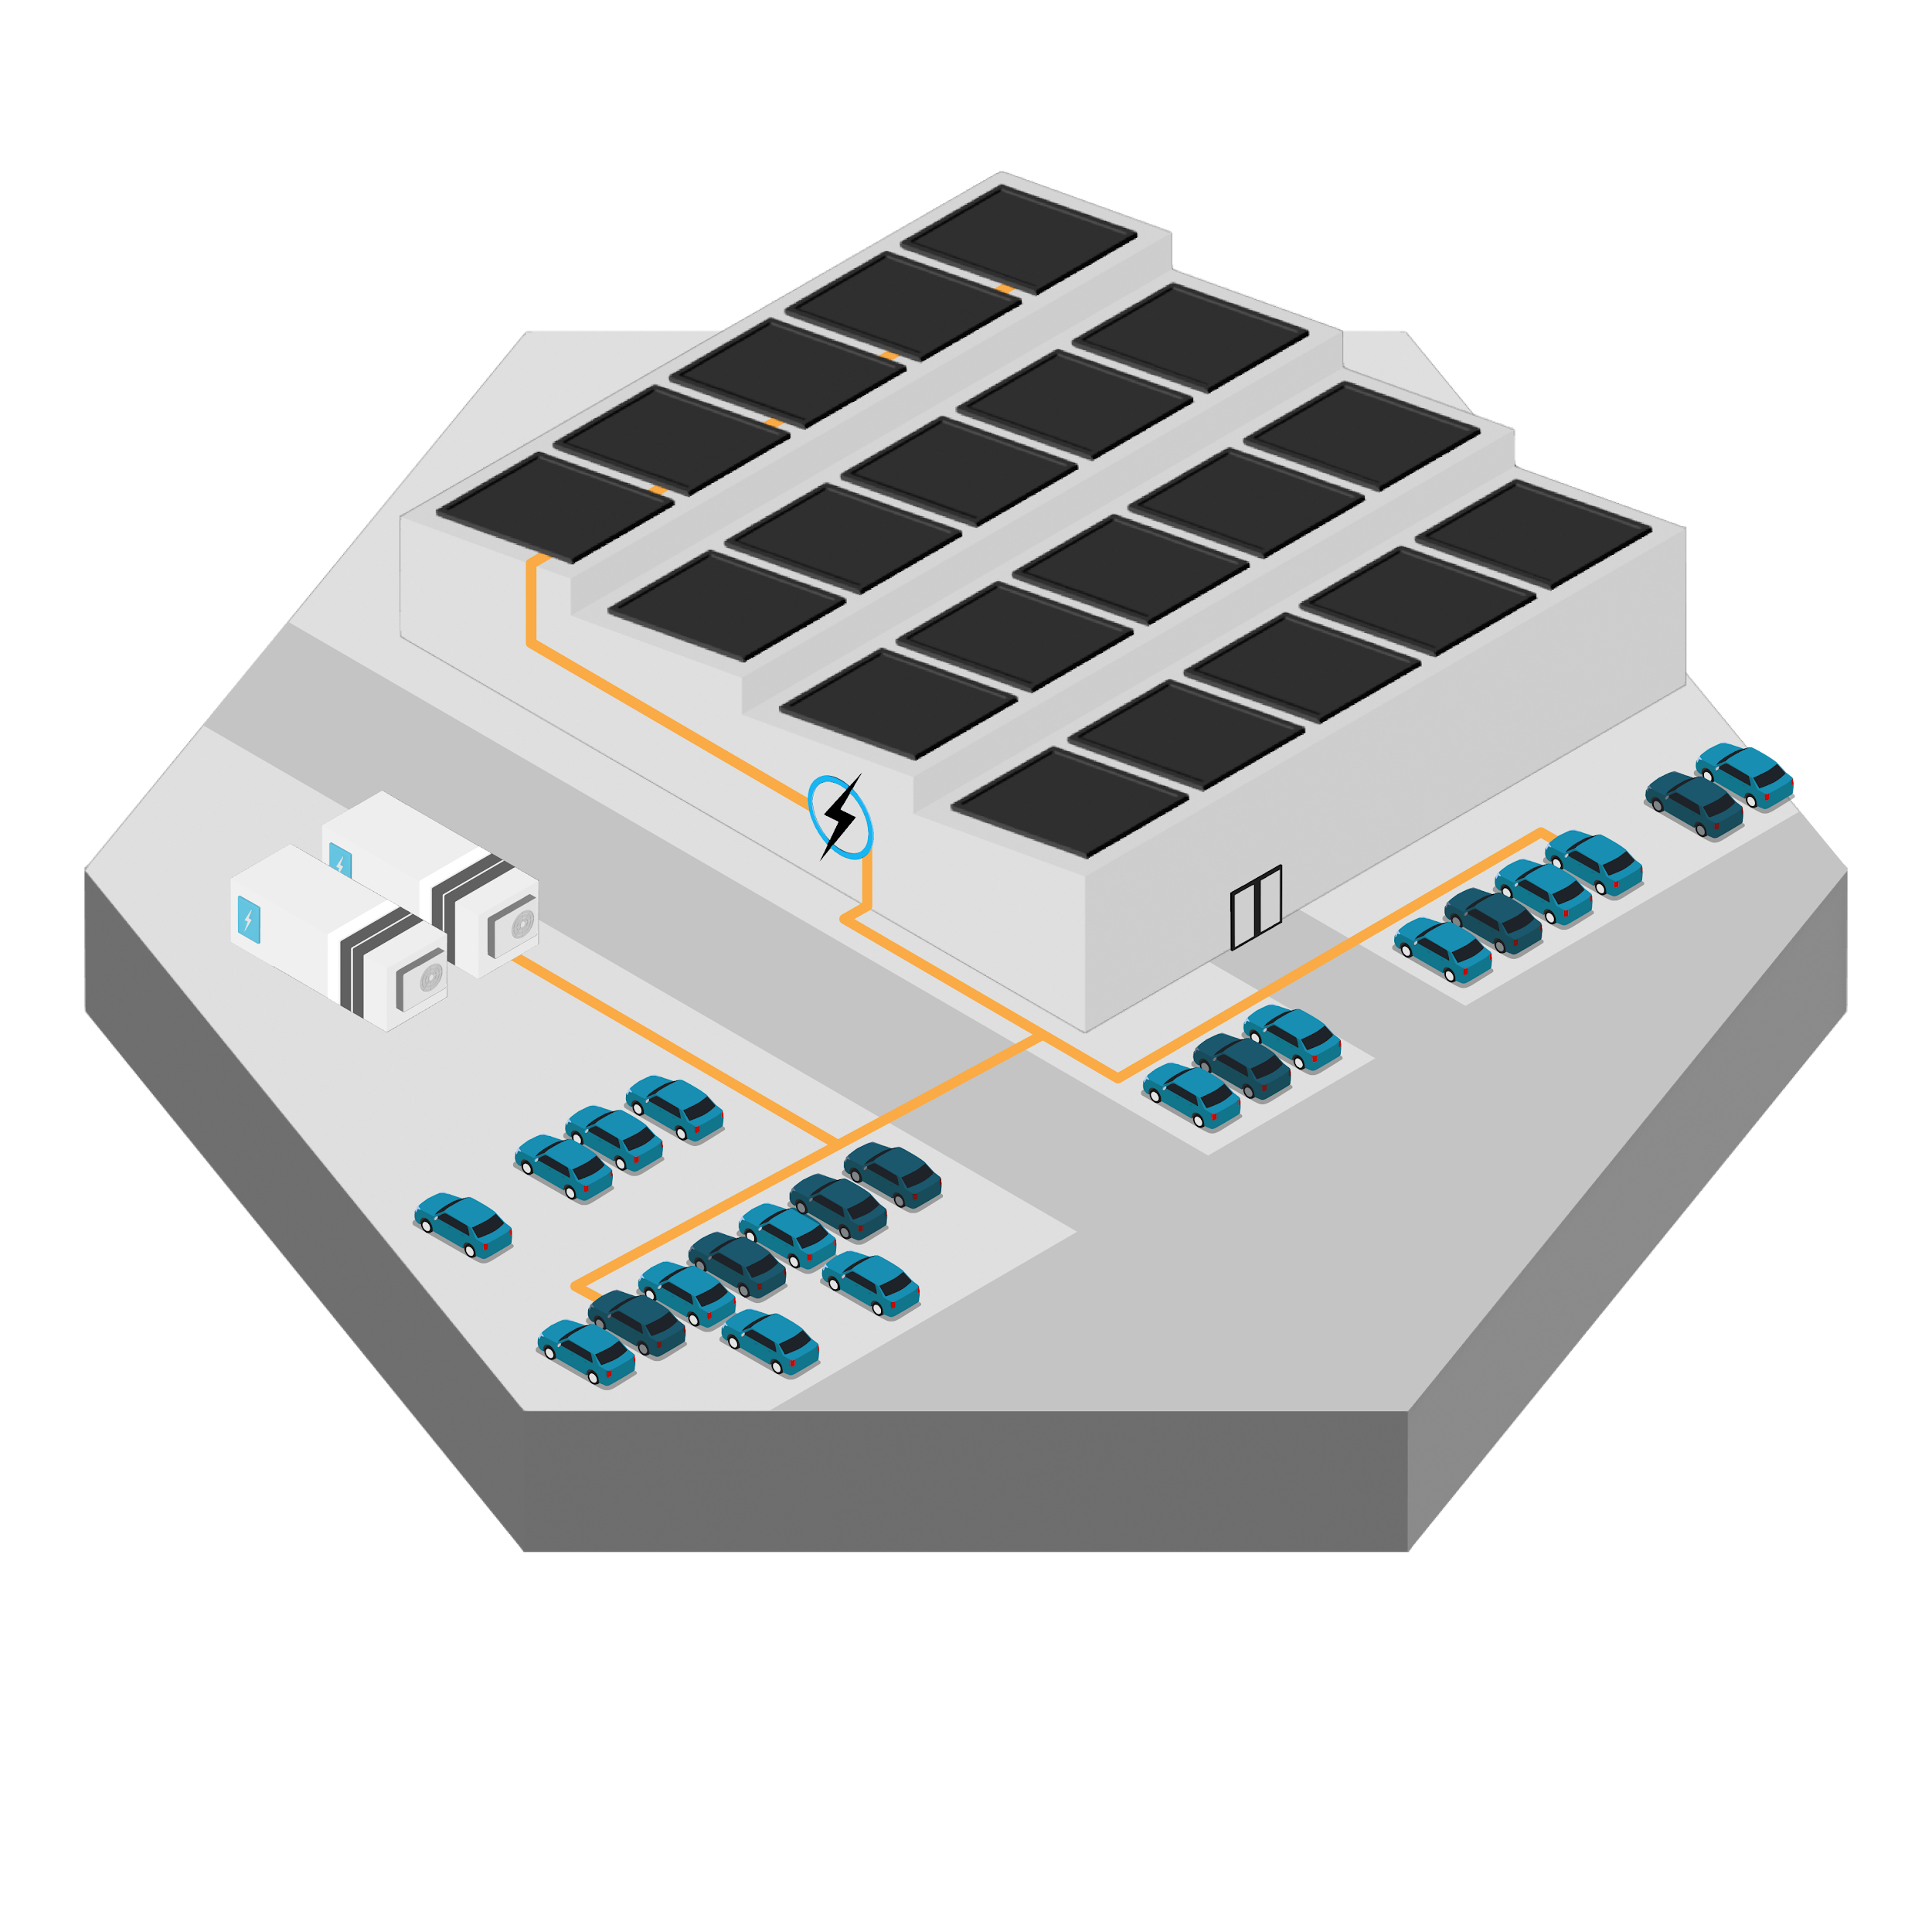
Corporate & Industrial
Make it possible to have more solar PV, BESS, EV chargers, air conditioning and industrial loads installed in commercial and industrial buildings. Monitor performance and get notifications of possible faults.
Furthermore, through VPP services gain additional revenue from these assets while at the same time improve the distribution and transmission grid operation.
Combined view for fleet management for real estate companies and other holders of multiple asset sites.

Slide 7
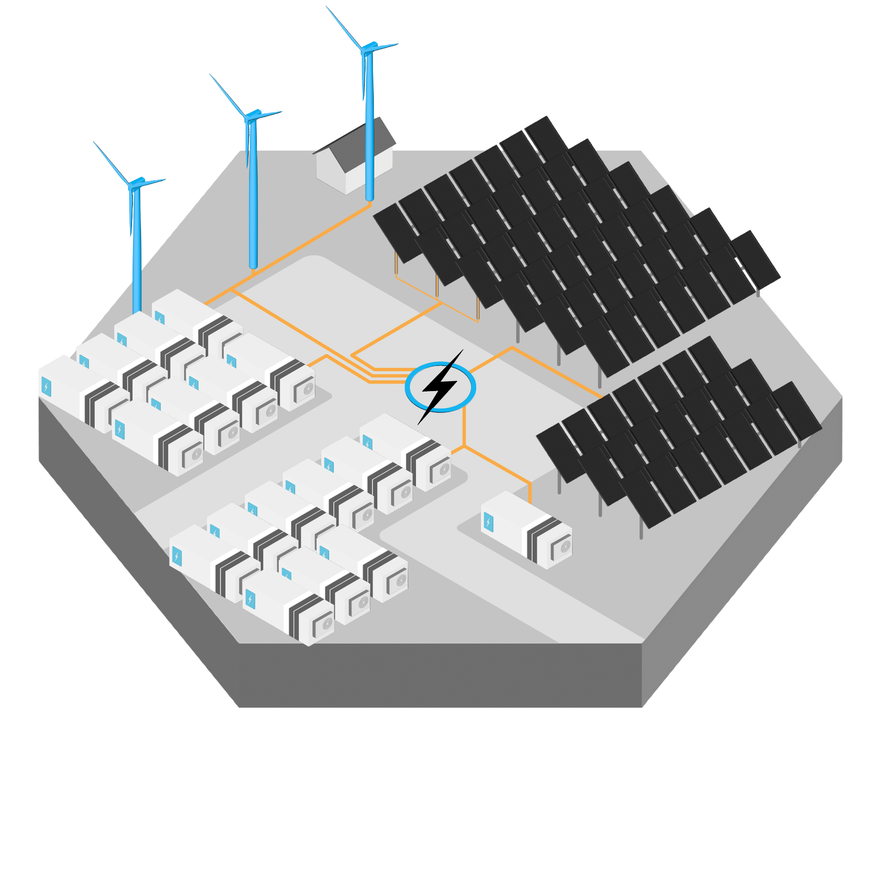
Utility Scale
Utility scale renewable energy asset management.
SCADA
Energy markets optimisation
Cable pooling, hybrid assets
Notification/alarms
Curtailment management

Slide 8
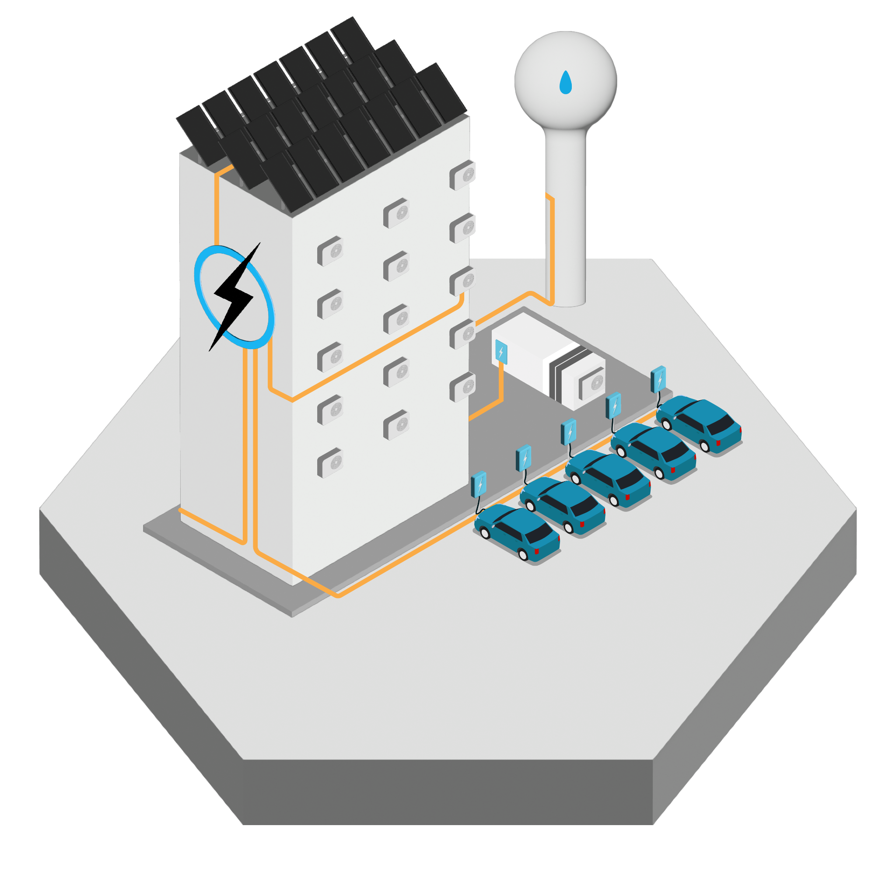


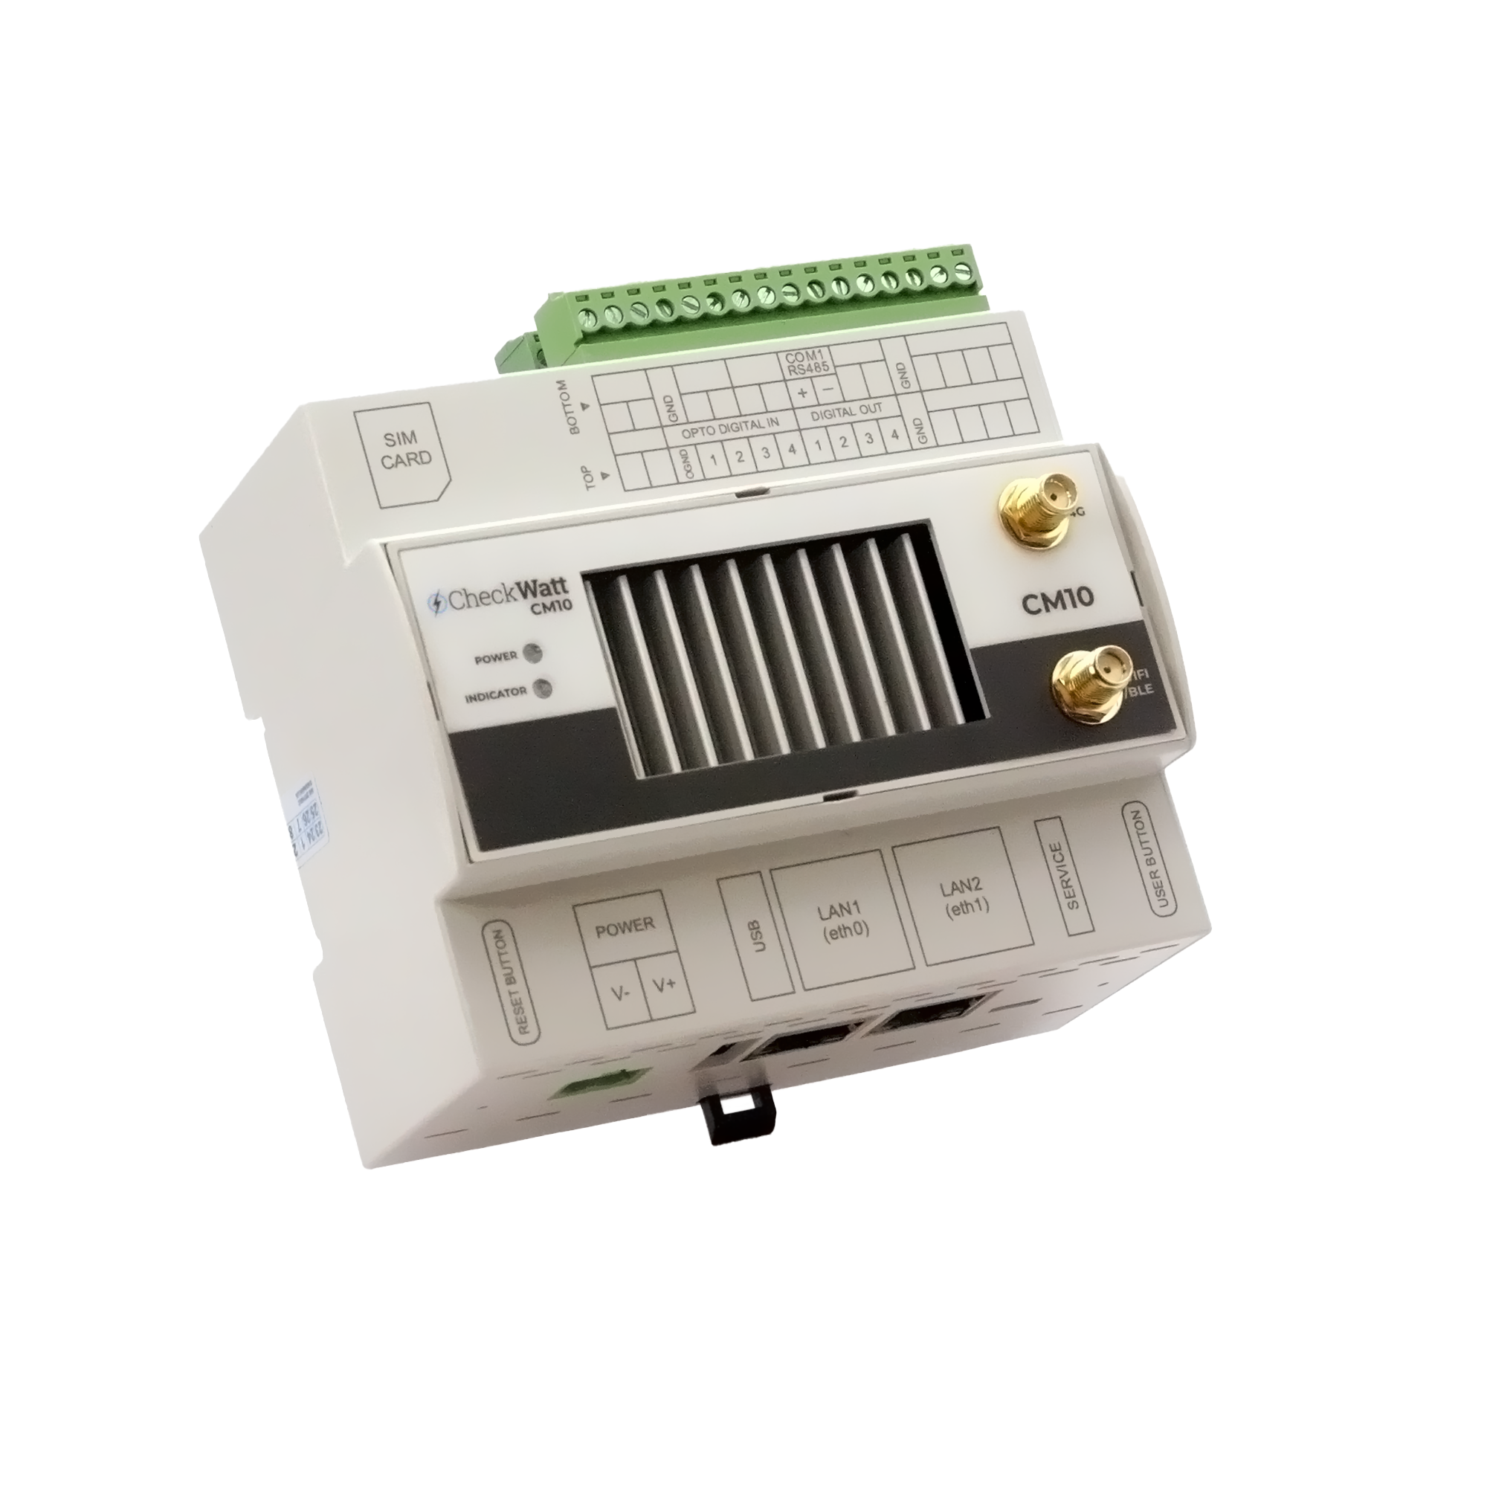
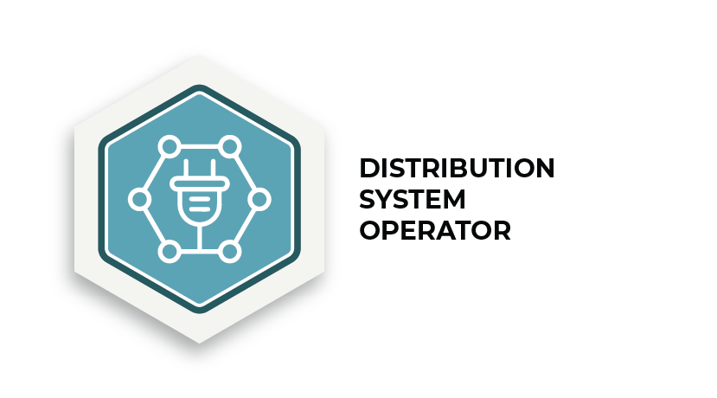




System structure
Assets (PV, BESS, EV, wind turbine, etc)
Sensors (energy, temp, irradiance, etc)
Protocols (Modbus, MQTT, IEC104, etc)
External stakeholders
Asset manufacturer cloud services
OTHER
“UTILITIES”
CM10
Central server
Dispatch optimization engine
Database
Application workers
Web GUI
Portfolio GUI
“CheckWatt Control Panel”
(grid operators, real estate companies, retailers, etc)
End user / Asset owner GUI
“Energy In Balance”

Slide 9
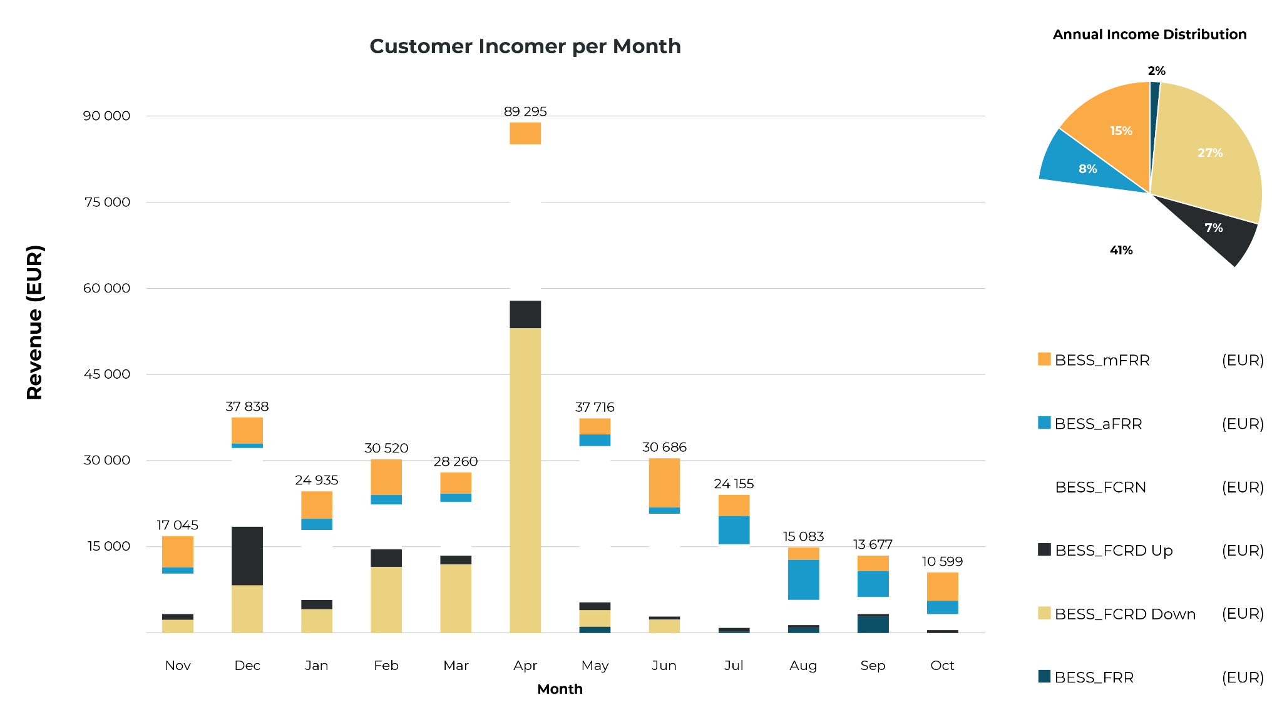
1 MW / 2 MWh Nordic example
Profit Summary - Dispatch Optimization
BESS FFR | 5 615 €
BESS FCR-D down | 99 115 €
BESS FCR-D up | 25 643 €
BESS FCR-N | 147 648 €
BESS aFRR down | 26 352 €
BESS aFRR up | 1 625 €
BESS mFRR down | 20 934 €
BESS mFRR up | 32 867 €
Total Multi-service | 359 801 €

Slide 10
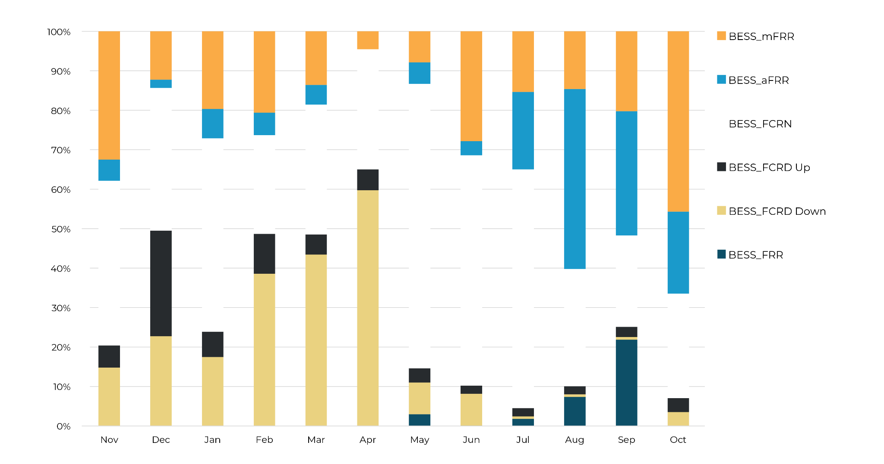
1 MW / 2 MWh Nordic example
Share of revenue per ancillary service

Slide 11
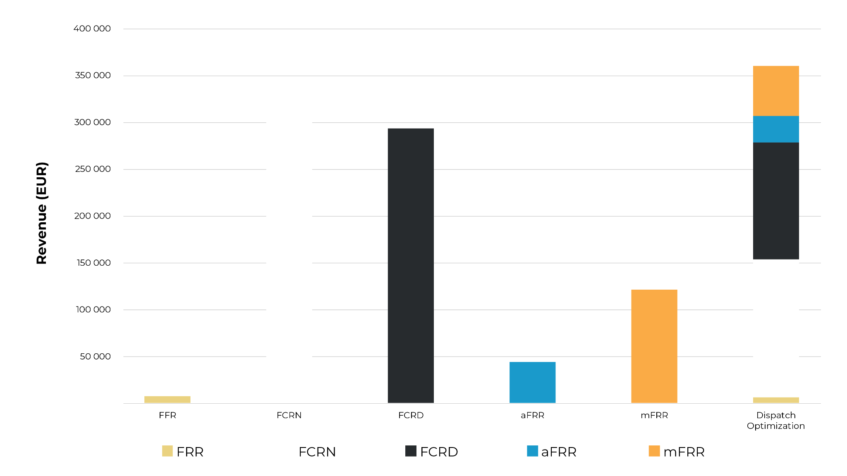
1 MW / 2 MWh Nordic example
Dispatch optimization vs Individual Service - whole 12 month period

Slide 12
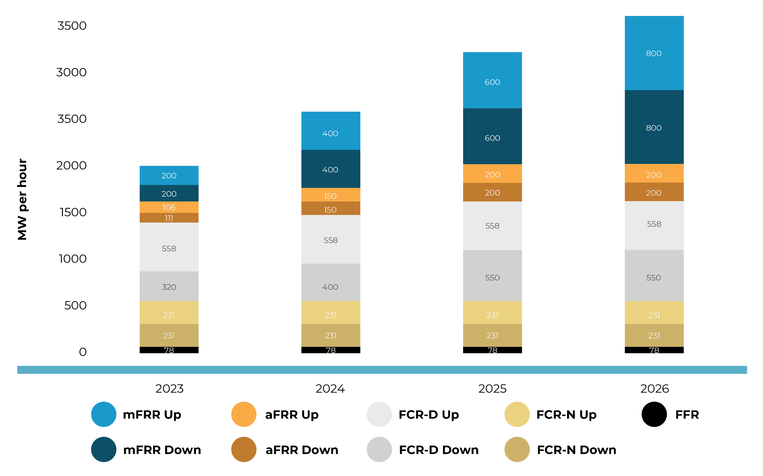
Additional factors to consider
1. TSOs are increasing demand
Source: https://checkwatt.se/batterirapporten

Slide 13
Additional factors to consider
2. ‘Flow-based’ brings the Nordics closer to continental Europe
Flow-based capacity calculation introduced end of October 2024 means more transmission grid capacity for energy trading and less remaining Available Transfer Capacity (ATC) for exchange of balancing energy which gives an increase of local FRR procurement.
The Transmission System Operator (TSO) can however reserve ATC prior DA (e.g. mFRR CM).
More trading across price bidding areas means an increased import of energy price volatility from northern continental Europe.

Slide 14
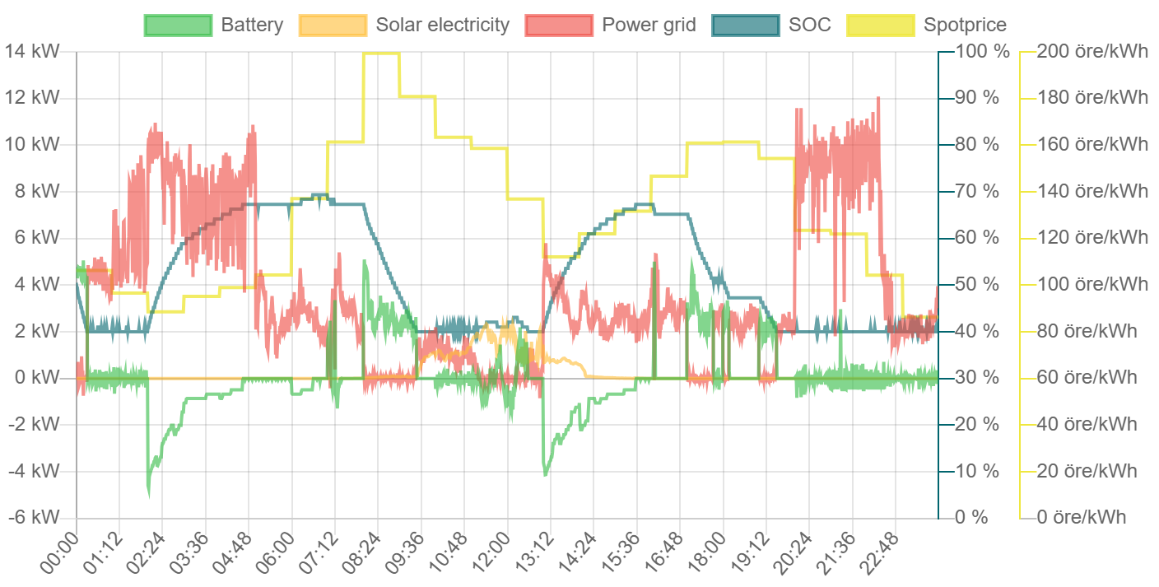
CheckWatt AI
Combine behind-the-meter EMS with VPP services

Slide 15
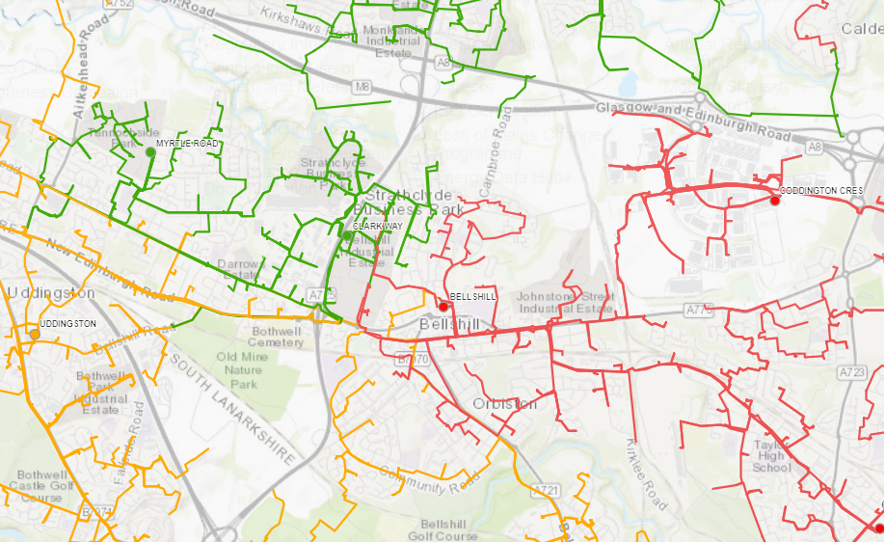
Energy Services from batteries
Local Flex Markets - Electrifying the society puts extremely high demand on distribution grids
Consumption, electricity is to replace:
Gas heating
Petrol Cars with EV
Fossil based public transport
Fossil fuels in industry
Production, make space for new capacity in renewables:
Solar PV
Wind power
Notes:
By aggregating resources within the local grid we can help the grid owner, the DSO, to take informed decisions.
By using flexible resources smarter, the overall cost for the grid owner can be reduced. CheckWatt’s VPP can not only support the DSO but also potentially earning money for the asset owner.

Slide 16
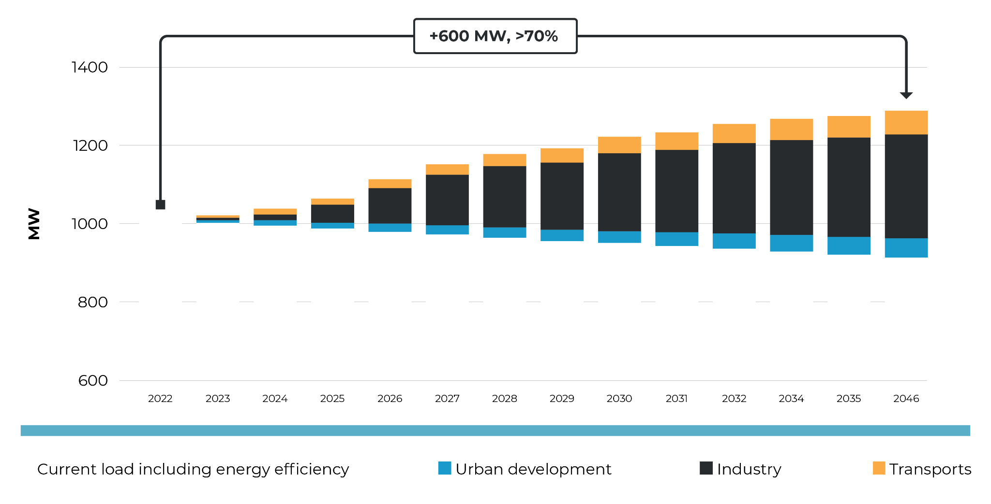
Example: Power demand Gothenburg
DSO: Göteborg Energi Nät AB
Notes:
400 MW will be needed by 2030. The peak demand occurs mainly during short periods when it's cold in the winter and when the sun shines the most in the summer.
2024/2025 15 MW via lokal Flex 15 mSEK
2025/2026

