Slide 1




Catalyzing the Future of BESS The Crucial Role of Benchmarking
Ewout Eijkelenboom, KYOS Energy Analytics
Rome – 3 December 2024

Slide 2

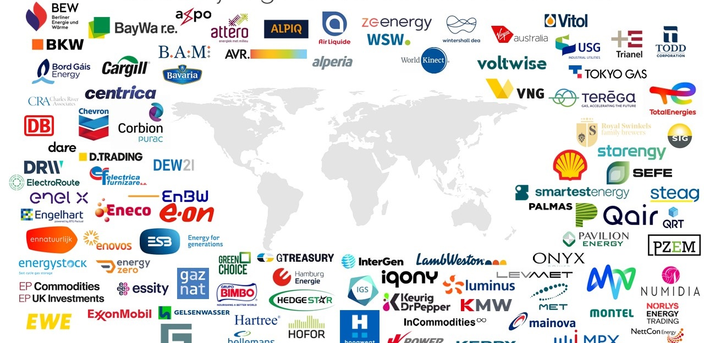

KYOS Energy Analytics
Headquarters in the Netherlands. A team of 40+ people, 5 different teams.
International client base across Europe, plus Americas and Japan.
More than 100 corporate clients.

Slide 3




KYOS Services
Software for energy valuation & optimization
Our Software & Models have been developed over the past 20 years by an experienced team of markets practitioners (ex-procurement, trading), quantitative analysts and IT developers.
Our E/CTRM software is in use by:
  Large Industrial consumers of energy
  Producers of energy
  Large industrials exposed to a multitude of commodities
We deliver an economical and flexible off-the-shelf SaaS solution, with quick implementation and strong support both during and post-implementation
Continuous feedback from our clients helps us stay ahead.
E/CTRM Software
Consultancy
Price data

Slide 4
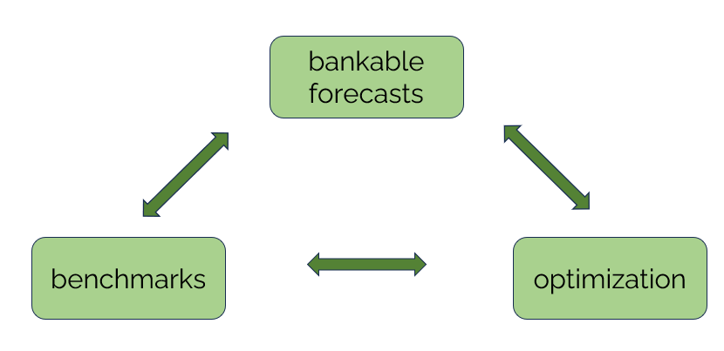
Some challenges for BESS asset owners
What are future BESS revenues?
  Market/asset specific
Where are revenues coming from?
  Changing markets
Route to Market/Optimizers
  How to select the best RtM provider?
  Does the RtM provider perform well?

Slide 5
BESS Investments →
BESS Valuations

Slide 6
Energy storage – not as easy as PV or wind
FCR
+ stable payments
- obligations reduce potential further revenue stacking
Balancing market (TSO)
FRR
Voluntary balancing
  A battery business case has to include a combination of revenue streams
  Full value can only be realized with active trading activities
+ price peaks
+ growing market
- advanced trading system
Intraday
Wholesale markets
Day ahead
Local grid services
Congestion management
+ various types of payments
- location and country specific
Portfolio optimization
Peak shaving
+ increase overall revenue
- more complex projects

Slide 7
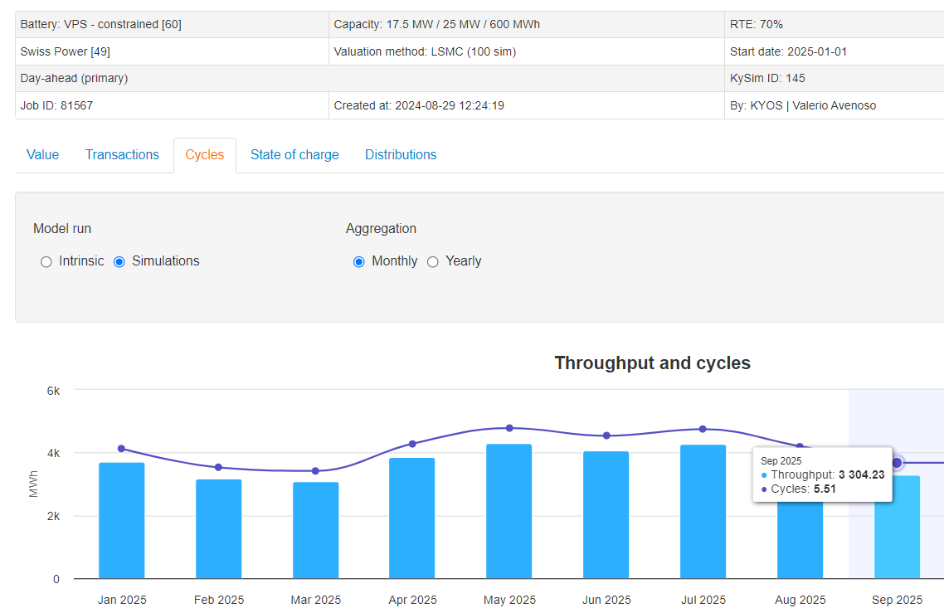
KYOS BESS valuation approach (KyBattery)
Calculates future market value, stacking revenue streams:
  Day-ahead, intraday, passive imbalance or a combination
  Combine with optimizing in FCR or aFRR market
  Stand-alone or co-located asset
Advanced trading strategies

Slide 8
KYOS BESS valuation approach (KyBattery)
Value of BESS: optionality
One price curve/scenario is not enough!
Unique: usage of realistic price simulations!
Valuation gives:
  Expected value (intrinsic and extrinsic value)
  Risk distribution
Important: transparent methodology to ensure bankability

Slide 9
BESS benchmarks

Slide 10




How good are BESS valuations?
Backtest
Use forecast to improve backtest
Forward view
Pros
Actual historical data
‘Easy’ to check
Takes future market changes into account
Probabilities and simulations, risk
Cons
Only one reality, no scenarios
Requires index or detailed data (order book)
More complex modelling approach
Requires market view on future volatility
Use backtest to validate forecast
Realistic price data
Realistic trading strategies

Slide 11
But…
Lack of good independent BESS benchmarks
Available for GB (e.g. Modo) – transparent data
Few markets (e.g. Germany) – available, but provided by optimizers
Most markets – not available
Independent benchmarks ?

Slide 12
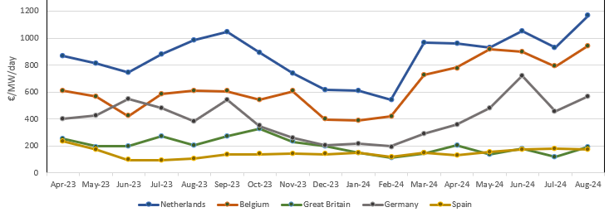

KYOS Battery Index
Assumptions:
  Mix of intraday trading (100% of capacity) and passive imbalance trading (max 30%)
  Intraday prices are ID1 (= index of average prices)
  Intraday prices can be perfectly forecasted
Main advantages:
  Can be validated relatively easily
  Similar approach with ID1 prices can be used for forward valuation
Shows historical revenues for a 2-hour battery.
Calculated with KyBattery software
See also:
https://power.kyos.com

Slide 13
BESS optimization

Slide 14
Theory is nice, but…
Every valuation model has its simplifications and assumptions
Every benchmark has its simplifications and limitations
As always, reality is different!

Slide 15



Going beyond: real-time battery optimizer
Assess real trading performance: orderbook instead of ID1 index
KYOS developed real-time battery optimization software
Can be run real-time, in shadow-trading or in backtest mode
BESS operations
Trading signals
4
3
Market
1
2
BESS state of charge and other technical parameters
Orderbook, trades and other market data

Slide 16
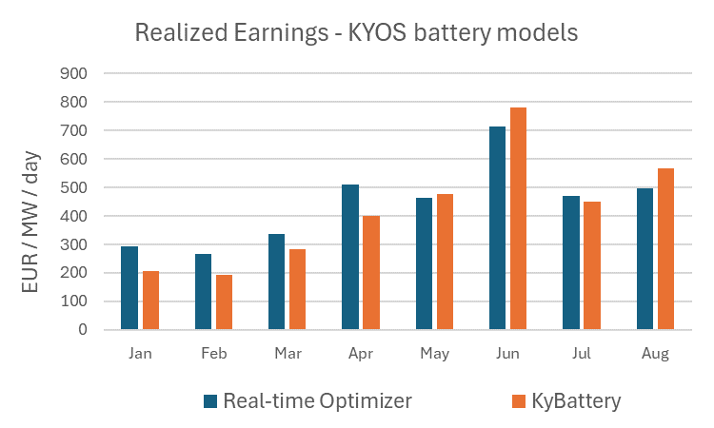
Real-time optimizer performance
Is the P&L of the real-time battery optimizer (intraday orderbook, shadow trading)
in line with the KyBattery backtest (ID1, ‘known prices’)?
Example results on the German intraday market

Slide 17
Example of challenge for BESS owner
BESS owners use Route-to-Market/optimizer
Different models possible:
  Fixed price/toll
  Index/formula
  Full merchant/open book
Challenges:
  How to select the best RtM provider?
  Does the RtM provider perform well?
Solutions:
  Upfront (forward) assessment of revenue models
  During operation: continuous benchmark of performance.

Slide 18
Summary
BESS growth requires three, linked, key elements
bankable forecasts
benchmarks
optimization

Slide 19



KYOS Energy Analytics: quarterly publications
Free publications
See: https://www.kyos.com/knowledge-center/

Slide 20

Contact us
We look forward to supporting you with the right data, tools and advice!
info@kyos.com
https://www.kyos.com/contact/
KYOS
Nieuwe Gracht 49
2011 ND Haarlem
The Netherlands

