Slide 1
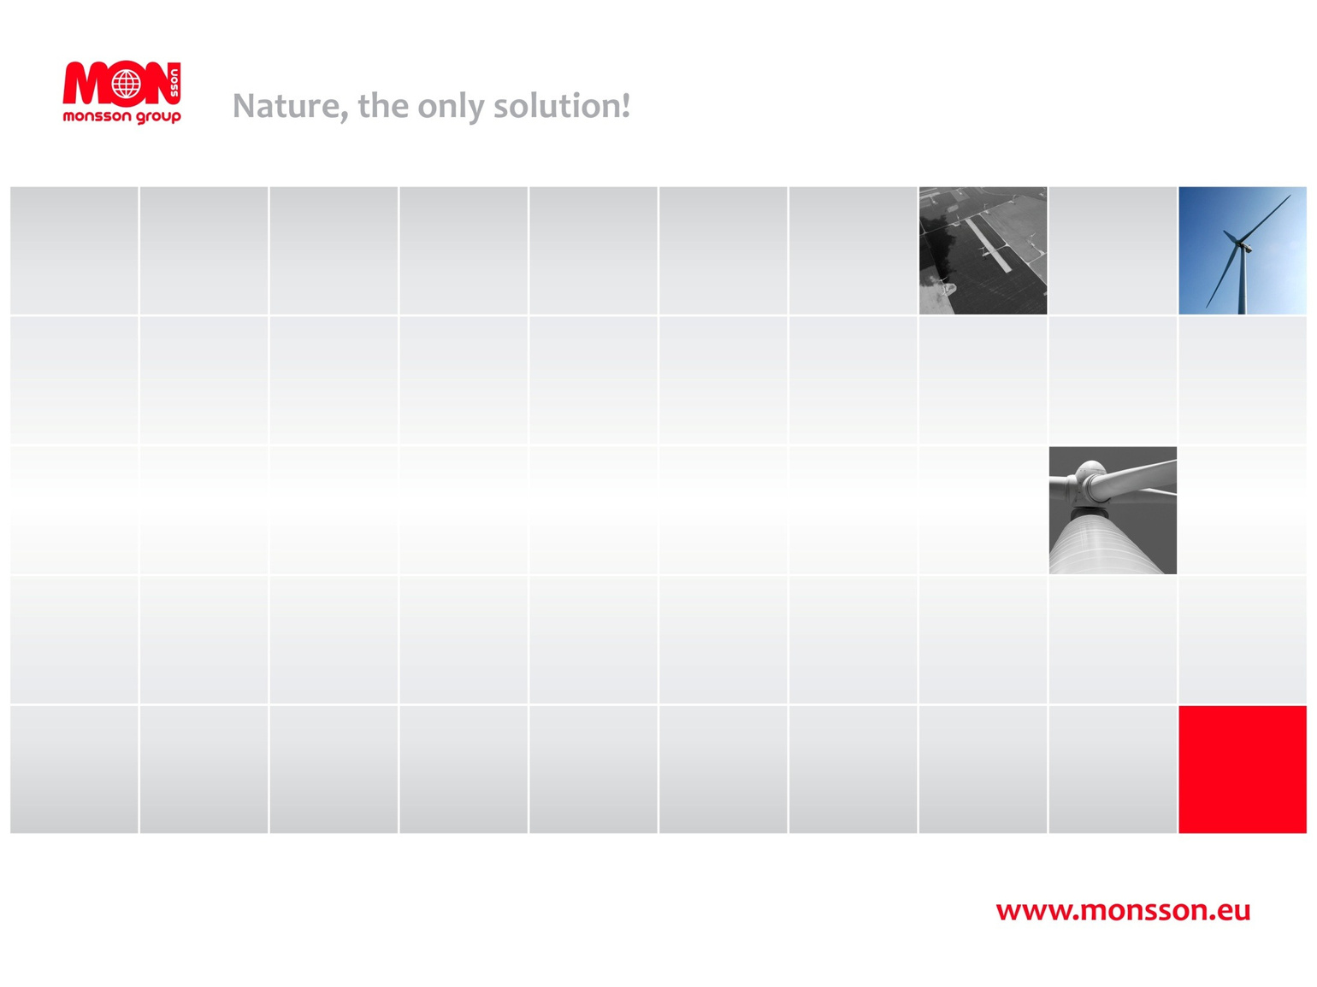

MONSSON
From Vision to Reality: Innovative BESS Solutions for
Today's Energy Challenges

Slide 2








About Monsson
Innovating in Renewable Energy Since 2004
A Legacy of Leadership
Over 6,000 MW of renewable projects developed worldwide
Diverse Expertise
Active in wind, solar, hybrid energy projects, research and development, energy trading
Operational Excellence
114 MW wind and solar in operation, 60 MWh energy storage systems and 156 MWh under construction
Global Innovation
Delivering large-scale renewable energy projects across multiple countries
2

Slide 3
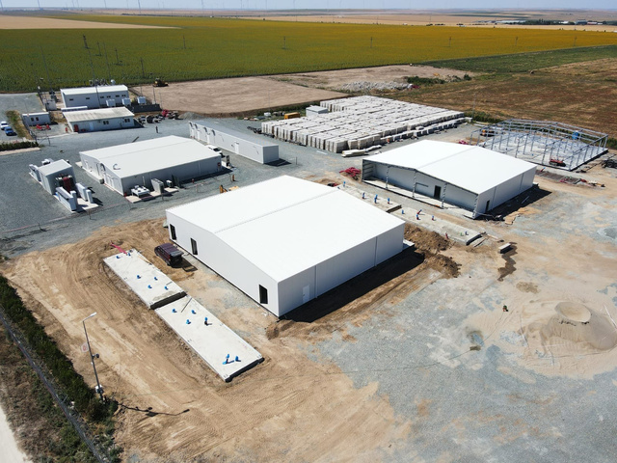
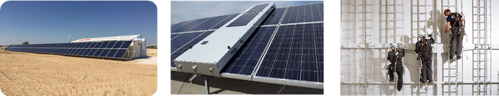
Achievements
Largest Onshore Wind Farm, 600 MW
—> The world's largest outside the USA (since 2012)
Largest Solar PV Plant in Europe
—> 1044 MW (under construction)
Firsts in Romania:
• Private Dispatch Center (2007)
• Renewable Training Center (2010)
• Energy ISP (2008)
Global Innovation:
—> Water desalination with renewables (Qatar, 2016) —> PV cleaning robot (2017)
3

Slide 4
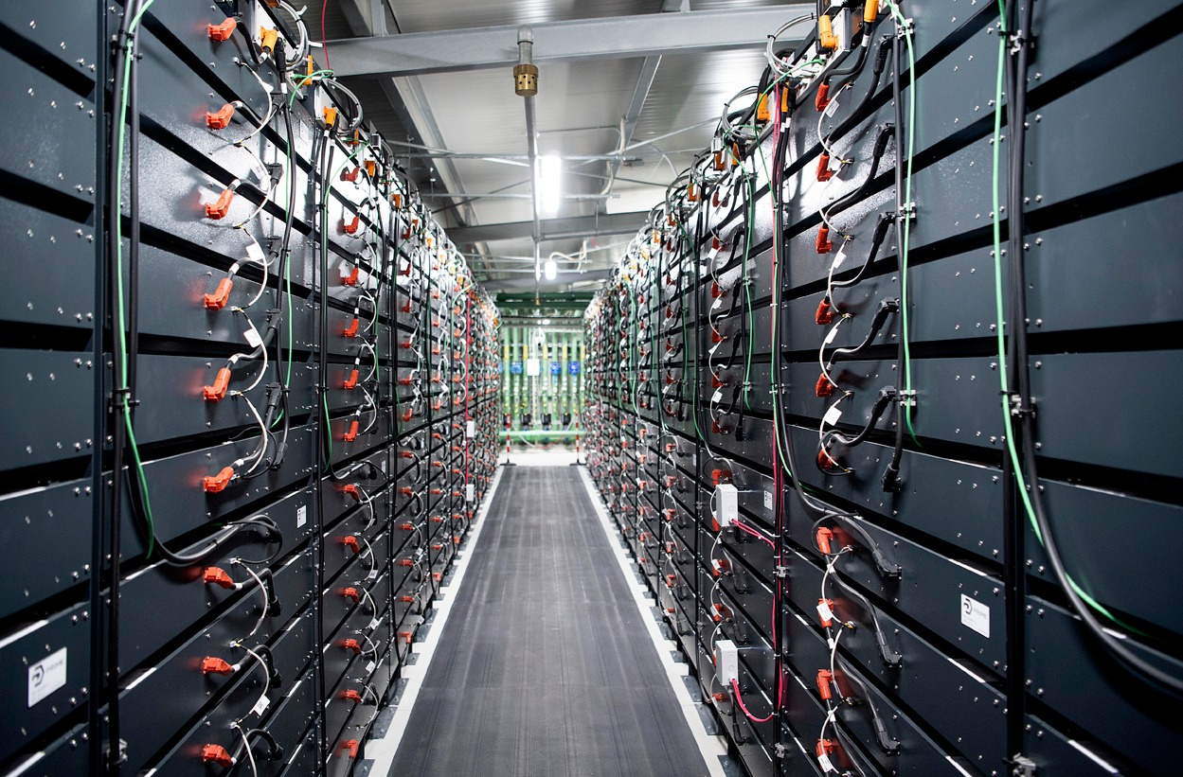




Energy Storage System Integrator
Redefining Energy Storage Solutions
In-house Innovation
Fully designed and developed by Monsson, integrating Li-Ion batteries into seamless energy solutions
Versatile Applications Suitable for grid services, arbitrage, balancing, and peak shaving.
Built for Extreme Climates Custom-built, insulated structures ensure optimal temperature control, extending battery lifespan.
Advanced Software Control Proprietary software ensures reliable and efficient performance across all energy needs.
4

Slide 5
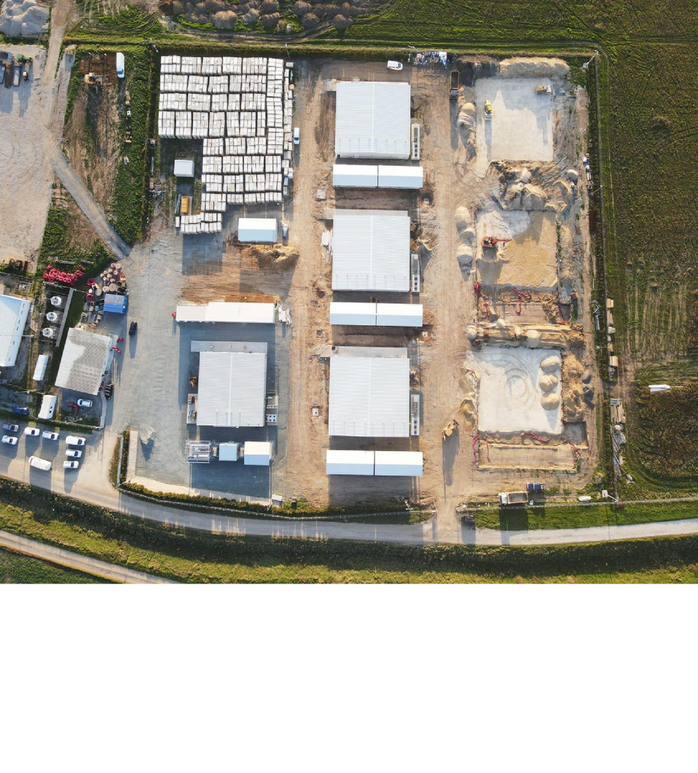

Mireasa Hybrid Park Case Study
Battery Energy Storage, 30 MW x 2h - operational
Wind farm, 50 MW - operational since 2015
Extension of Battery Storage to 54 MW x 4h - under construction, COD Q1 2025
Solar PV Plant, 35 MW - under construction, COD Q2 2025
Location: Constanta, Romania
5

Slide 6
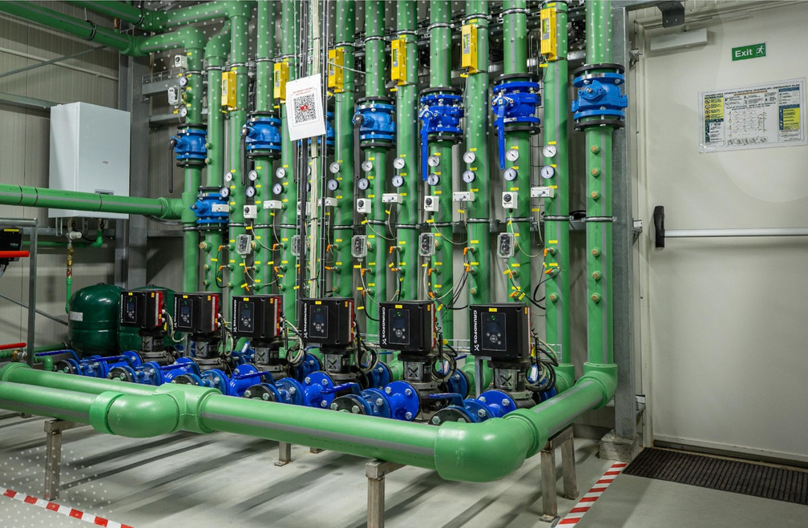
Innovative Technologies and Superior Quality - High Level Differentiators
Addressing Battery Degradation and Operational Efficiency
Climate-Adaptive Design. Insulated housing maintains constant battery temperatures whatever outside ambient temperature.
Multiple layers for parameters and safety monitoring. Redundant safety systems monitor temperature, gas emissions, and potential hazards.
State-of-the-Art Cooling Systems: Minimizes energy consumption and prolongs battery life.
Automated and Remote Operation: Ensures real-time efficiency and year- round reliability.
Easy Operation and Maintenance. Designed for year-round easy access to all equipment and reduced downtime for scheduled or unplanned works.
Impact: Optimized safety, longer lifecycle, higher round trip efficiency, and optimized safety.
6

Slide 7

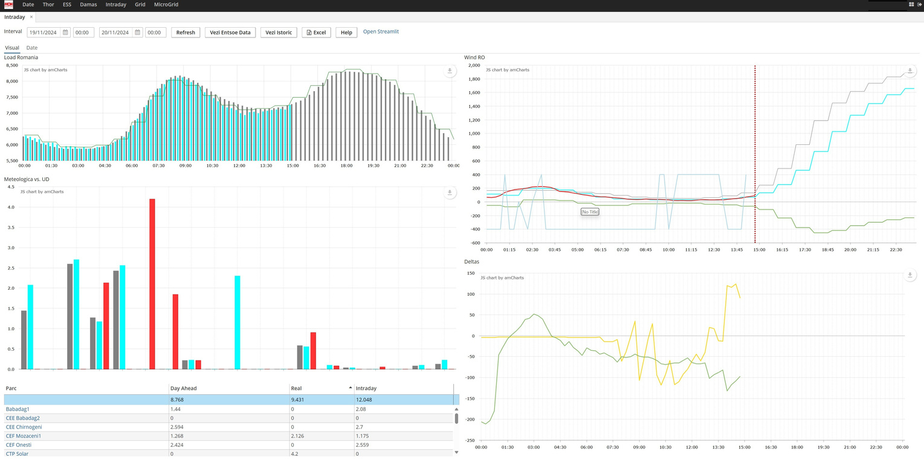

Innovative Technologies and Superior Quality - High Level Differentiators
Addressing Market Volatility
Fully automated operation enables response to market fluctuations in real time.
What-If Analyses: Simulations to anticipate market conditions and adjust operational strategies, optimizing revenue by adapting to peak demand periods.
Monsson Energy Management System
Advanced Forecasting: SCADA integration allows for predictive adjustments based on market data.
Impact: Maximized profitability and system stability.
7

Slide 8
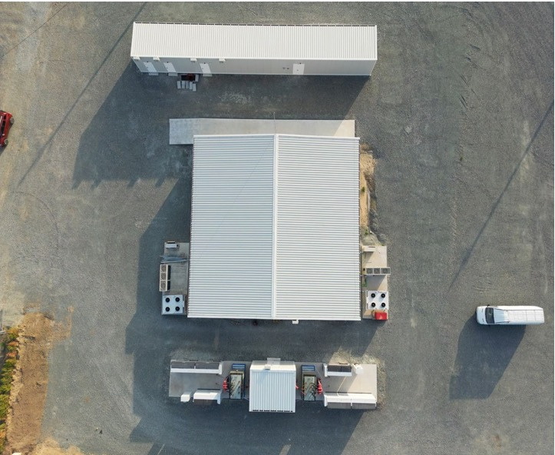
Innovative technologies and superior quality - high level differentiators
Addressing Cost Management
Real-time monitoring helps anticipating potential operational issues, reducing repairing costs and minimizing downtime.
Easy to Repower: Replaceable components for lower long-term operational costs.
Modular and Scalable: Easily expandable to meet growing energy storage demands.
Impact: Maximized profitability and system stability.
9

Slide 9
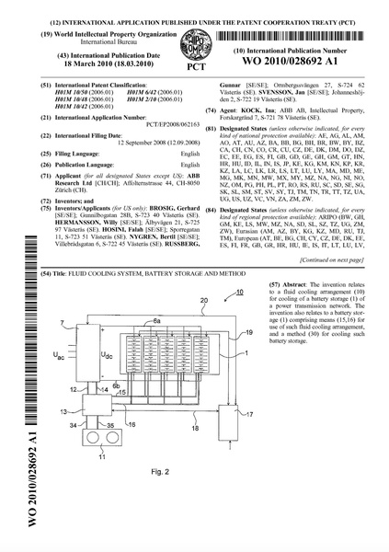


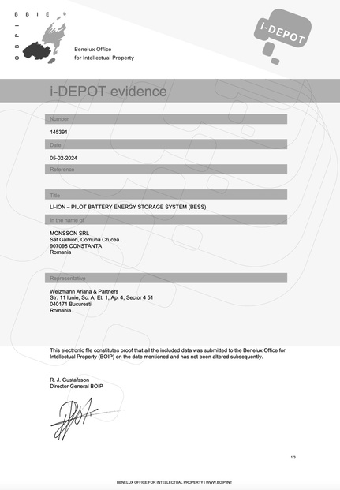
Certified and Registered for quality
TUV Certification/ Undergoing DNV certification meeting strict standards for large-scale energy storage
Patent application. Registered in Romania as 'Electrical Energy Storage Installation in Li-Ion Batteries' (OSIM A/ 00074/21.03.2024)
EU-manufactured components comply with grid codes and EU environmental standards for sustainable energy storage
Registered with the BOIP (Benelux Office for Intellectual Property).
10

Slide 10
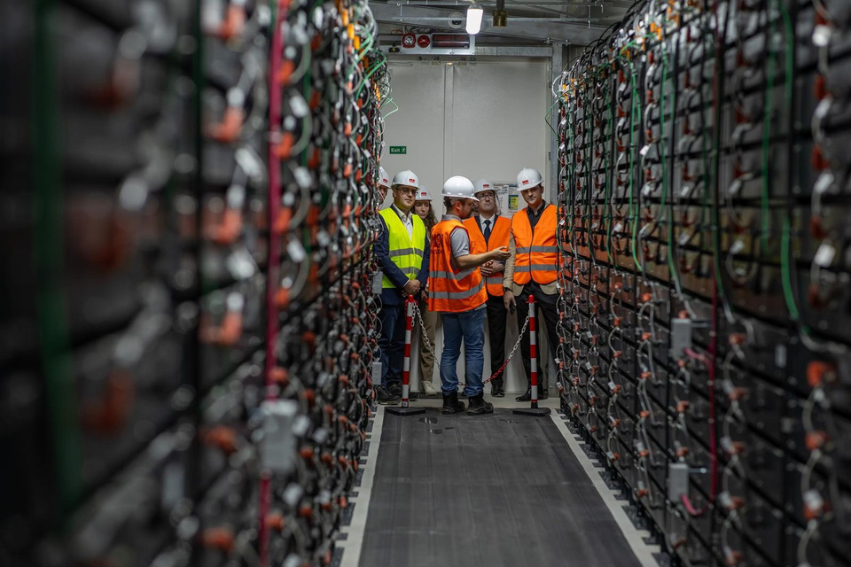

Comprehensive Impact and Conclusion
Realizing the Vision:
At the core of renewable integration, Monsson drives the transition to sustainable and resilient energy systems.
Innovation in Action:
Monsson has developed an energy storage solution that addresses both the unique challenges of hybrid renewable energy projects or standalone projects. By integrating advanced cooling systems, intelligent SCADA control, and robust safety features, the system ensures reliability and efficiency in diverse operational scenarios.
Delivering Impact:
Increased renewable penetration and grid flexibility. Reduced emissions, supporting global energy transition goals.
A Blueprint for the Future:
Scalable, adaptable solutions already demonstrated, set the stage for similar hybrid projects worldwide.
11

Slide 11
Contact
Thank you for your attention.
Mihaela Popescu +40 751 22 44 76
mihaela.popescu@monsson.eu
Director
ASSET MANAGEMENT DIVISION
Battery Energy Storage
www.monsson.eu
12

