Slide 1



Data Centers and 24/7 Carbon Free Energy

Slide 2
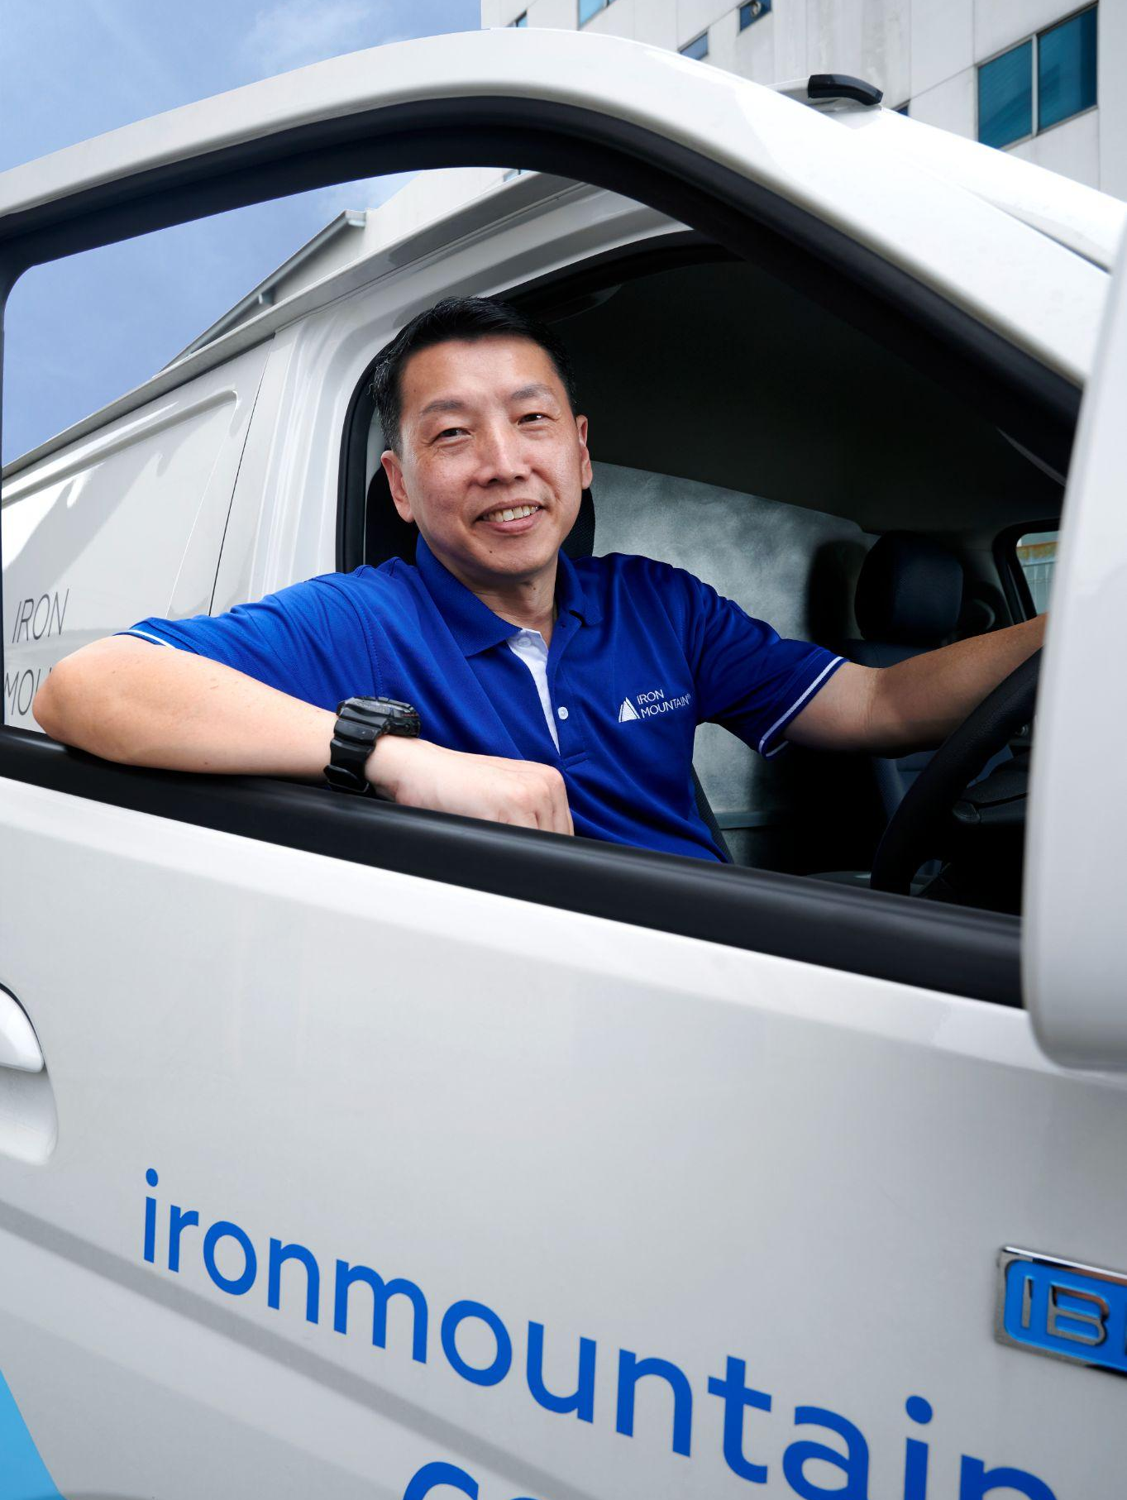

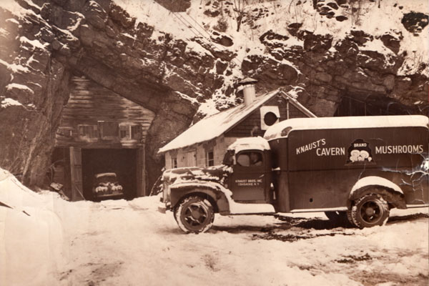
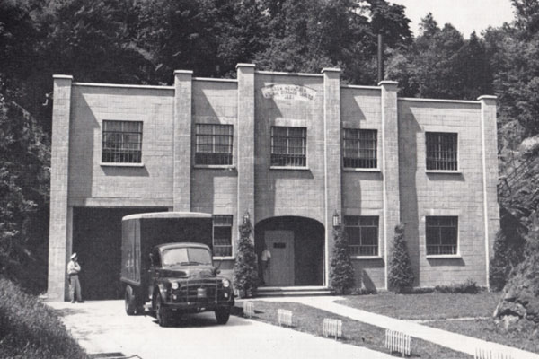
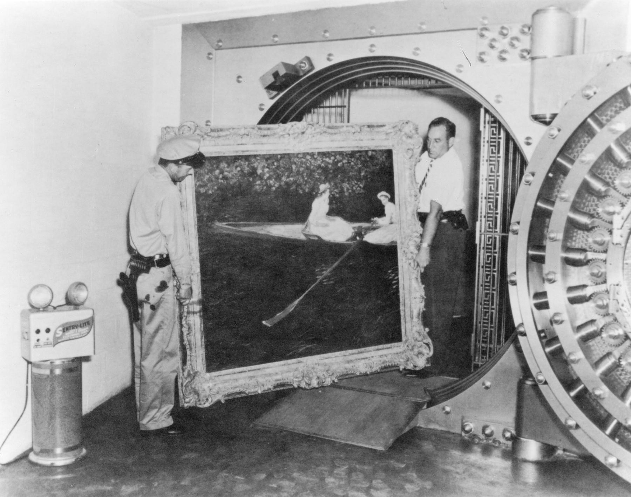
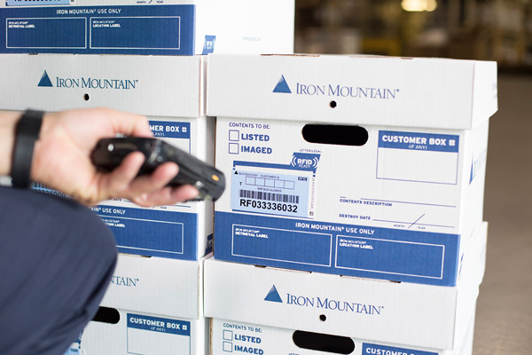
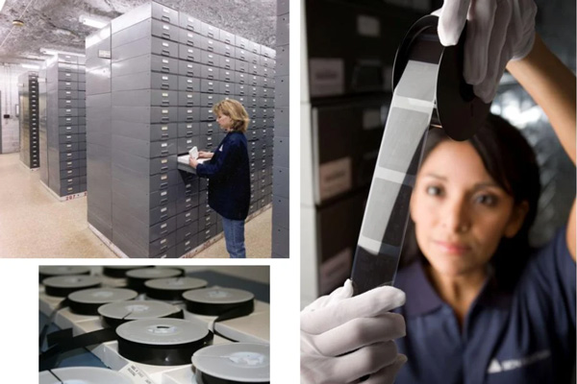
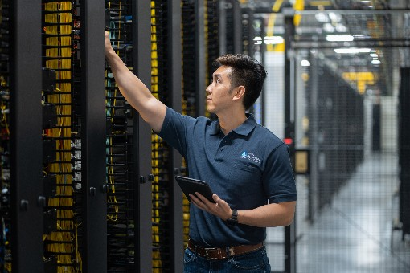
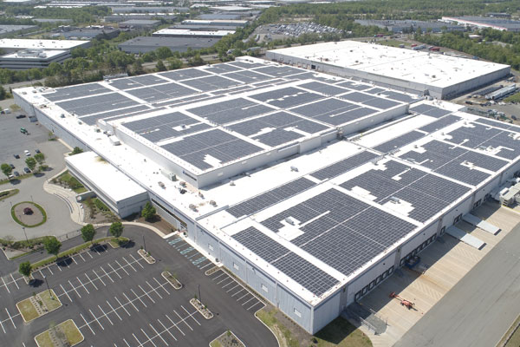

Iron Mountain
1936
2024
2

Slide 3
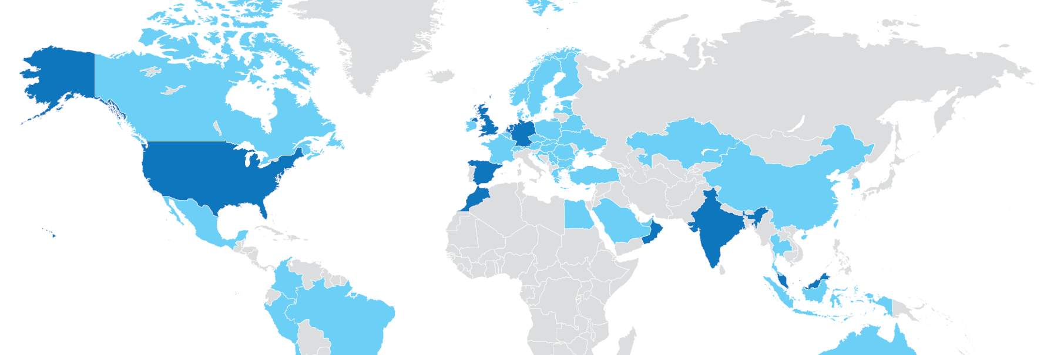





Global Portfolio of Secure Data Centers
North America
Boston
Chicago
Denver
Kansas City
Miami
New Jersey
EMEA
Amsterdam (AMS-1)
Frankfurt (FRA-1, FRA-2)
London (LON-1, LON-2, LON-3)
Madrid (MAD-1, MAD-2)
APAC
Bangalore
Delhi-NCR
Hyderabad
Chennai
Mumbai (MUM-1, MUM-2)
Pune
Singapore
Ohio
W. Pennsylvania
Phoenix (AZP-1, AZP-2, AZP-3)
Scottsdale
N. Virginia (VA-1 — VA-7)
IRM Markets
Data Center Markets
Operational Data Centers
Under Development
Hyperscale
Scale
Retail
25+ locations
Hyperscale-Ready
Strategic Edge
Underground
1300+ customers
7 countries
21 markets
5M+ gross square feet
3

Slide 4
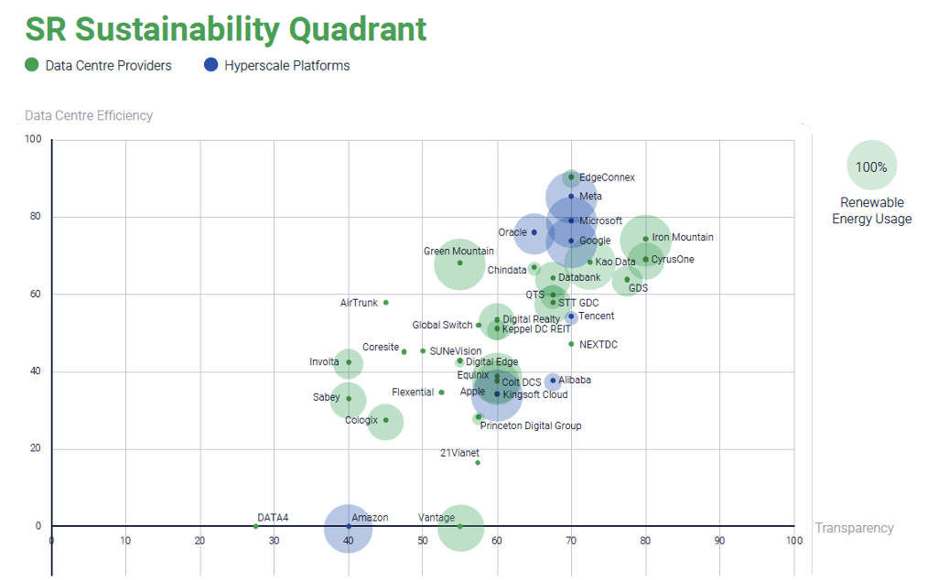
Leading among data center providers
Structure Research Sustainability Quadrant
Q4 2023 independent report by Structure Research covering 36 leading operators
IMDC no. 1 for transparency
IMDC in top 5 for efficiency

Slide 5
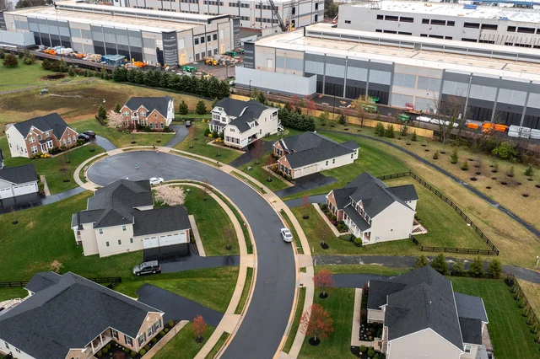
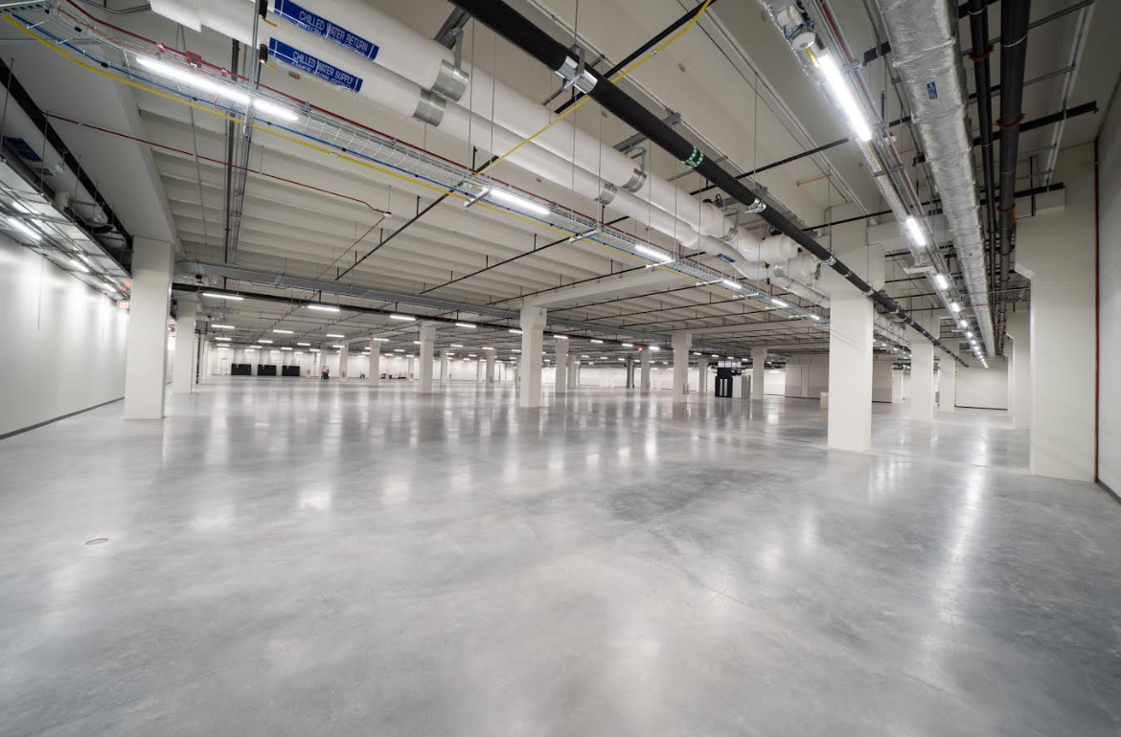


More comprehensive impact considerations
Land
Building
Power
- Community engagement
- Biodiversity
- Heat capture and use
- Embodied carbon
- Increasing densities
- Alternate backup/UPS designs
- Energy Efficiency
- Cooling technologies
- Clean power (?)

Slide 6
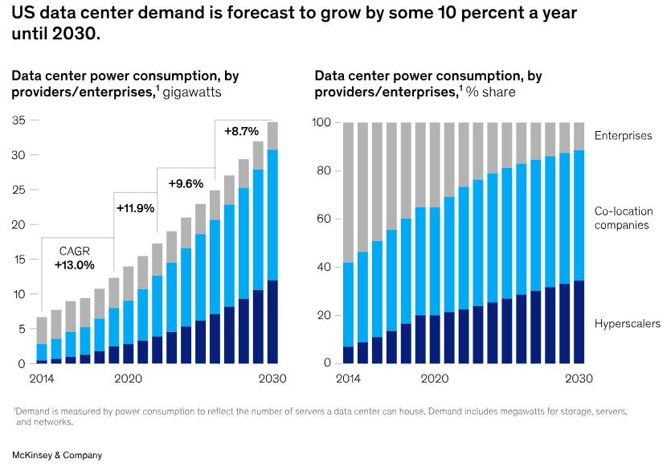

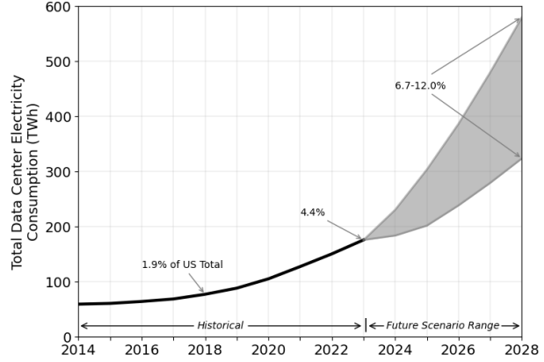
Source: LBNL 2024 US data center energy usage

Slide 7
What does ‘Net Zero’ power really mean?
Are we achieving it?
Is it important?
Why?

Slide 8
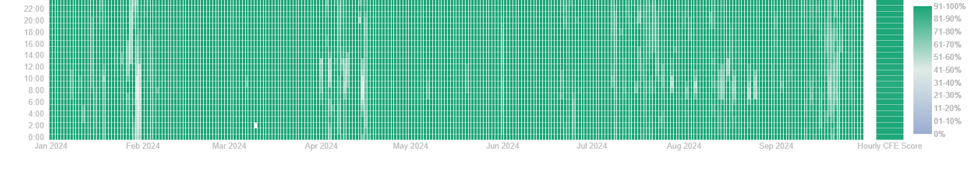
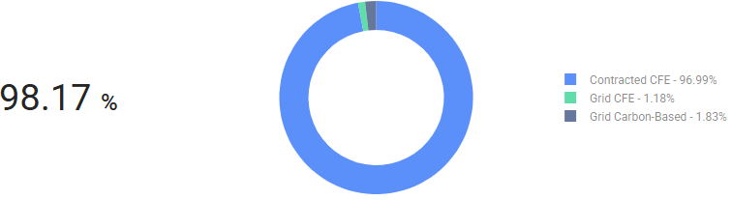
24/7 Carbon Free Energy - hourly matching

Slide 9
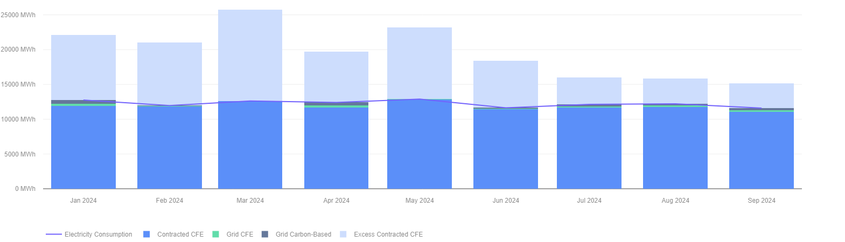
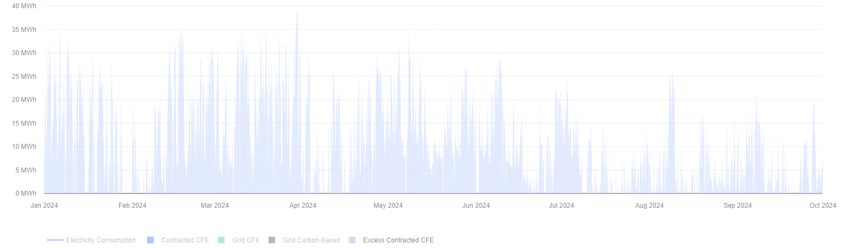

Slide 10
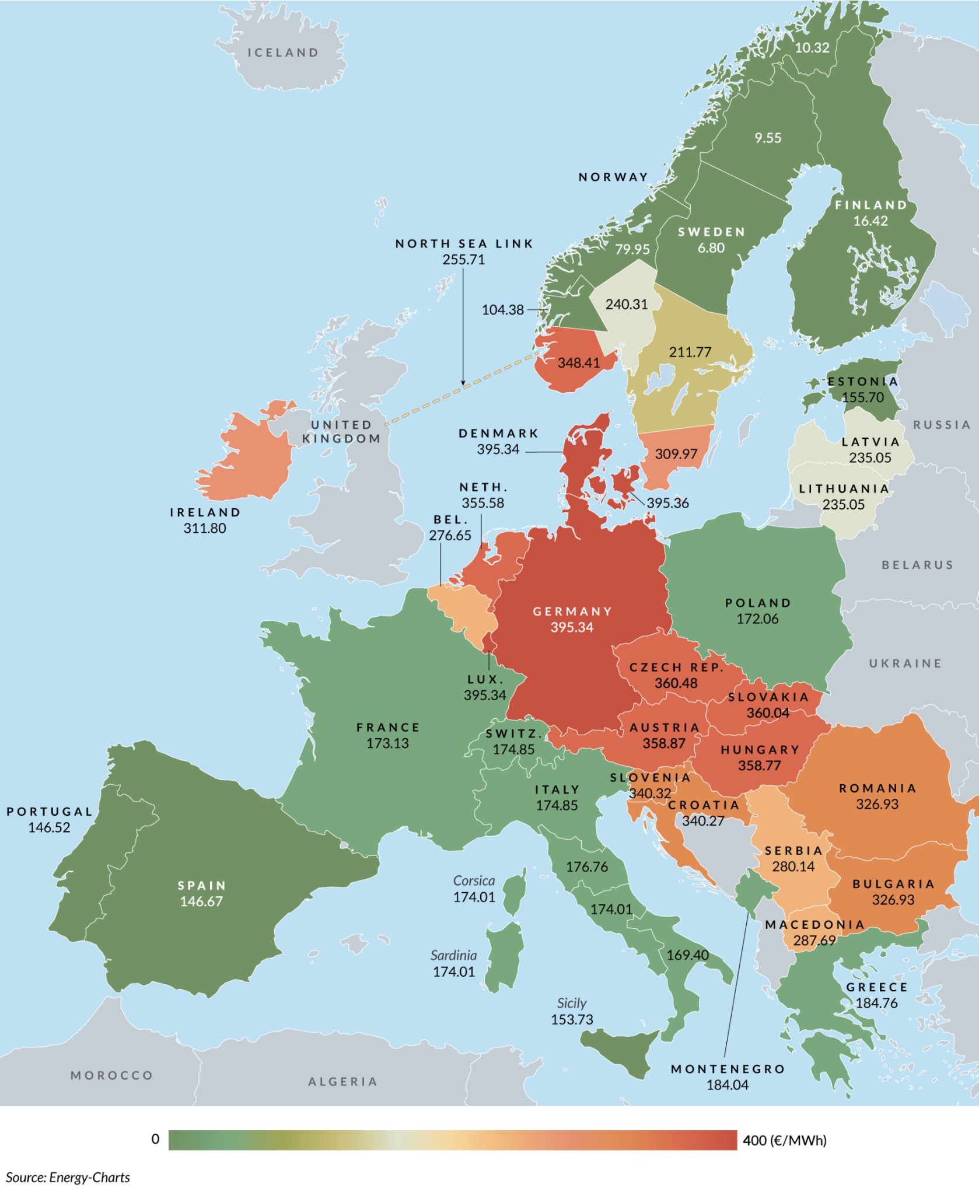
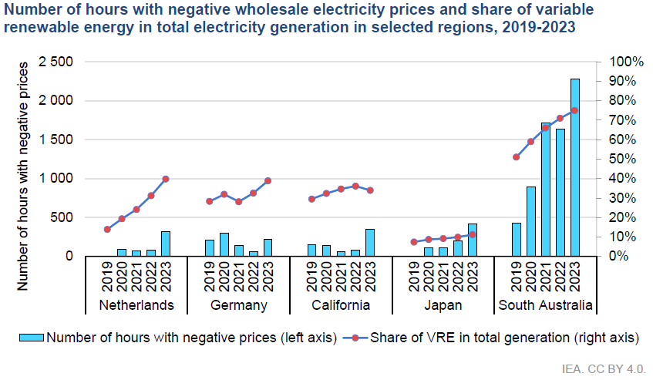
Effect of increased intermittent generation

Slide 11
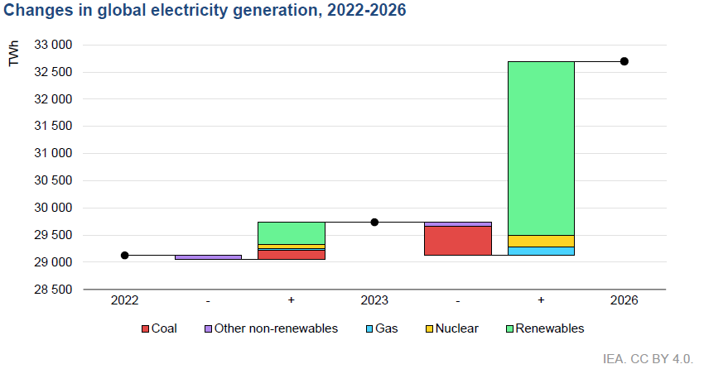
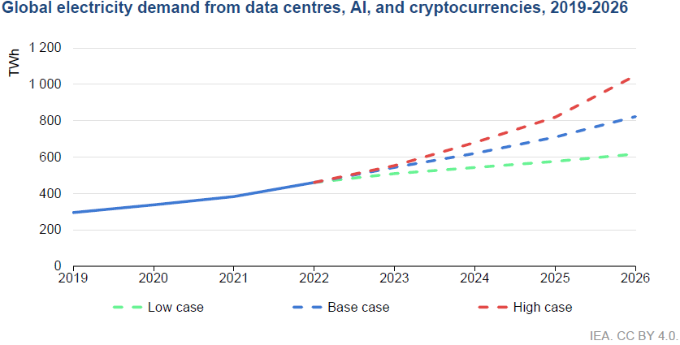
Globally, clean energy is outpacing data centers
- Over 90% of all new capacity in US was carbon free in 2024
- UK retired its last coal plant September 2024
- Over half of UK generation was from renewables in 2024
- Renewables overtake fossil fuels as the dominant source in the EU
Using clean energy has surpassed buying clean energy as the primary challenge

Slide 12




Hourly carbon-free power - targets & actions
Our target, unique in the colocation industry, is to run all data center operations on local 100% carbon-free energy by 2040.
Progress: in 2023 we tracked 186,457 MWh’s matched with locally produced carbon free energy in our five pilot sites (25% of all customer power overhead). We are now rolling out tracking and power purchase restructuring across all of our facilities worldwide
On-site renewables
On-site renewables (currently 21.3 MW solar from rooftop arrays)
Google methodology
We are rolling out heatmaps of how carbon-free all our customer power is hour-by-hour by facility, worldwide to achieve 24/7 carbon free energy
Low-Carbon
We are restructuring our power purchase agreements to increase local carbon-free power levels

Slide 13
Video
https://www.youtube.com/watch?v=lYjVfifPCJM

Slide 14
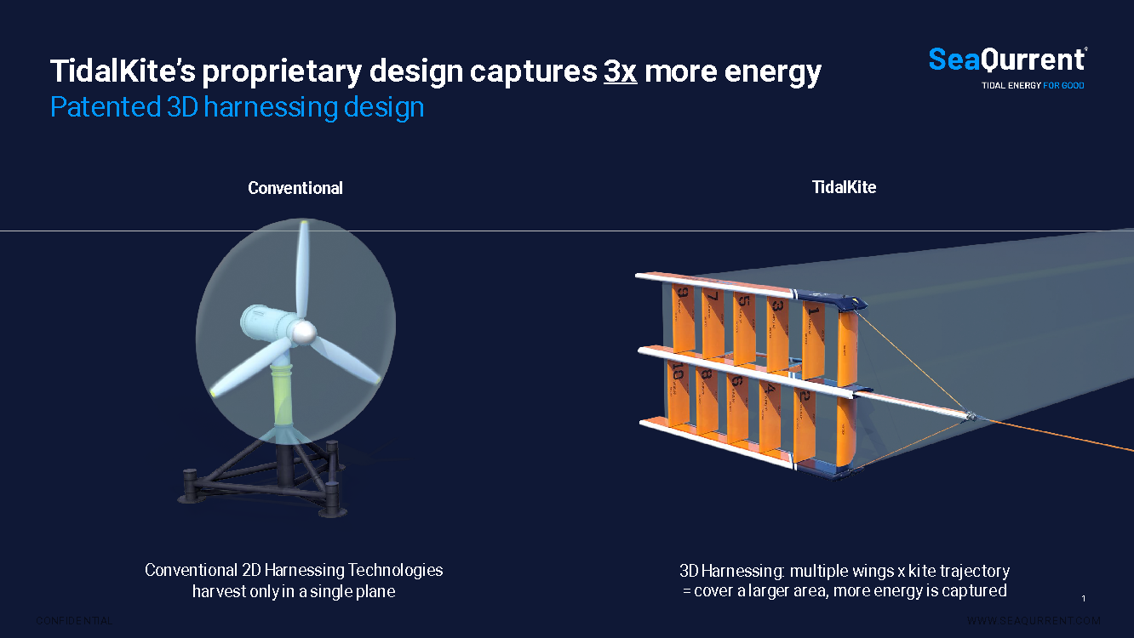

Slide 15
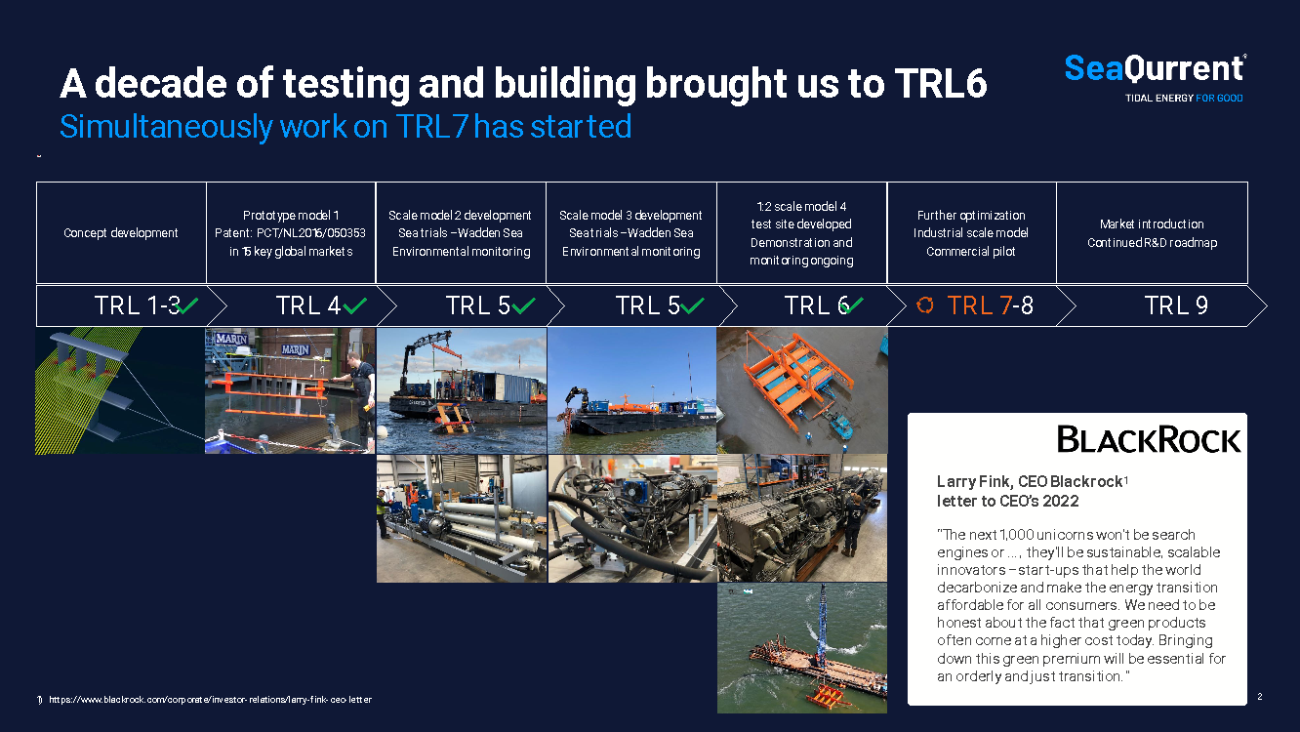

Slide 16
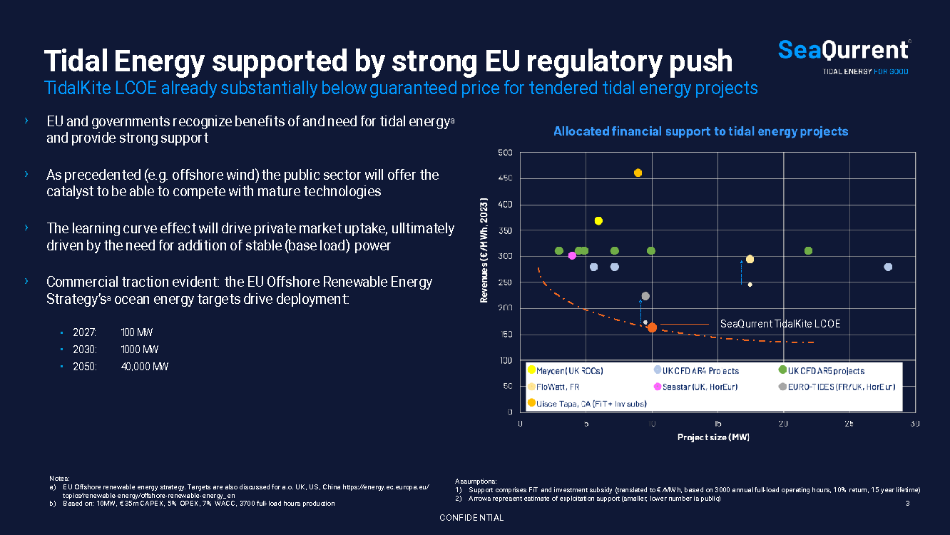

Slide 17
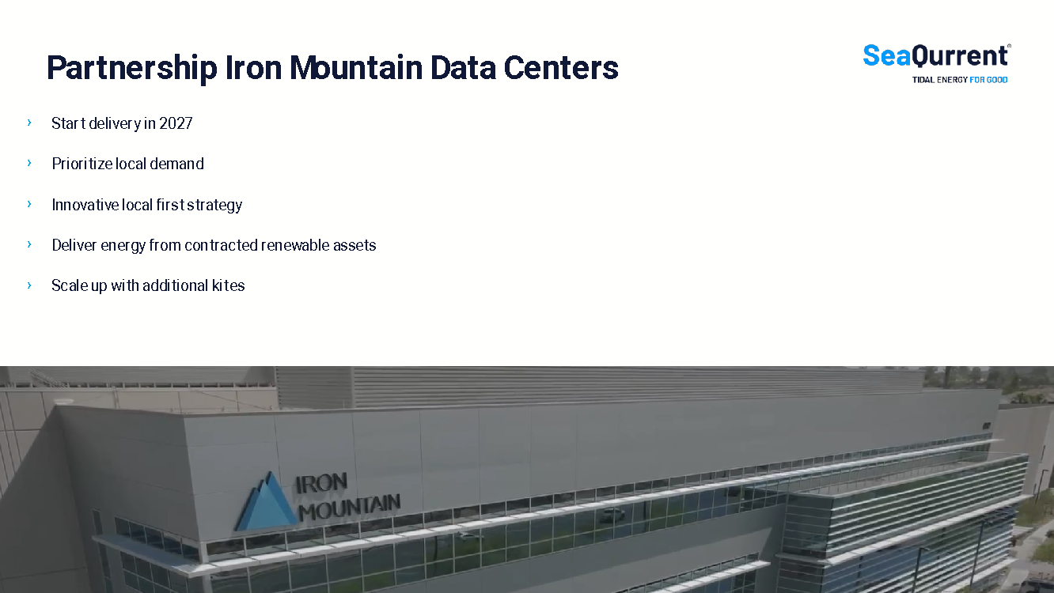

Slide 18
Thanks for your attention!
Q & A

