Slide 1

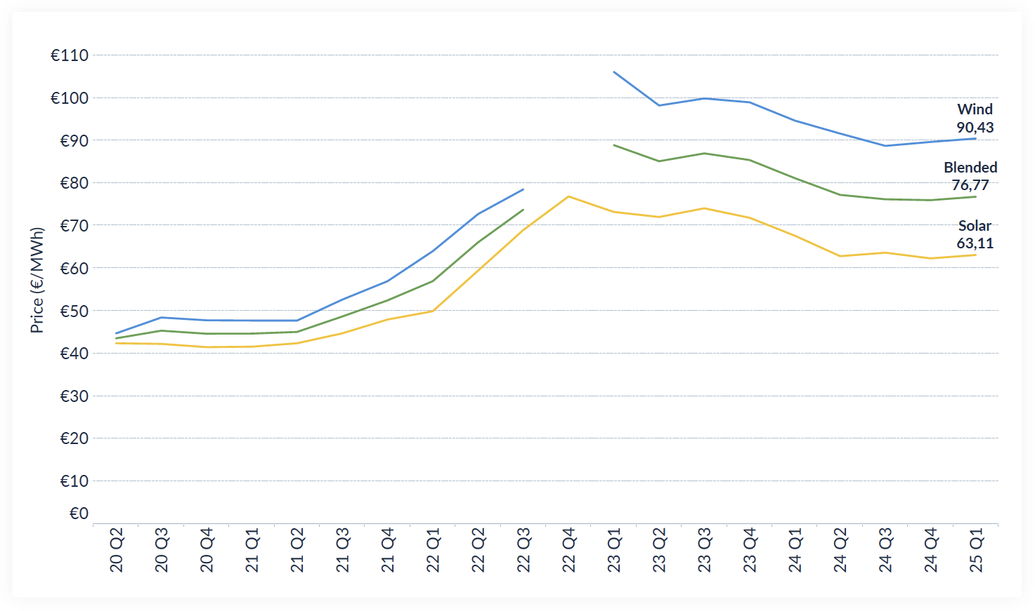
P25 PPA Price Trends Across Europe (Q2 2020 – Q1 2025) from the LevelTen Energy Platform

