Slide 2

Exploring the Future of UK Offshore Wind Capture Prices
Tasmin Chowdhary
Insight by Volue

Slide 3

Tasmin Chowdhary
Market Expert UK & Ireland,
Insight by Volue

Slide 4
Agenda
Production growth
Cross-border comparison
Capture prices outlook
Regulatory and Policy Updates
Conclusions
14 May 2025, All-Energy Conference, Glasgow

Slide 5

Insight
The energy mix is getting greener and more weather-dependent. In markets with a lot of renewables, energy production relies on wind and sun forecasts.
Volue provides reliable real-time data, forecasts and market analysis for all geographical areas in Europe with all time horizons – from 15 minutes Intraday forecasts to 30 years of investment analysis.
Check the analysis on our web pages.
Feed the data into your own models through our API.
1.8 billion daily calls to API
14 May 2025, All-Energy Conference, Glasgow

Slide 6
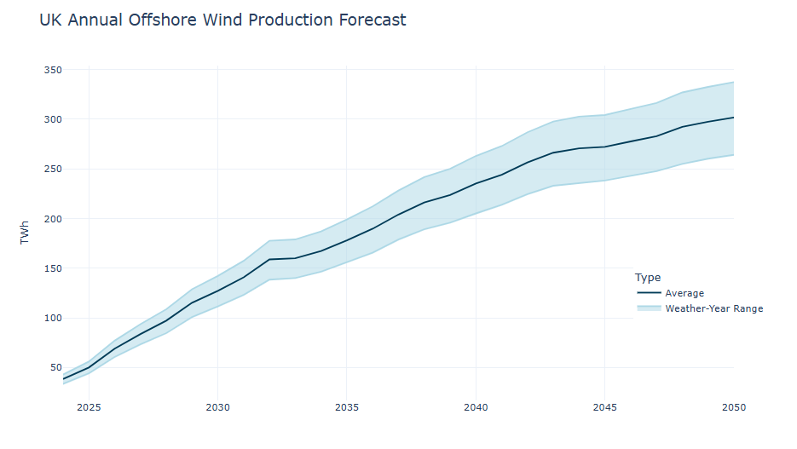
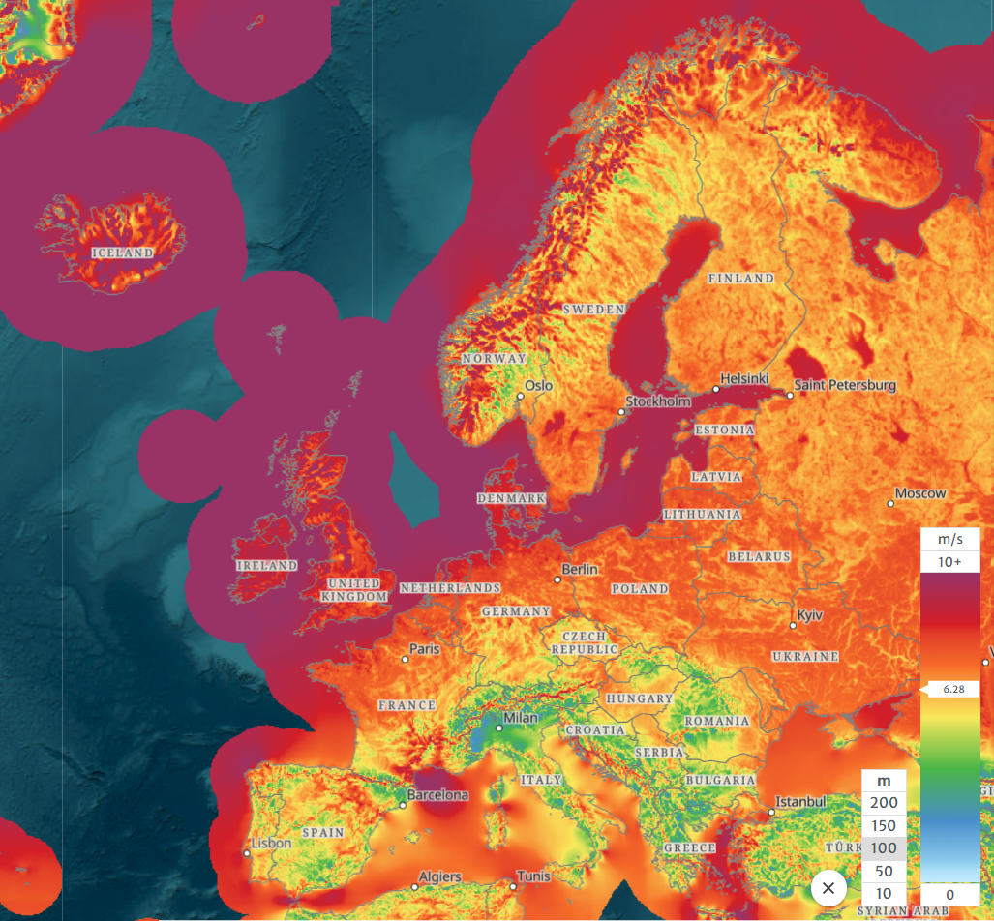
Offshore Wind Boom
Source: Global Wind Atlas
Offshore wind output increasing rapidly from 50 TWh in 2025 to 127 TWh by 2030 under normal weather conditions
Currently 15 GW commissioned and 6.4GW under construction
Range of production outcomes increases in windy vs. calm years
Optimal location: UK benefits from some of the best wind speeds in Europe of 9-10 m/s
14 May 2025, All-Energy Conference, Glasgow

Slide 7
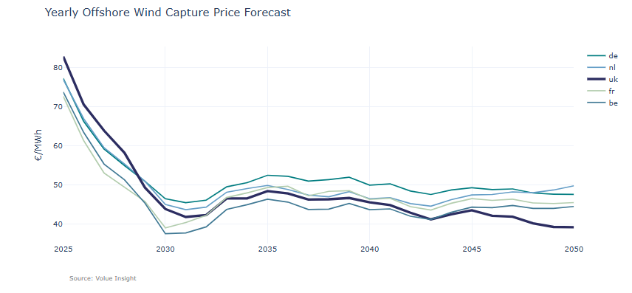
UK Sees Highest Capture Prices This Decade…
UK consumers initially face higher average capture prices
Germany overtakes as premium market for offshore wind
Capture prices eroded in the late 2040s by cannibalization effect
14 May 2025, All-Energy Conference, Glasgow

Slide 8
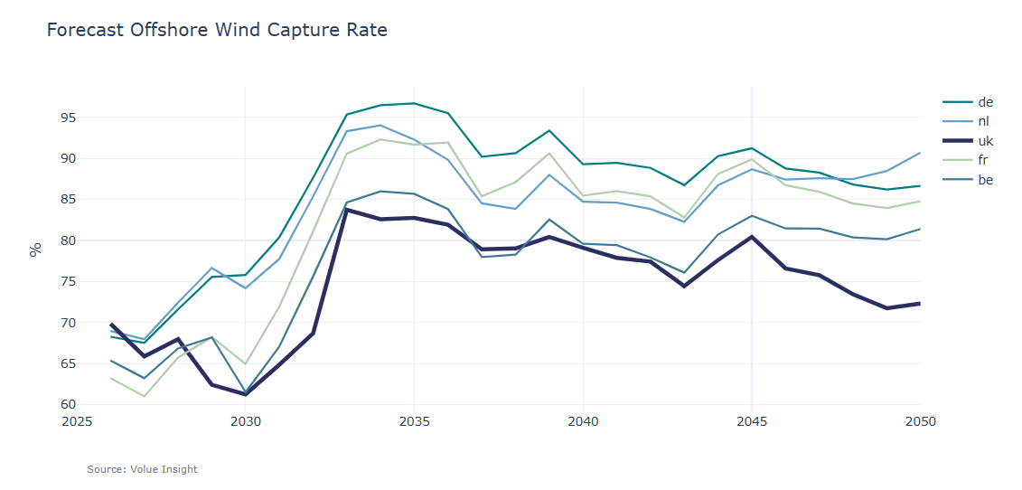
…However, Capture Rates Are Lower
Capture rate is defined as the capture price/baseload price
UK set to have lowest capture rates as higher production volumes weighs on revenue potential on the spot market
The capture rate hits a low in 2030 but rises later in the decade thanks to growing consumption
14 May 2025, All-Energy Conference, Glasgow

Slide 9
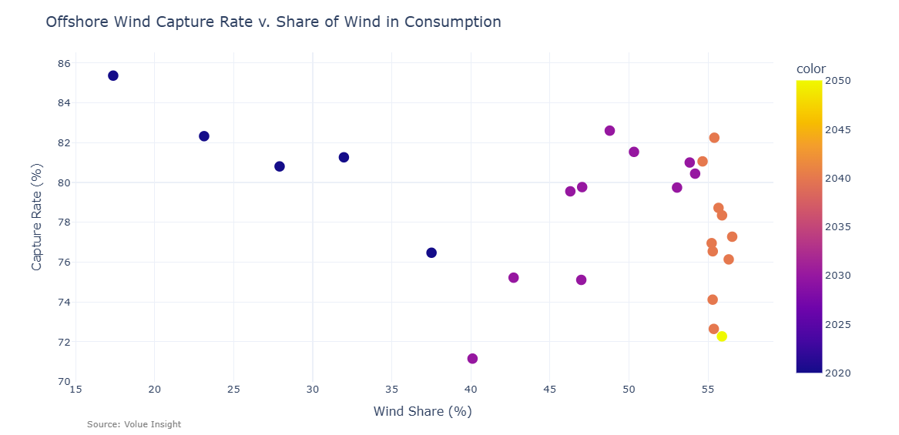
Limits to Declining Wind Capture Rate Trend
Capture rate tends to decrease as the wind share increases but there is a limit.
Wind project owners face a wider range of possible capture rates by the 2040s despite stable wind share.
14 May 2025, All-Energy Conference, Glasgow

Slide 10
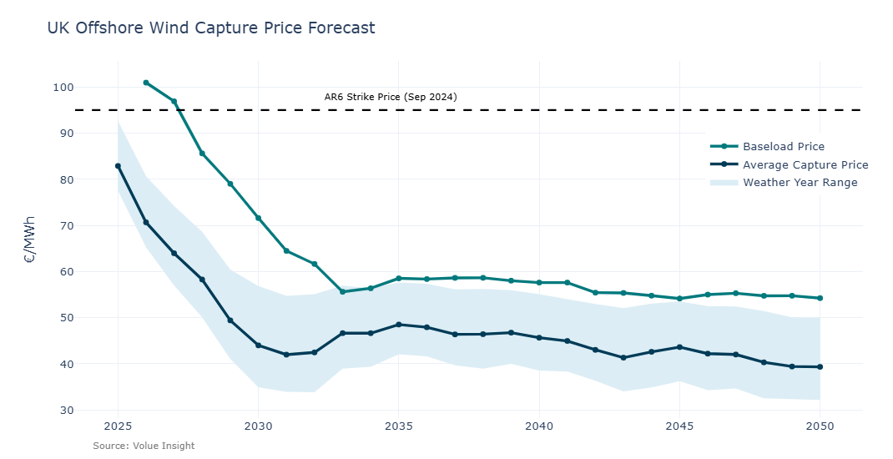
UK Capture Prices Outlook
Increased production volumes lead to cannibalization effect in the 2020s
Commissioning of electrolysers and batteries in 2030s to help absorb excess production and boost capture prices
CfD offers protection compared to forecast capture prices
Short-term PPAs should account for the strong decline expected this decade
Weather risk needs to be included in offtake agreements, range could be €20-30 within one year
Weather year simulations highlight variations around the average
(1986-2015)
Note: CfD strike price calculated in 2025 €/MWh
14 May 2025, All-Energy Conference, Glasgow

Slide 11
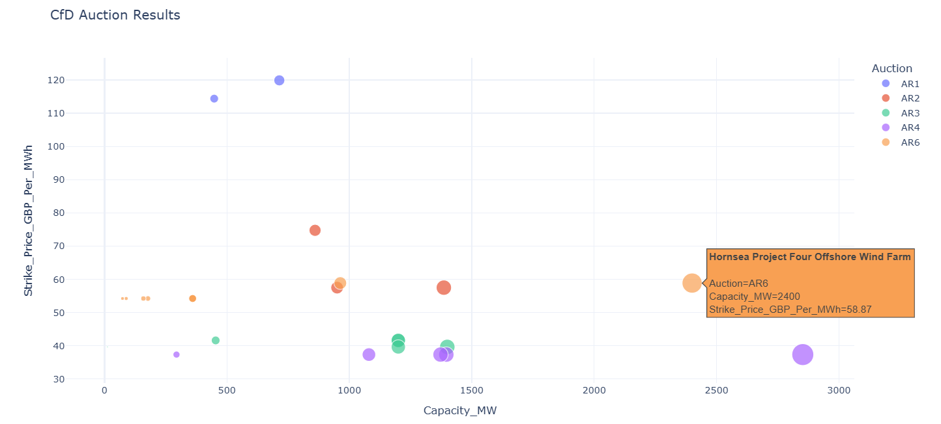
CfD Offers Long-Term Revenue Security
14 May 2025, All-Energy Conference, Glasgow

Slide 12
CfD: New Proposals for AR7
1. Flexible planning consent
No longer need planning consent before bidding in CfD, but must meet certain milestones
2. Reassessing contract term
Prolong the CfD term from the current 15 years
3. Capacity targets
Set capacity goal for each round, budget published afterwards, transparent bidding process
Analysis
Relaxed planning rules enables more participation, increases competition, lower barriers to entry;
Projects may reach FID faster and this would increase overall realised capacity;
Likely to be long-term payments to wind farms based on low expected capture prices, extending CfD term ultimately costlier to taxpayers;
Capacity targets with set delivery years would help achieve goals as UK currently not on course to meet 2030 target of 43-50 GW;
Orsted cancellation signals need for higher maximum bidding prices.
14 May 2025, All-Energy Conference, Glasgow
Notes:
Still need to have applied for Development Consent Order in England and Wales
Aim to keep up to date with technology advancement, global supply chain costs and consumer bills

Slide 13
Locational Marginal Pricing
Market design uncertainty may hinder project investment. Clarity necessary before the next CfD Allocation Round.
Benefits:
Offer economic incentives to production in high-priced areas and consumption in low-priced areas.
Investment in renewable projects where conditions should be tight.
More intermittent supply means greater need for flexibility to keep system in balance.
Enhanced security of supply given GB power system isolated as an island.
Drawbacks:
Risk of de-industrialization grows as large consumers face higher bills.
Locational price risk -data centres and digital sector would likely face higher power prices.
Rising PPA costs/risks and change of law clauses necessary.
High upfront implementation costs.
May cause under-investment in key grid reinforcement projects.
14 May 2025, All-Energy Conference, Glasgow

Slide 14
Grid connection reform
PROBLEM: project backlog of 750 GW, older infeasible projects holding back newer, ready projects
SOLUTIONS:
Gates 1 and Gate 2
  Gate 1: Projects with indicative connection offer and date
  Gate 2: Queue position for eligible projects, meet readiness and strategic alignment
  Gate 2 to Whole Queue: Reassessing all projects with a connection against new Gate 2 criteria
‘First come, first served’ → ‘First ready and needed, first connected’
Progression Commitment Fee for projects in Gate 2 without submitting planning application. Initially dormant but could be activated if grid connection offer terminated. Pushes developers to evaluate readiness.
Termination of projects which have failed to make progress.
Analysis
Enable commissioning of projects ready to deliver and unblock the queue, means closer to achieving Clean Power 2030 capacity targets.
More consumption in the form of data centres, EVs, batteries would be beneficial to capture prices, limit the price downside during windy periods.
Increased wind capacity dampens overall capture price outlook, but the pace of offshore development is constrained by seabed leases, long planning, permitting and construction times.
14 May 2025, All-Energy Conference, Glasgow
Notes:
PCF would be initially £2500/MW but increase by £2500/MW every 6 months up to a maximum £10000/MW
Bi-annual application window. Must meet certain criteria to be put in Gate 1 or 2
https://www.ofgem.gov.uk/sites/default/files/2025-04/CMP434-Final-Decision.pdf

Slide 15
Conclusions
Offshore wind production is set to double in the next 5 years with increased capacity and government ambitions.
More wind production as a share of the power mix leads to a strong price cannibalisation effect.
Government CfDs remain an attractive option compared to forecast market capture prices.
Connections reform to speed up new projects, potential to weigh further on capture prices if new supply is commissioned faster than demand.
The UK has one of the lowest offshore wind capture rates in north-west Europe, but the long-run declining trend is limited.
14 May 2025, All-Energy Conference, Glasgow

Slide 16

Q&A
Thank you for your attention. Questions?
Scan here to learn more about Volue

