Slide 1
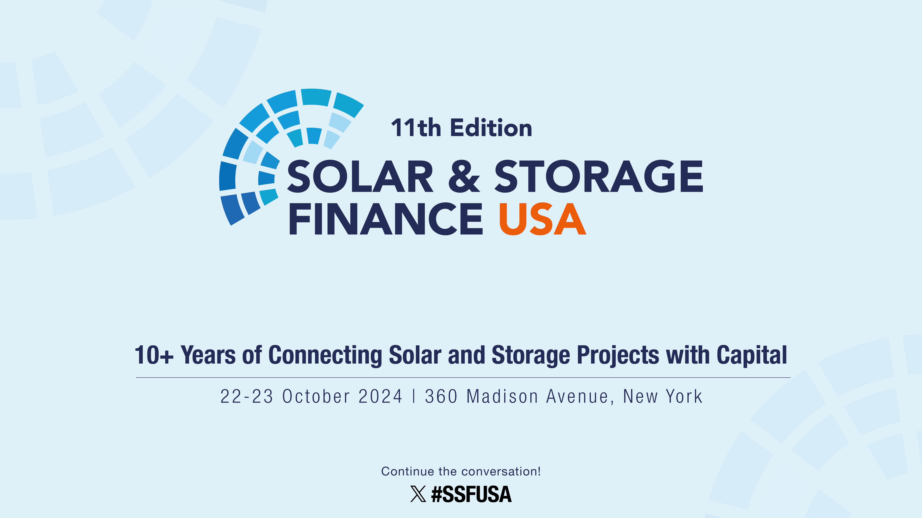

Slide 2
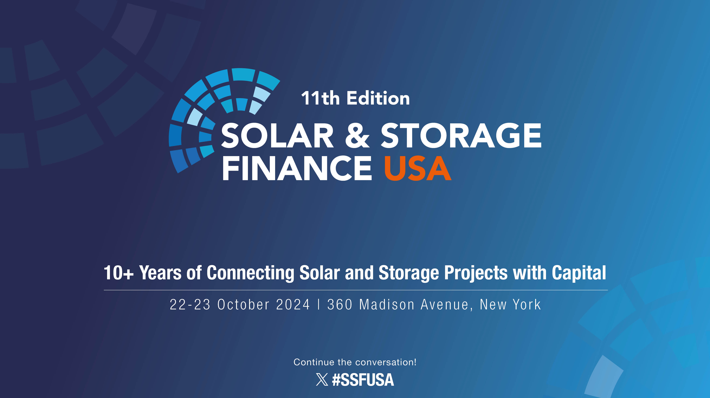

Slide 3
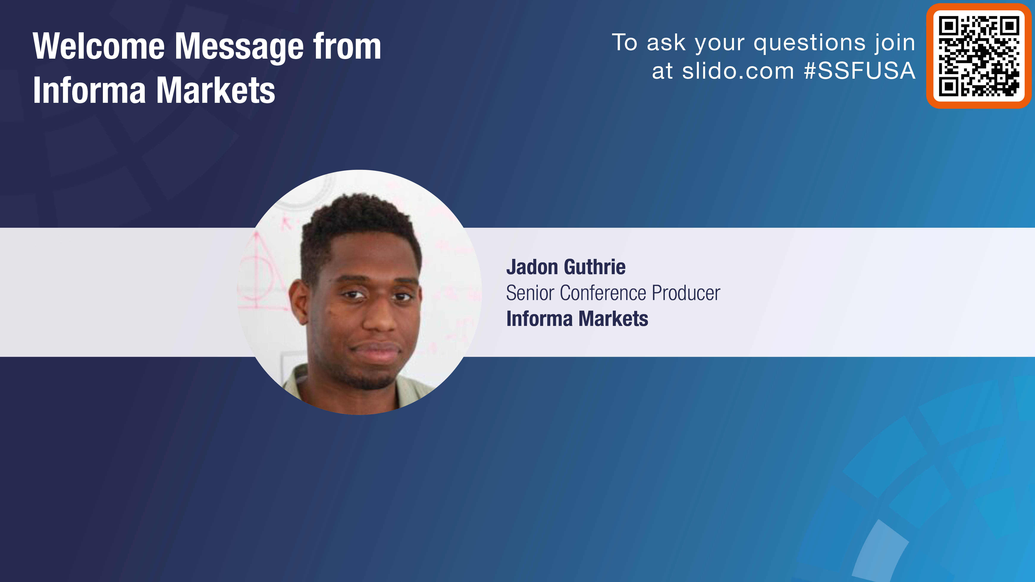

Slide 4
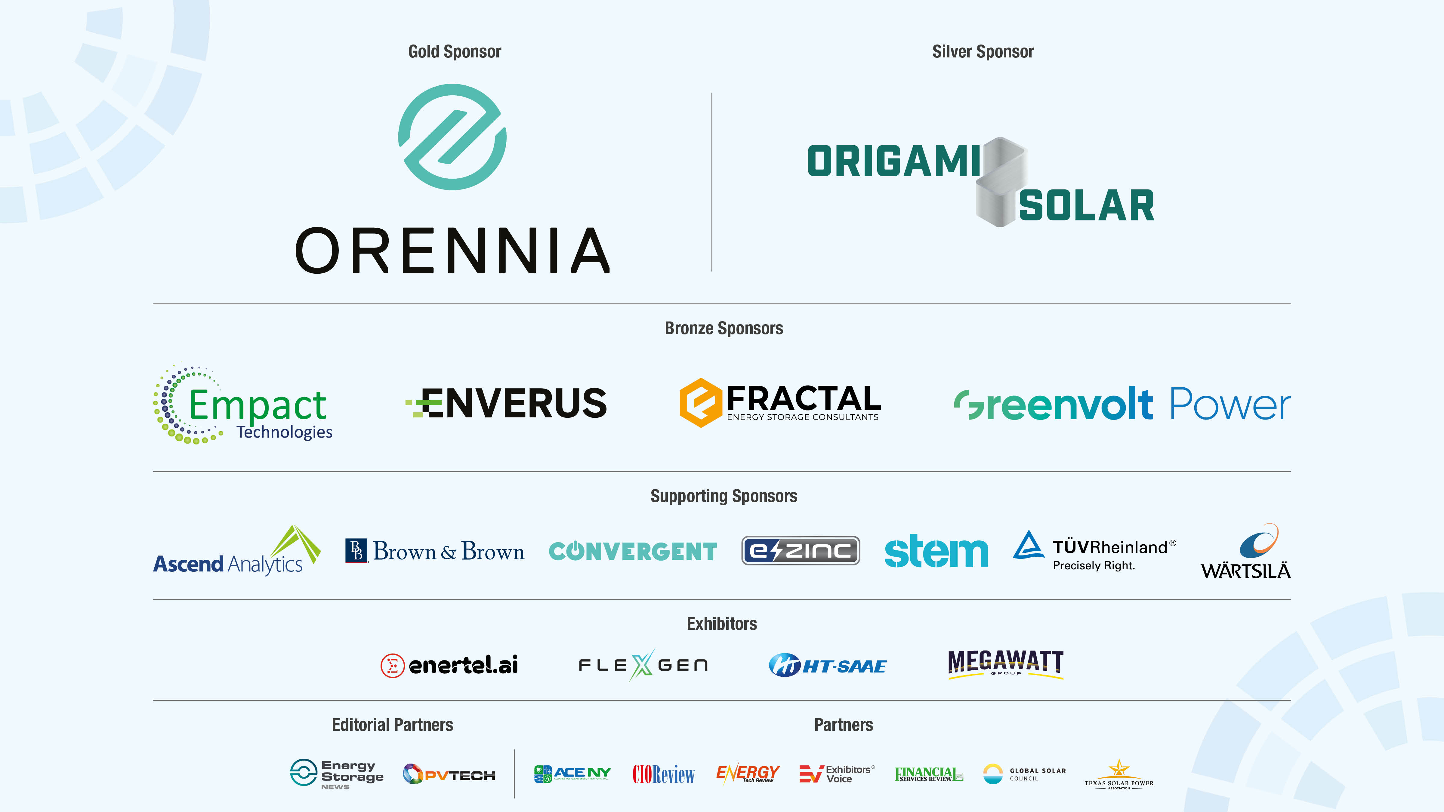

Slide 5
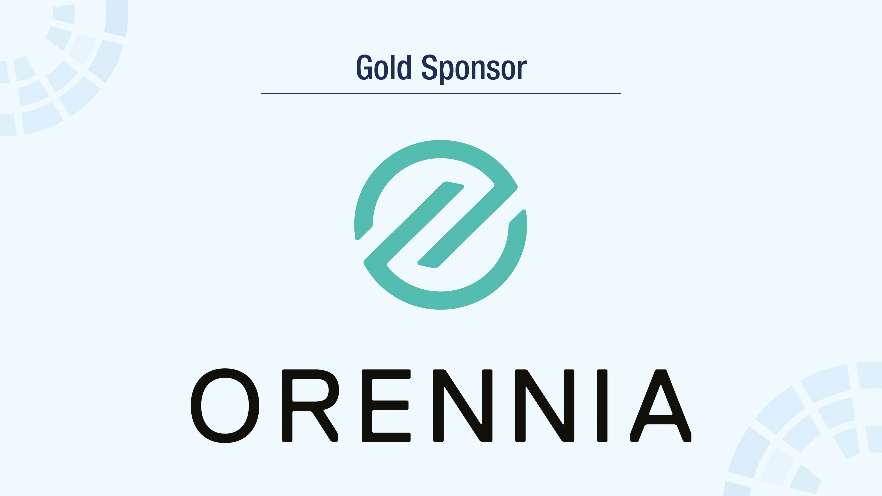

Slide 6
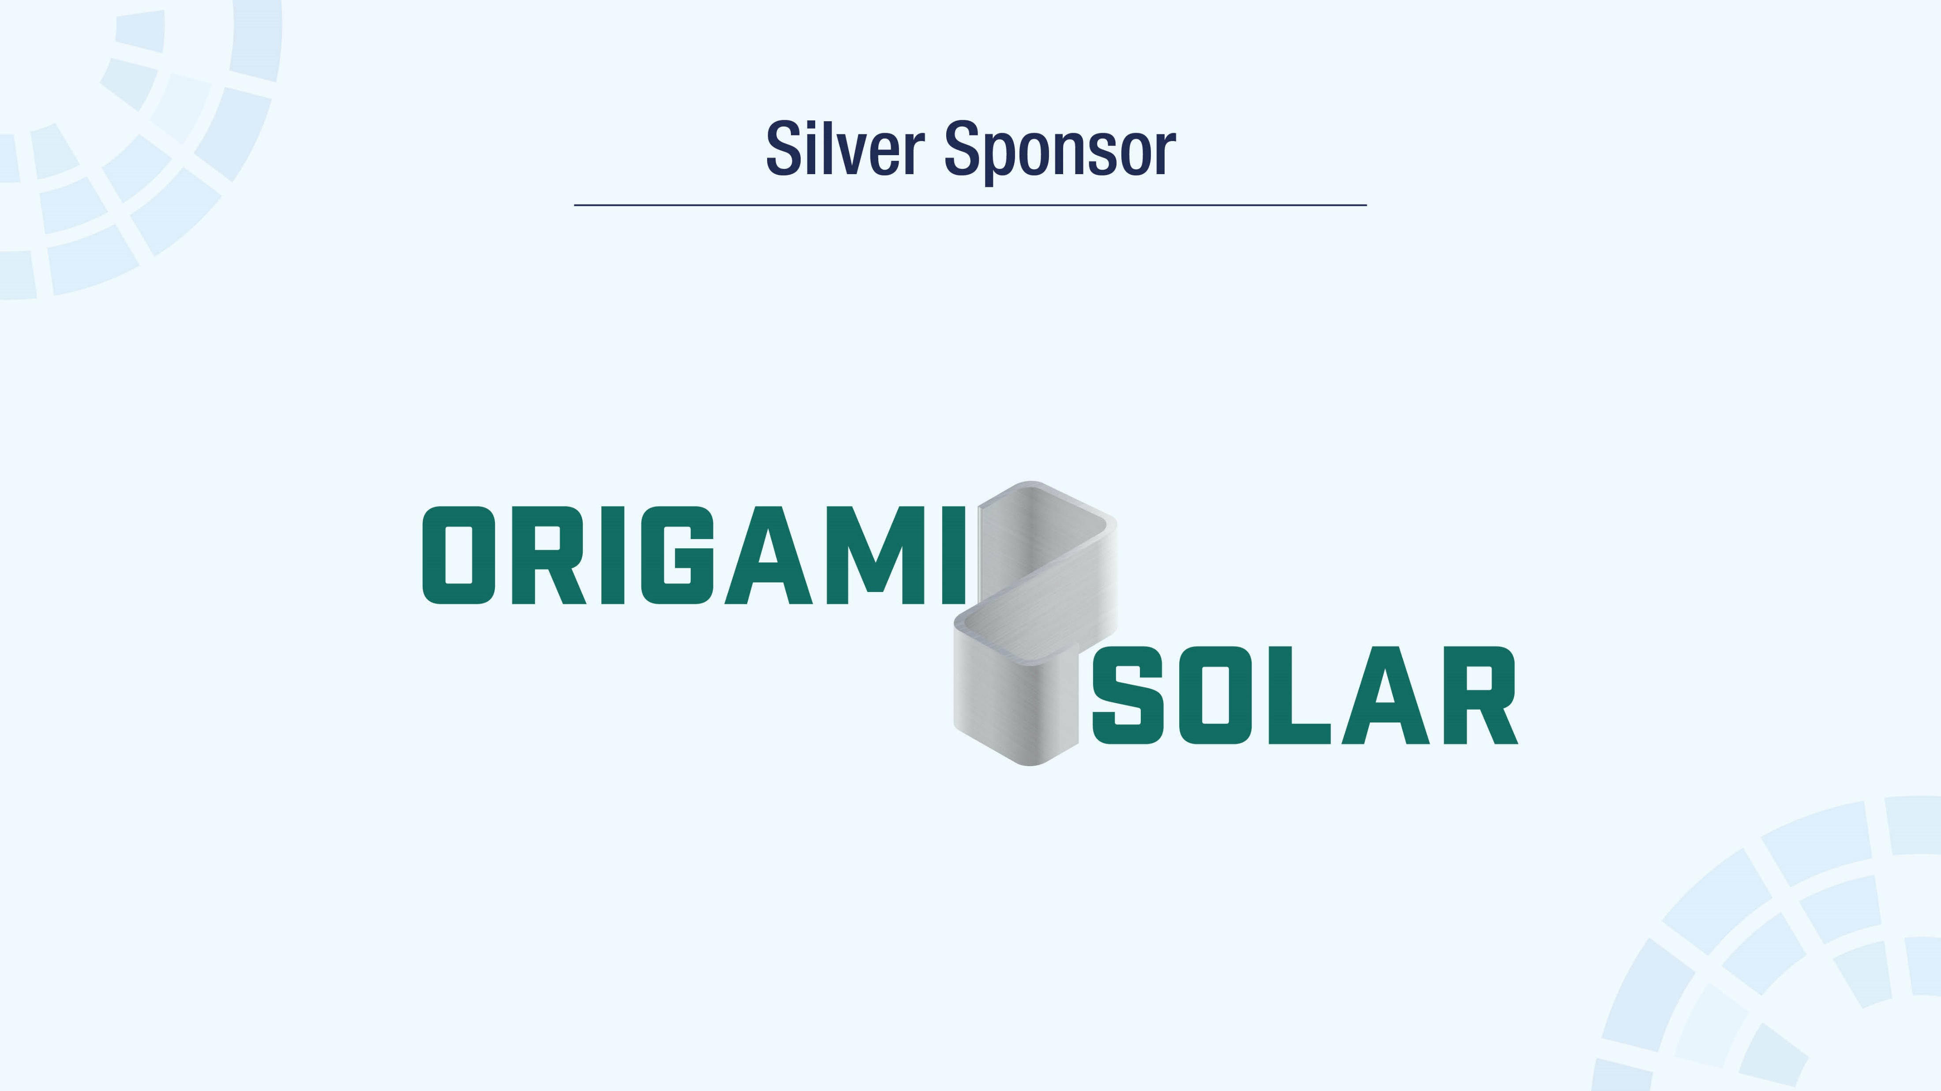

Slide 7
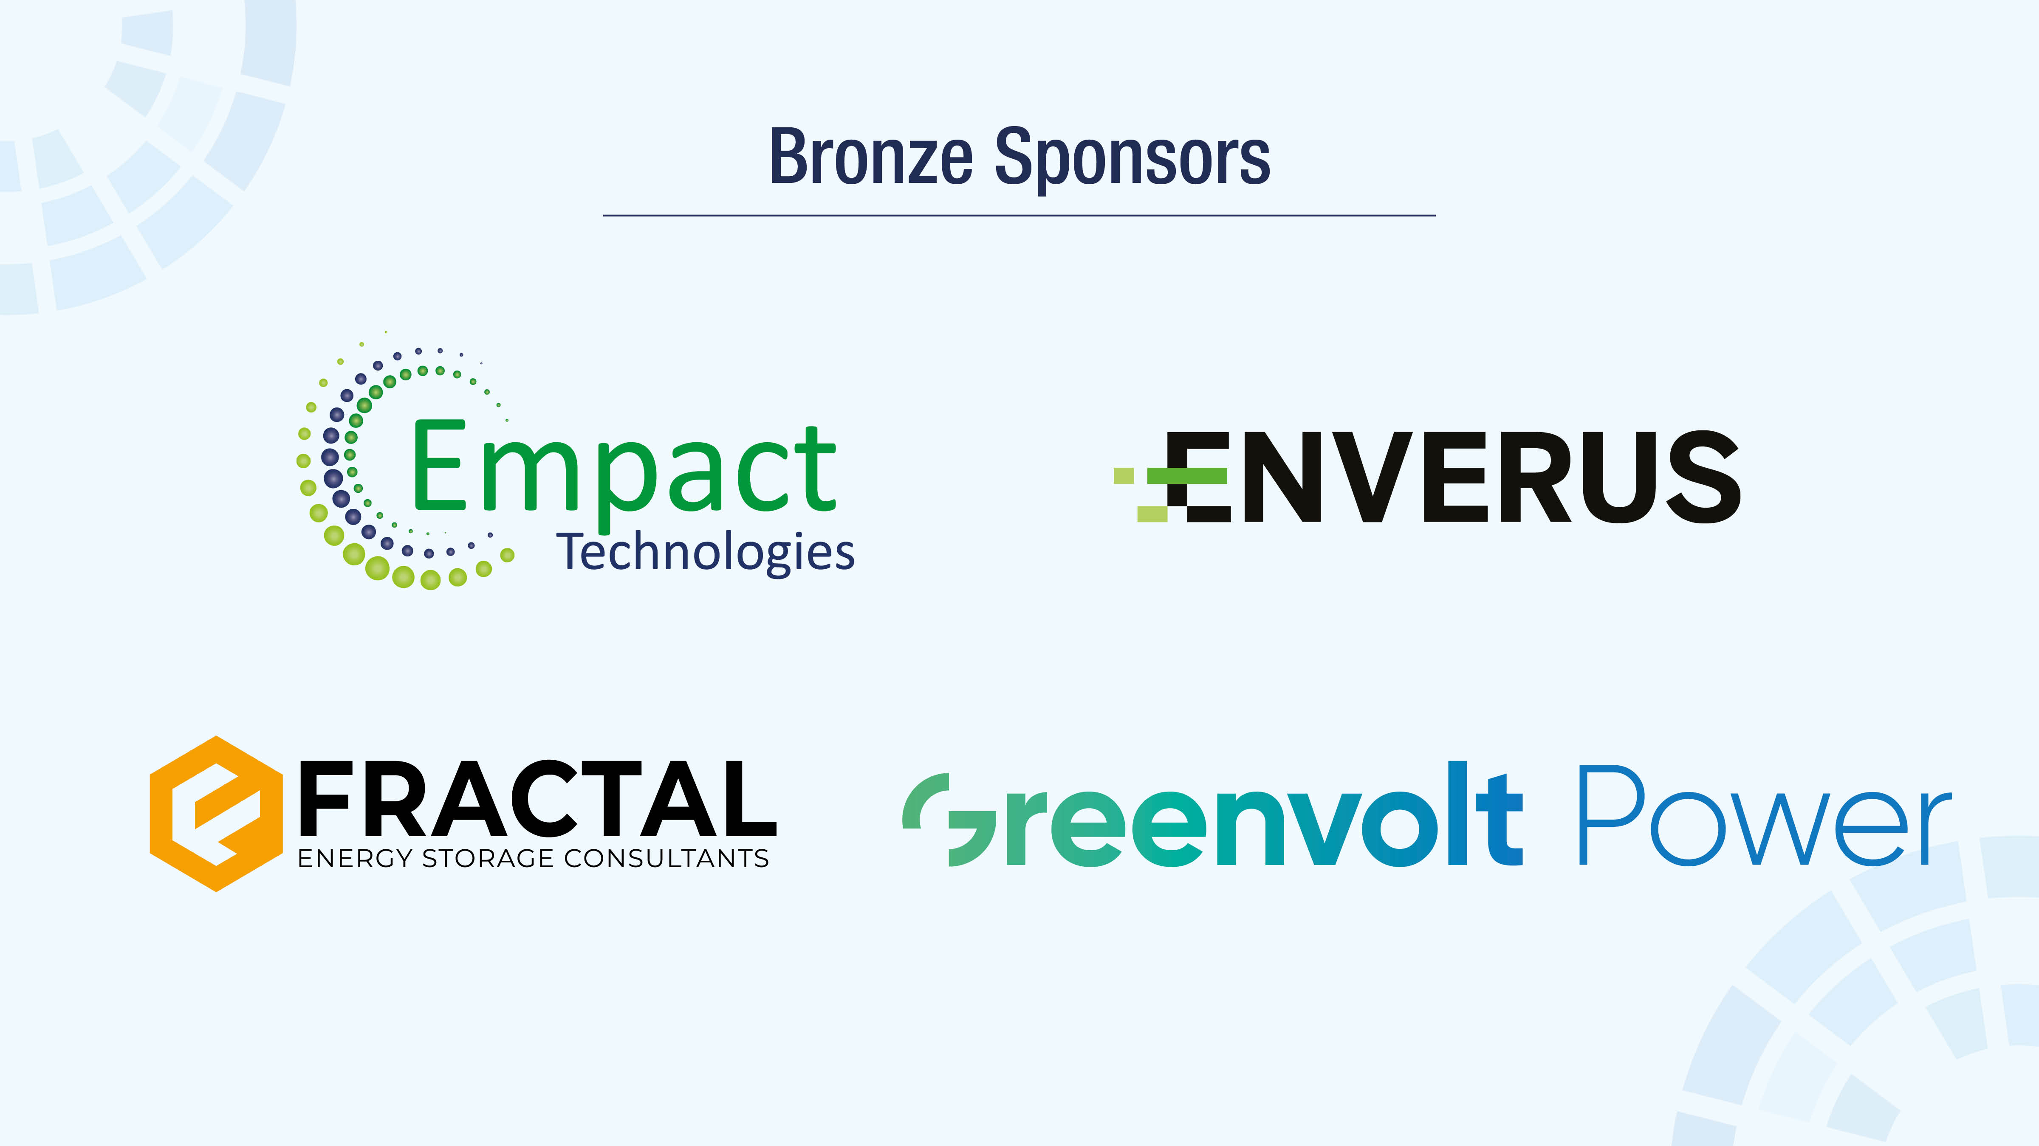

Slide 8
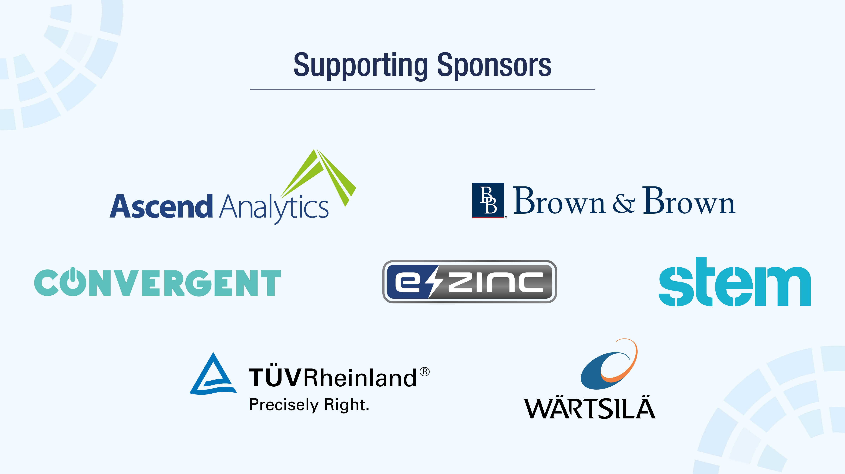

Slide 9
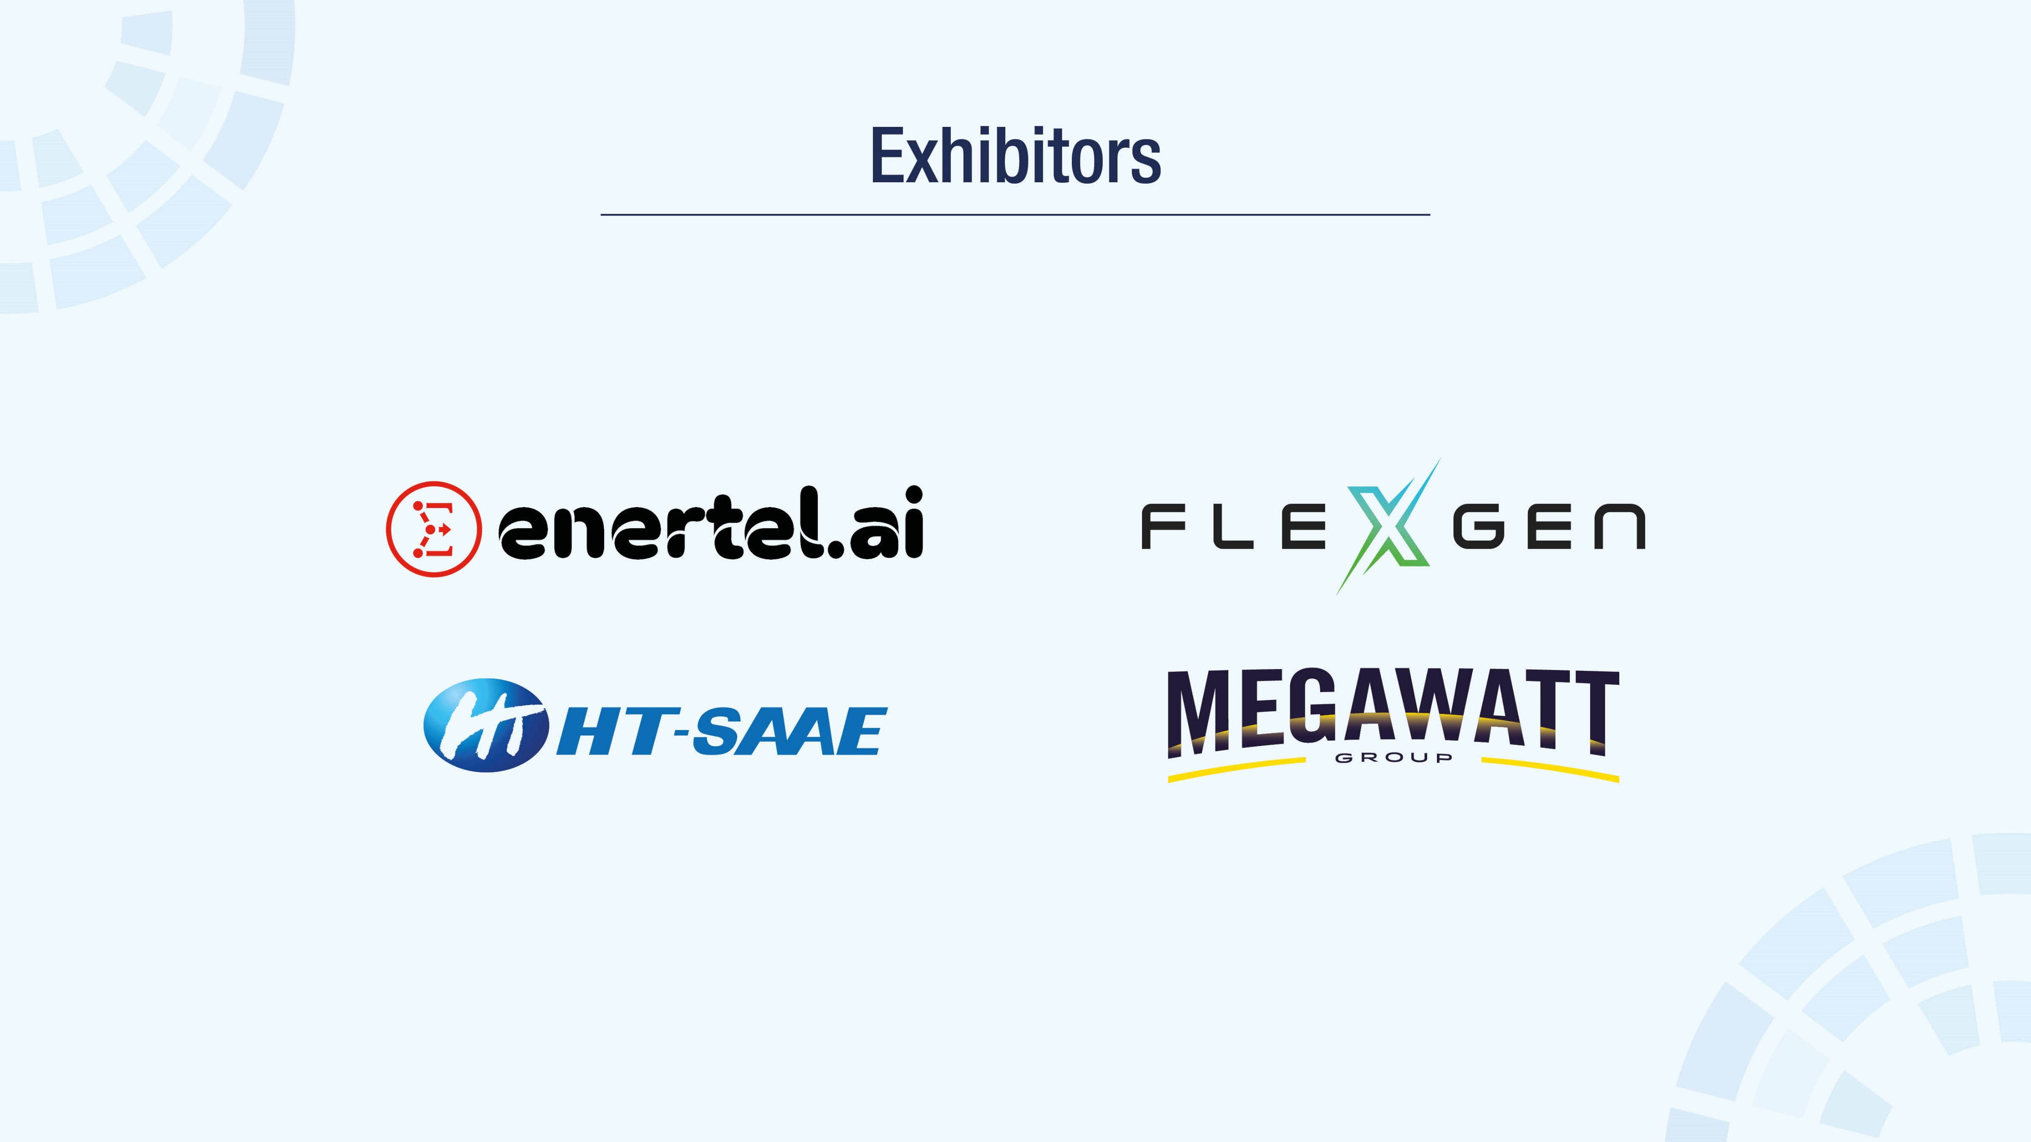

Slide 10
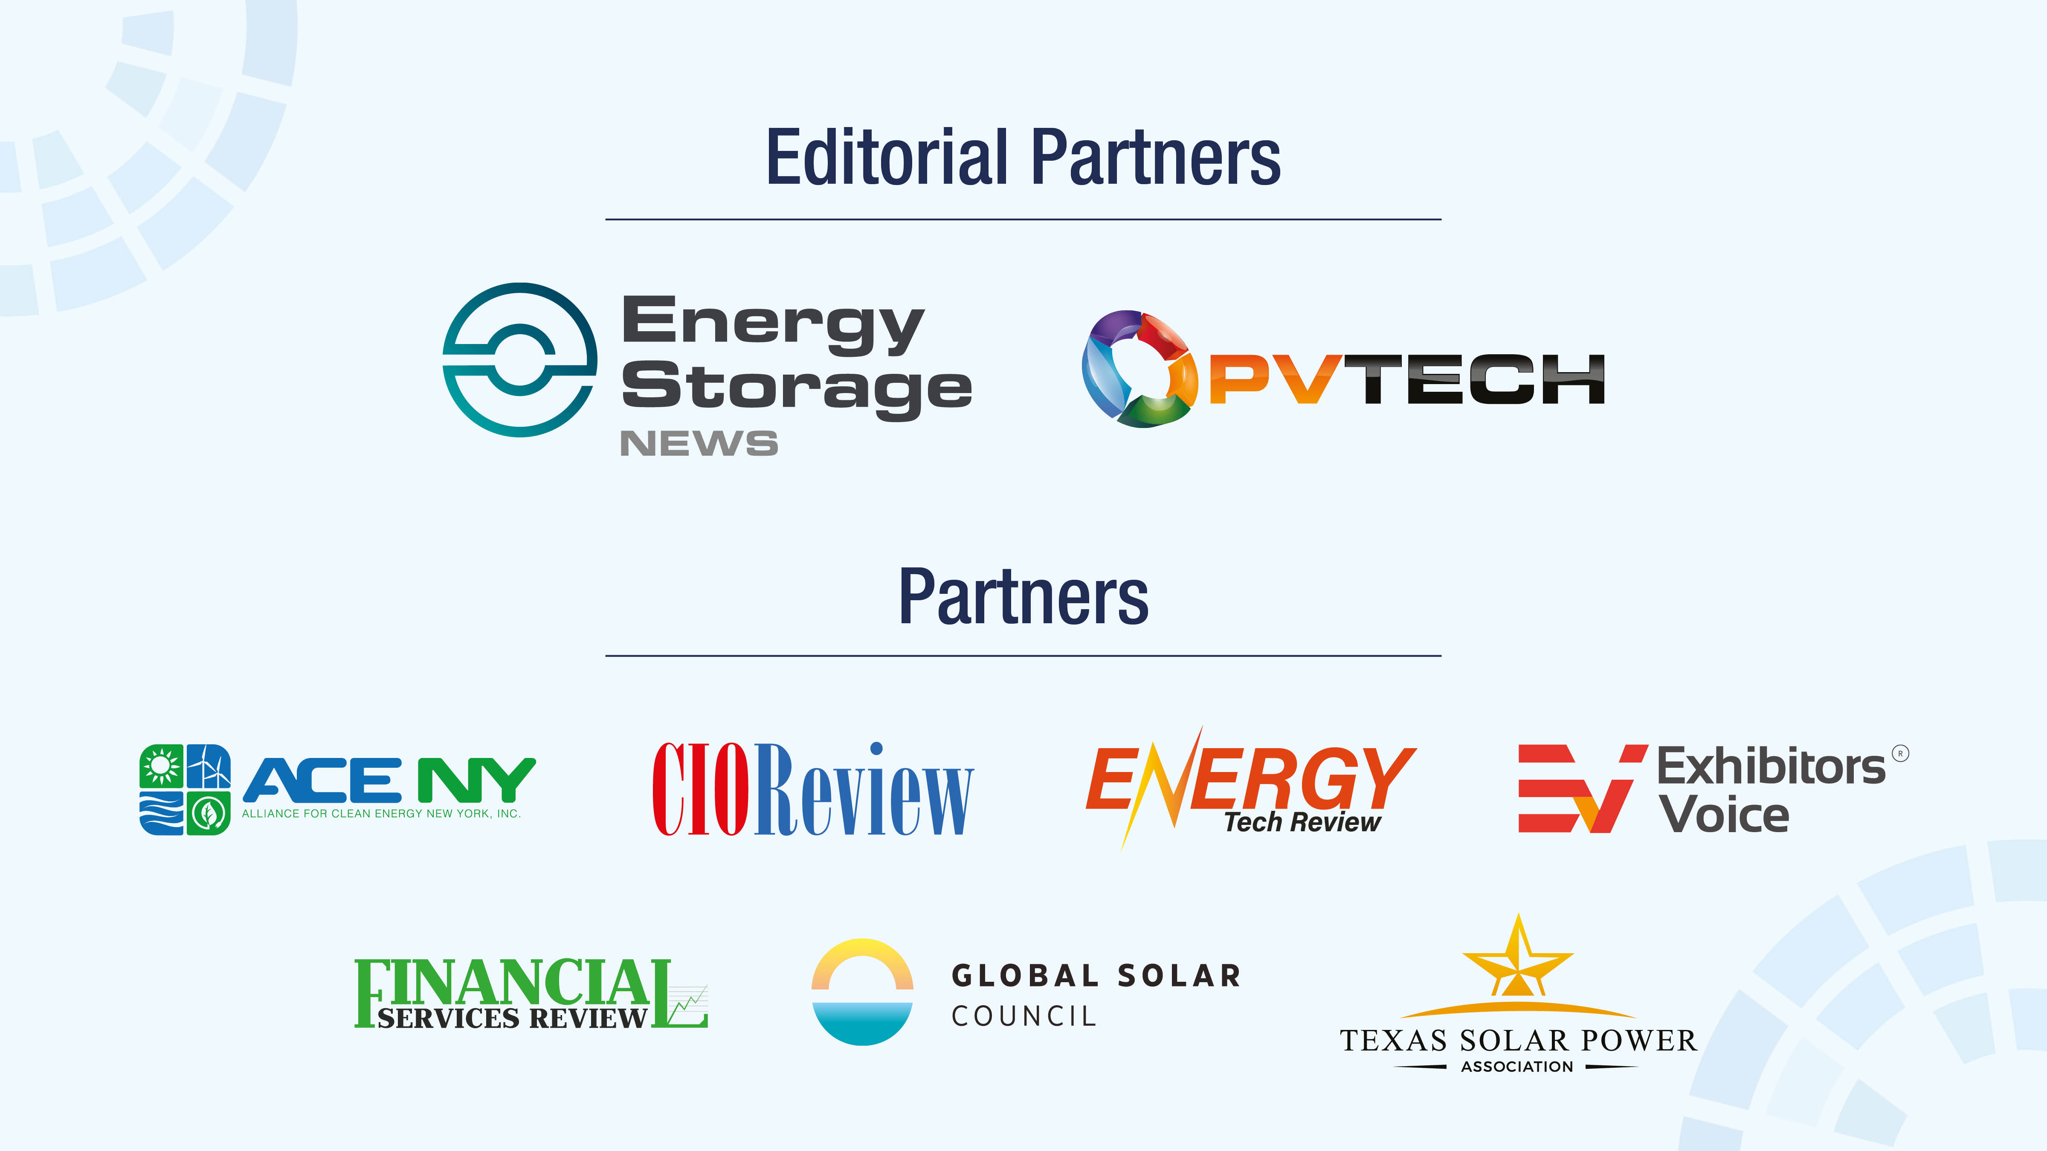

Slide 11
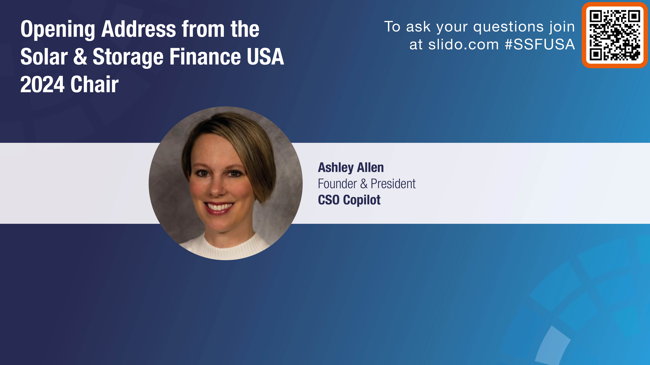

Slide 12
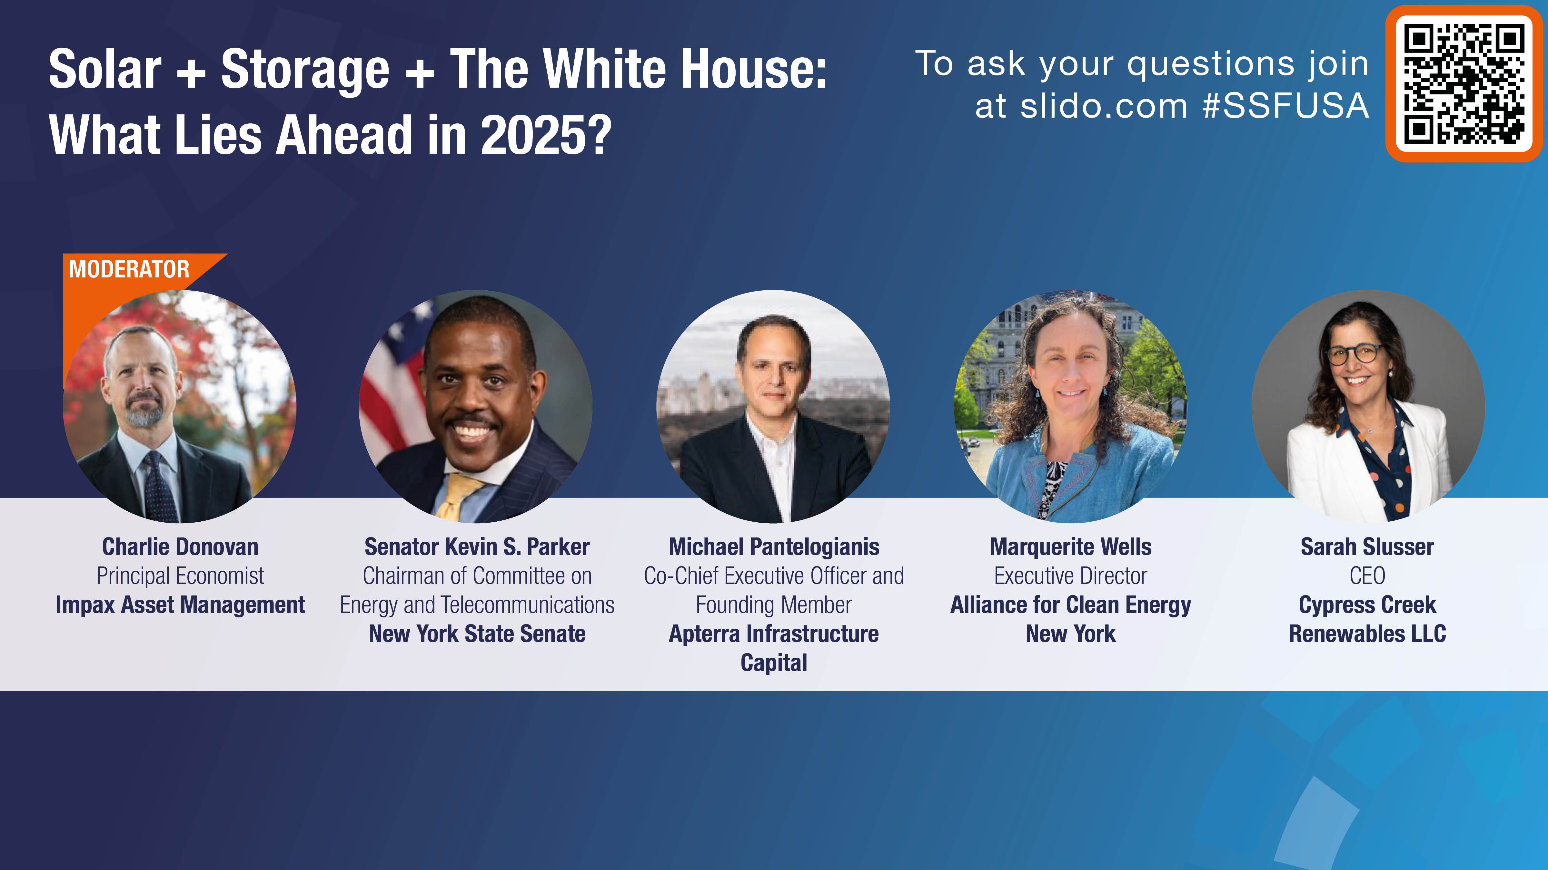

Slide 14



Please download and install the Slido app on all computers you use
Audience Q&A
ⓘ Start presenting to display the audience questions on this slide.

Slide 15
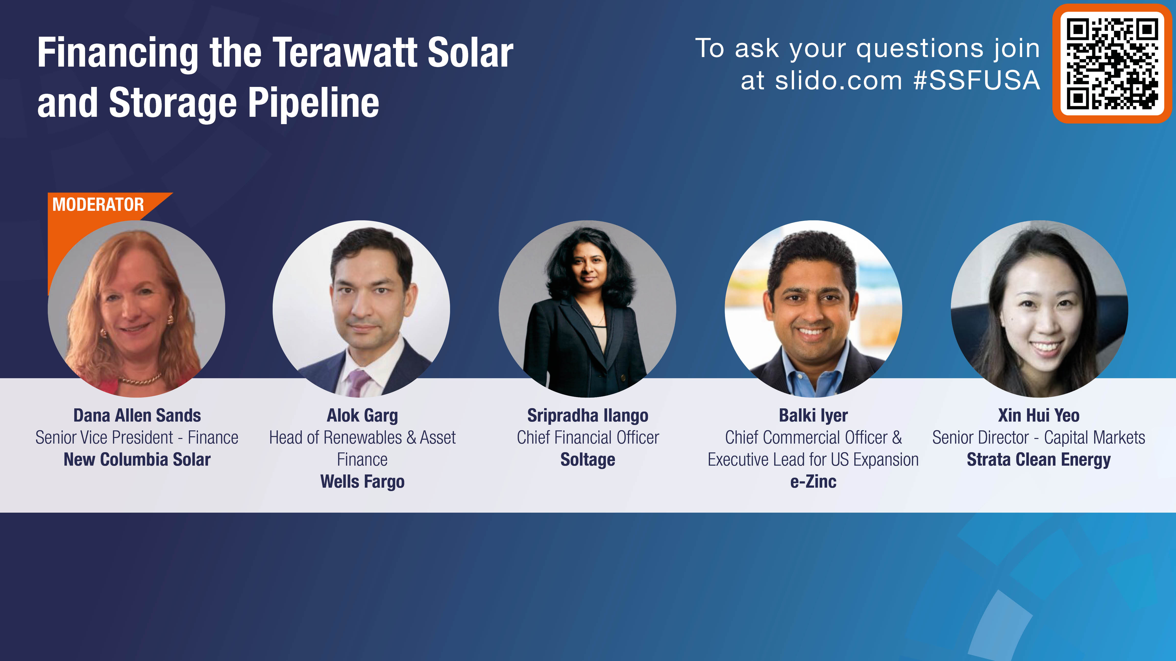

Slide 16
Please download and install the Slido app on all computers you use
Audience Q&A
ⓘ Start presenting to display the audience questions on this slide.

Slide 17
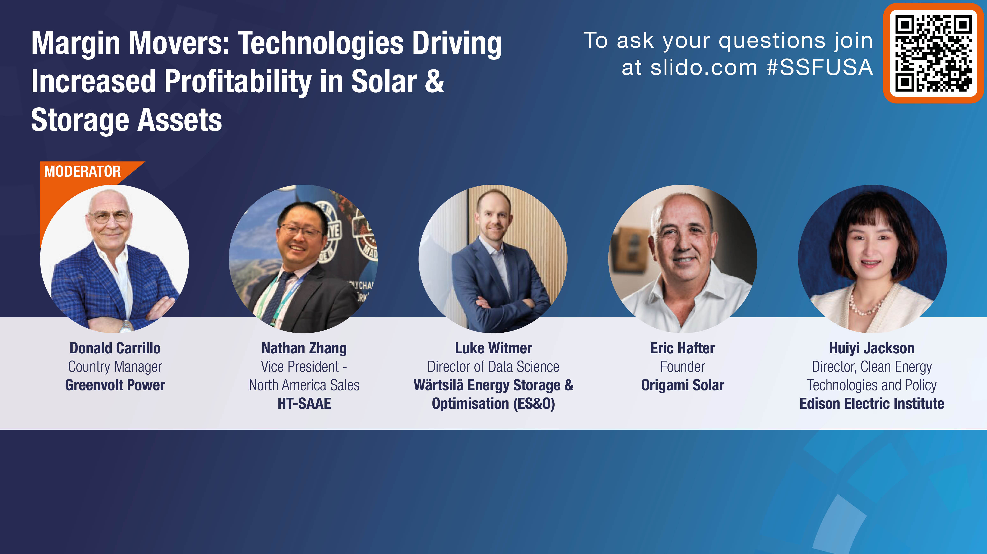

Slide 18
Please download and install the Slido app on all computers you use
Audience Q&A
ⓘ Start presenting to display the audience questions on this slide.

Slide 19


Slide 20
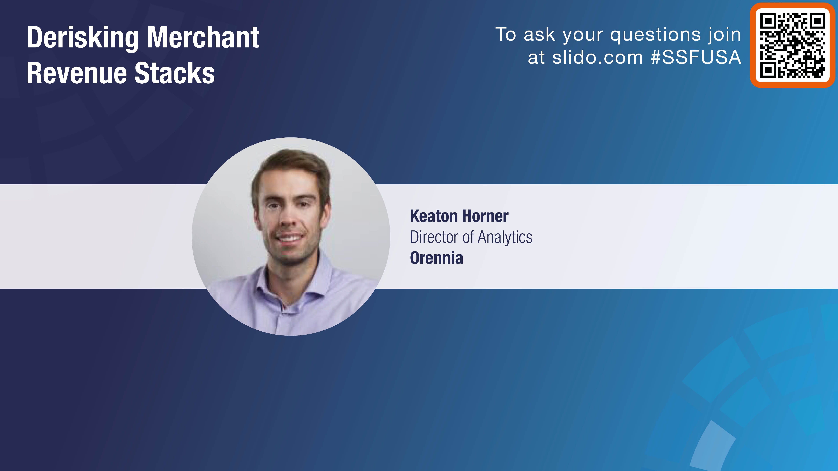

Slide 21
Derisking Merchant Revenue Stacks
Past and Future
Oct 2024

Slide 22
Macro

Slide 23
Entering a New Era of Demand
Demand has been flat over the past 20 years, but is now increasing
Source: Orennia

Slide 24
Data Center Energy Demands
Price
Clean
Speed
Reliability
Less Important
More Important

Slide 25



















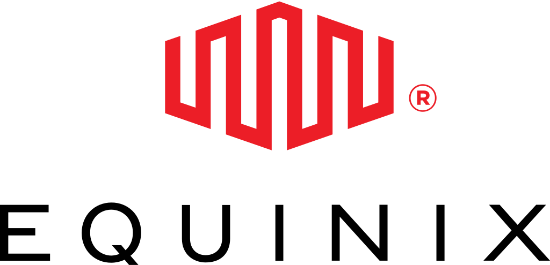

Big Tech Investments
Leading investments in emerging energy technologies
RENEWABLE NATURAL GAS
US Energy will supply food waste-based RNG to Microsoft to back up San Jose data center
ADVANCED NUCLEAR
Wyoming Hyperscale agree to 100 MW of micronuclear power from Oklo
DIRECT AIR CAPTURE
Microsoft agrees to buy 500,000 tonnes of carbon removal credits over six years
CONVENTIONAL NUCLEAR
Microsoft and Constellation plan to restart Three Mile Island Unit 1
DIRECT AIR CAPTURE
Climeworks and Microsoft announce 10-year carbon removal agreement
GREEN HYDROGEN
Microsoft takes part in Electric Hydrogen's $380 million Series C financing
BIOENERGY, CARBON CAPTURE & STORAGE
Ørsted sells 1 million carbon removal tonnes to Microsoft
ADVANCED NUCLEAR
Oracle says it's building a gigawatt-scale data center powered by three SMRs
DIRECT AIR CAPTURE
Heirloom agrees to sell 315,000 carbon removal credits to Microsoft
CONVENTIONAL NUCLEAR
Amazon acquires 650-MW data center campus powered by nuclear reactor
2022
2023
2024
DIRECT AIR CAPTURE
Google to buy carbon removal credits from Holocene at $100 per ton by 2030
DIRECT AIR CAPTURE
Amazon commits to buying 250,000 tons of carbon removal credits from 1PointFive
GREEN HYDROGEN
Amazon participates in Sunfire's €315 MM Series E financing to develop electrolyzers
NEXT-GEN GEOTHERMAL
Fervo to build 112-MW geothermal facility to add to Nevada grid
NEXT-GEN GEOTHERMAL
Google leads $40 million Series C funding round for Dandelion Energy
GREEN HYDROGEN
Amazon invests in the two electrolyzer companies
NEXT-GEN GEOTHERMAL
Sage Geosystems announces a 150-MW plant, the first geothermal project east of the Rockies
NEXT-GEN GEOTHERMAL
Google and Fervo announce first-of-its-kid 3.5-MW project in Nevada
ADVANCED NUCLEAR
Equinix signs non-binding agreement for 500 MW of micronuclear power from Oklo
BIOENERGY, CARBON CAPTURE & STORAGE
Microsoft signs 3.33 million tonne carbon removal deal
25

Slide 26
Time Spent in the IQ
It takes over 5 years for projects to go through the queue
Years in interconnection queue
0
4
8
12
16
4 yrs
US presidential term length
Geothermal
Hydro
Natural gas
Storage
Solar
Wind
Coal
Nuclear
Median for projects with an executed interconnection agreement
Source: Orennia

Slide 27
Storage Is Becoming Mainstream

Slide 28
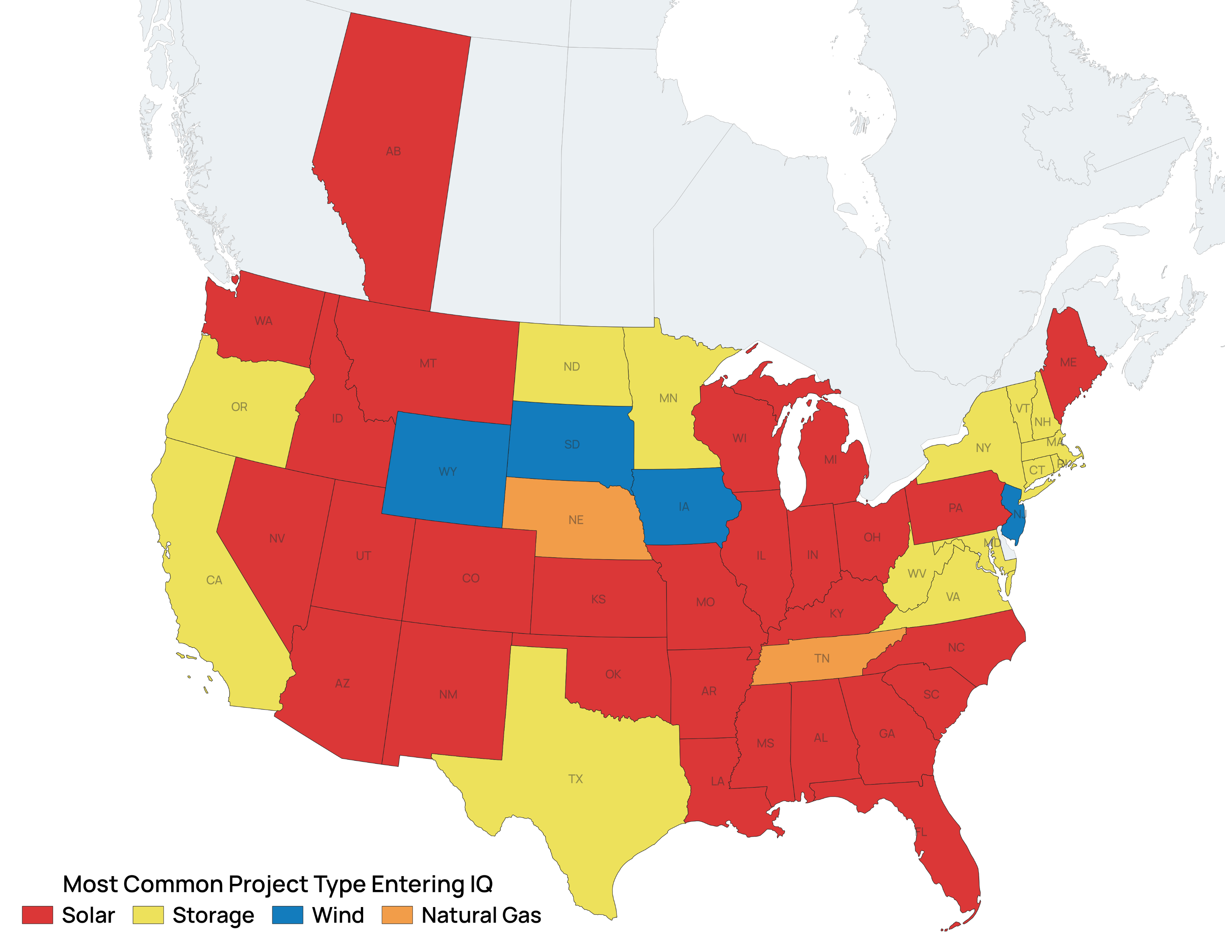
45% of New Capacity in the IQ Is Storage
Largest source of additions by type in each state
Projects that entered the IQ over the past 2 years
1.3 TW
Storage
Solar
Wind
Gas
Other
Source: Orennia

Slide 29
Storage Offers Competitive Returns
Standalone Storage
Solar
Wind
Source: Orennia

Slide 30
Top Standalone Storage Operators
Source: Orennia

Slide 31
Revenue Performance

Slide 32
Revenue Profile Varies by Market
Source: Orennia

Slide 33
Benchmarking Operator Performance
Source: Orennia

Slide 34
Operator Performance is Converging
Source: Orennia

Slide 35
What Happened this Summer in ERCOT?
Source: Orennia

Slide 36
August Supply and Demand Comparison
2023
2024
Source: Orennia

Slide 37
ERCOT Revenue Expectations
Source: Orennia

Slide 39
Please download and install the Slido app on all computers you use
Audience Q&A
ⓘ Start presenting to display the audience questions on this slide.

Slide 40
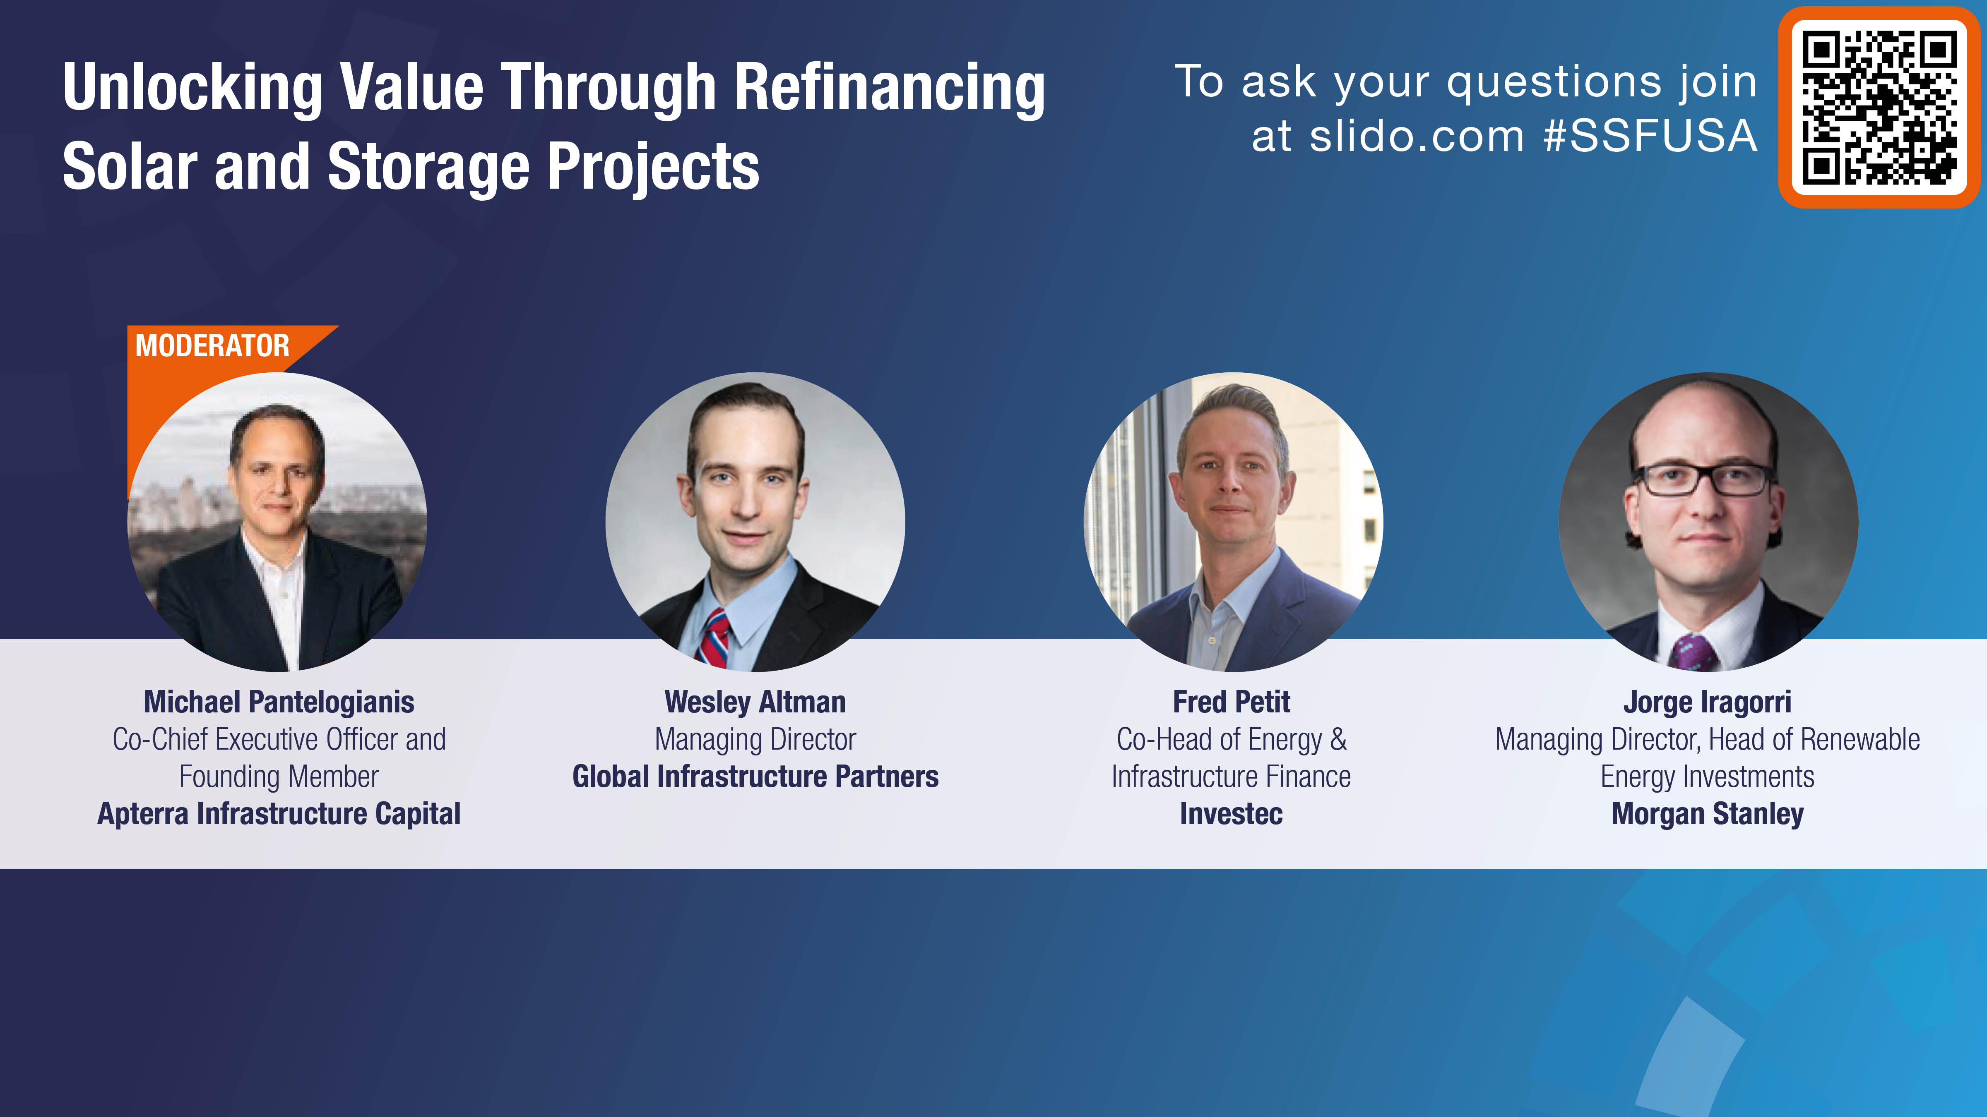

Slide 41
Please download and install the Slido app on all computers you use
Audience Q&A
ⓘ Start presenting to display the audience questions on this slide.

Slide 42


Slide 43
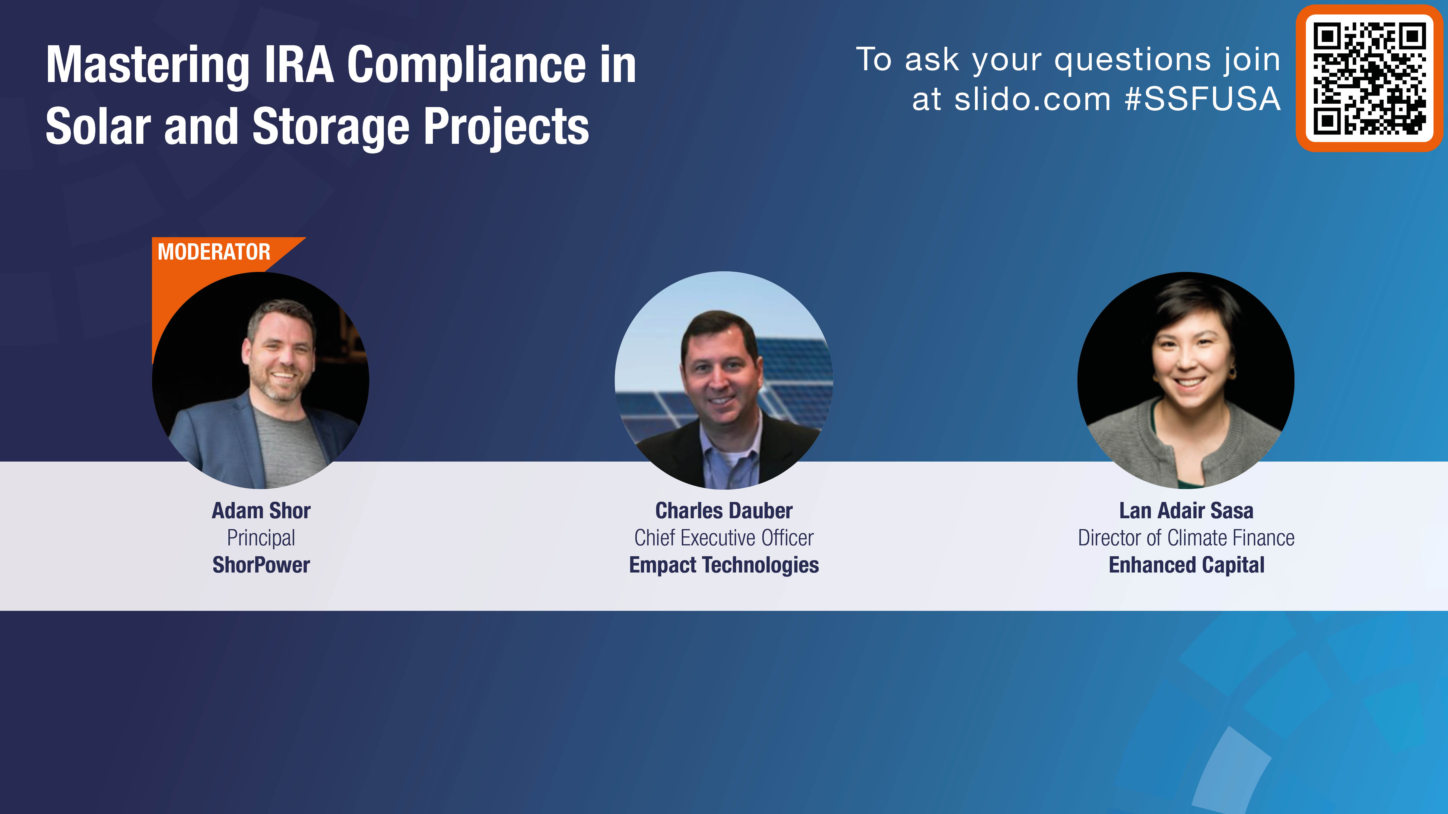

Slide 44
Please download and install the Slido app on all computers you use
Audience Q&A
ⓘ Start presenting to display the audience questions on this slide.

Slide 45
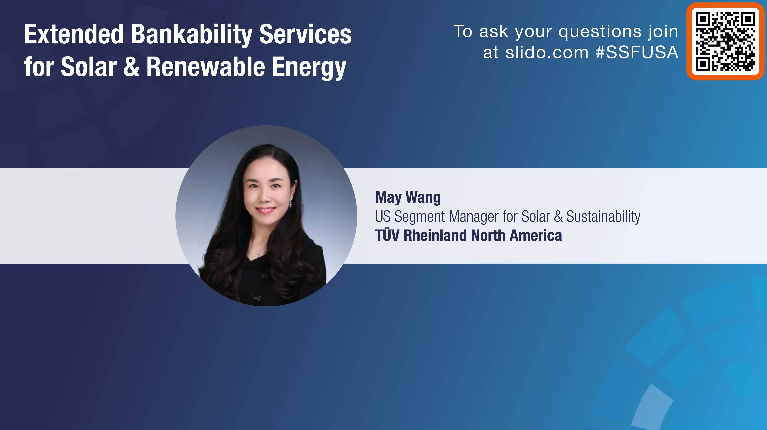

Slide 46
Smart Investments in Solar & Renewable Energy
Leveraging TÜV Rheinland’s Expertise for Financial Security
May Wang

Slide 47
Agenda
Chapter
Topic
Page
1
Company Introduction of TÜV Rheinland
3-5
2
TÜV Rheinland’s Solution for PV Systems and Products
6-23
2.1
Extended bankability service
6
2.2
Technical Due Diligence
7
2.3
Performance and Yield Forecasting
8-14
2.4
Certification and Compliance
15-18
2.5
Lifecycle Management & Supply Chain Service
19-21
2.6
ESG and Sustainability
22
3
Today for Tomorrow —— Join us!
22

Slide 48
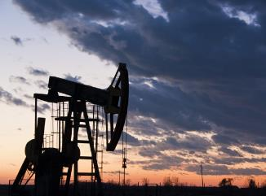
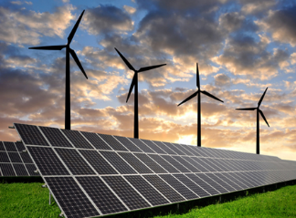
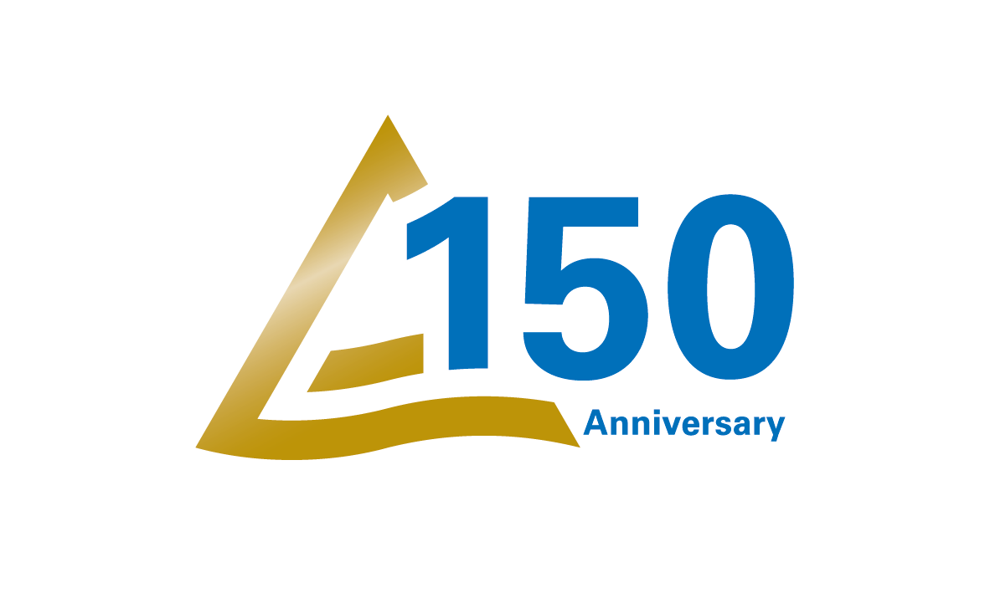
Safety and Quality Alongside the Energy Revolution.
  TÜV Rheinland was founded as part of
  the German Steam Boiler Association.
  A company with a clear mission:
  to make new technologies controllable.
  In the fossil energy era, TÜV Rheinland has evolved, keeping pace with industrial progress and energy development.
  Safety, quality and reliability are TÜV Rheinland’s areas of expertise.

Slide 49

Immediate Conclusion – Why TÜV Rheinland?
Your Investment with TÜV Rheinland’s 42 Years of Expertise
  With over 42 years of experience, TÜV Rheinland helps investors and EPCs make informed, financially secure investments by minimizing risk, maximizing performance, and ensuring long-term project viability.
IEC TC 82
R&D
edge
Added value
Global
availability
20+ working groups of IEC TC 82 for standard development have been and are being led by TÜV Rheinland.
The R&D competency of TÜV Rheinland is unrivaled in measuring and testing of new or innovative PV technologies and applications.
Our unique programs enable you to stand out from the competition and achieve greater success.
Testing centers and expert hubs across the globe enable TÜV Rheinland to respond rapidly to your local needs.
TÜV Rheinland's Solar Business

Slide 50
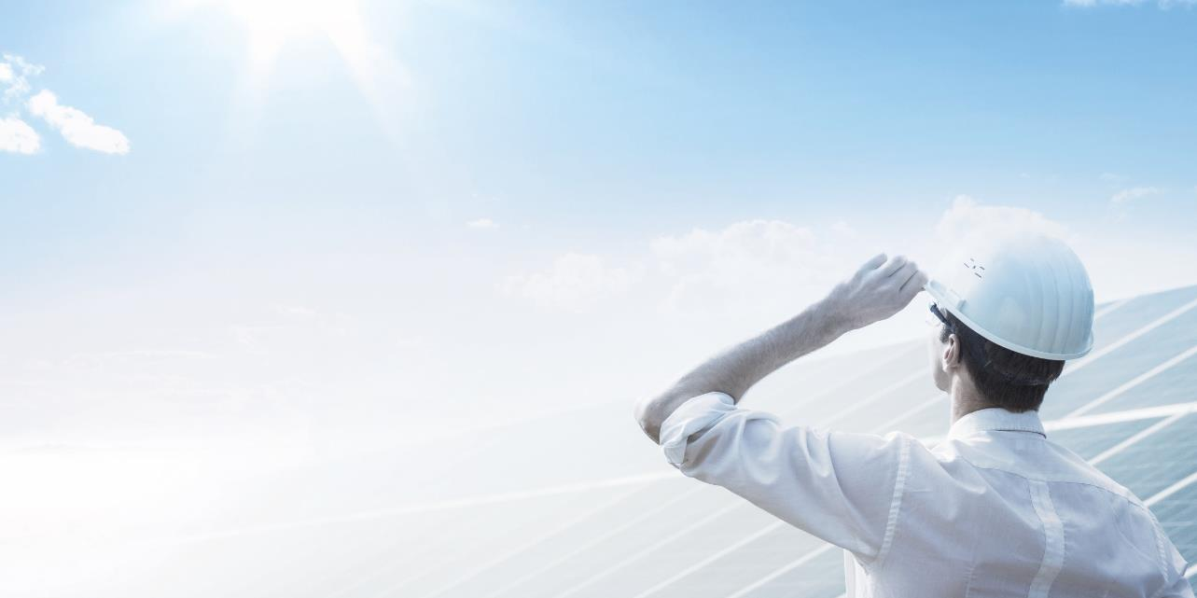
What makes TÜV Rheinland Special?
Offering tailor-made solutions for manufacturers, EPCs and investors along the value chain globally.
More than 42 years of experience in PV
Power plant inspections since 1990
Advised on PV projects adding up to more than 20GW worldwide
10,000 m² of lab testing areas
250+ PV experts worldwide

Slide 51



Focus on Investors’ Priorities-extended bankability service
The Smart Way to Invest in Solar Energy
• Investors are not just seeking upfront savings but long-term predictable returns.
• TÜV Rheinland’s extended bankability services provide the technical and financial confidence you need to secure funding and ensure lasting value.
Ranking: Superior or Good
Listed on the TÜV Rheinland website
TÜV Rheinland has established criteria for PV modules.
The standard includes eight test sequences the data from these tests not only allow system designers to make reliable energy yield predictions but also enhance the project‘s credibility and appeal.
Further reading: Extended Bankability for PV module(s) | TÜV Rheinland
Lead time: 6 months
TÜV Rheinland's Solar Business

Slide 52
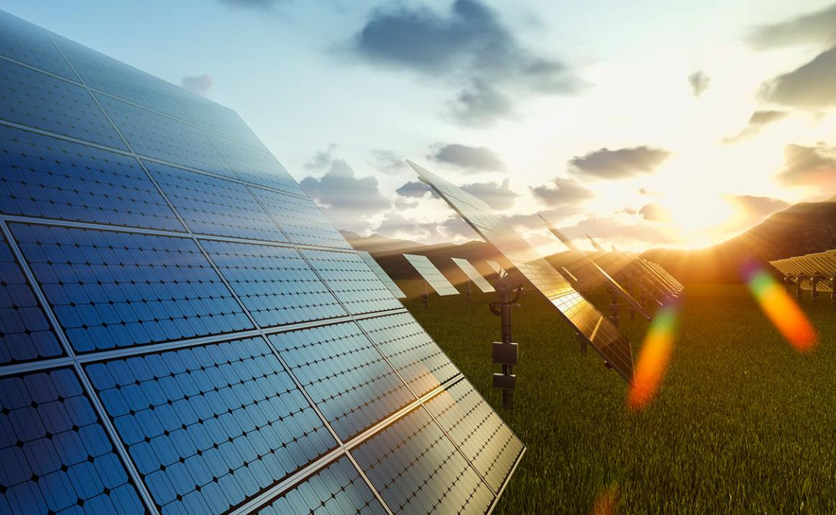
Technical Due Diligence – Your Risk Mitigation Tool
Comprehensive Technical Due Diligence (Solid investments with our solar technical due diligence)
Key Benefit: Reduce risks by ensuring projects are technically sound, maximizing success rates for investors and EPCs.
Our approach to technical due diligence for PV power plants encompasses the following key branches:
Evaluation of the technical feasibility
Contractual management
Risk management
Inspection and fault detection of PV system design, PV components, construction and performance
Plant construction monitoring
Assessment of plant’s performance on energy yield predictions
Power determination of PV modules
Complete portfolio thoroughly detailing the results of our inspection and assessment services.
TÜV Rheinland's Solar Business

Slide 53
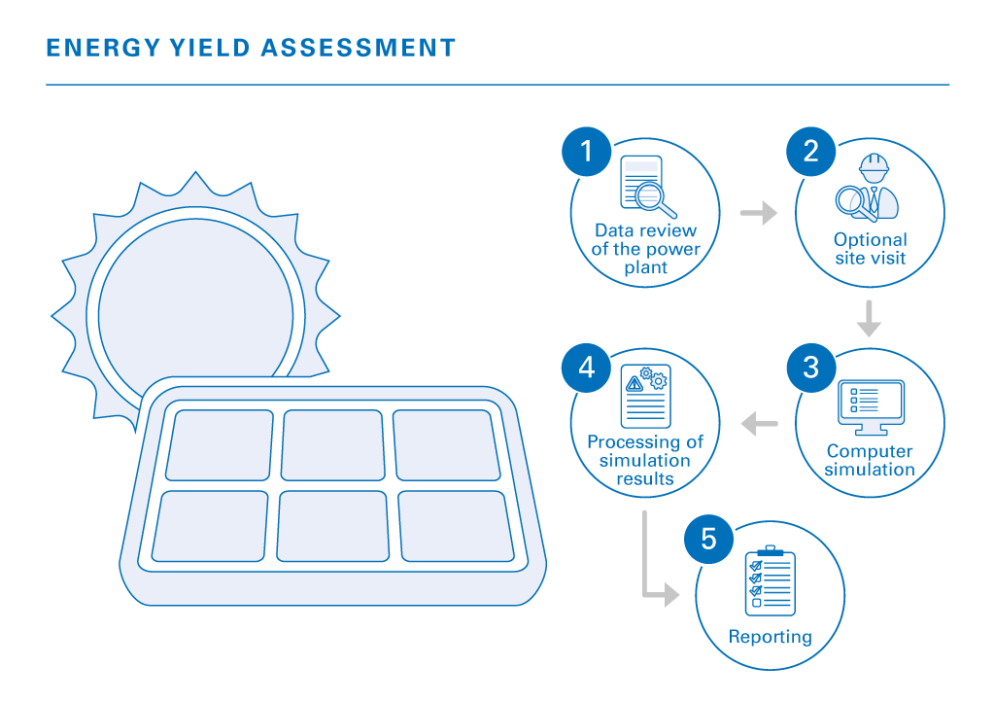
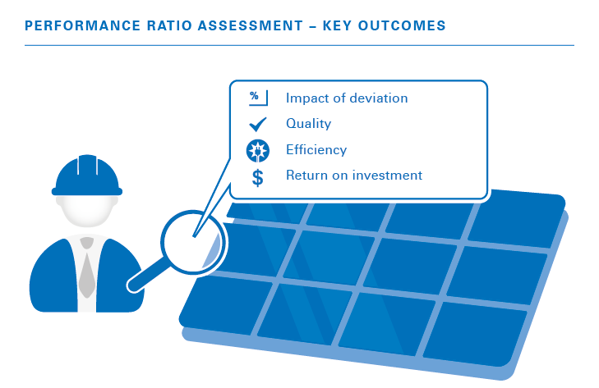
Performance Forecasting – Know Your Returns
Accurate Yield and Performance Forecasting
Key Benefit: Investors get reliable, data-backed predictions of financial returns and operational performance.
We take into account all the particulars related to your specific project: solar resources, technical system design, energy loss and any uncertainties related to each step of the simulation.
We use meteorological data and performance modeling to predict energy yields with precision.
TÜV Rheinland's Solar Business

Slide 54

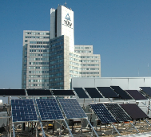
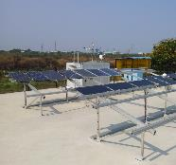

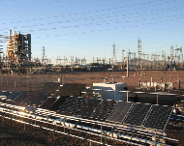
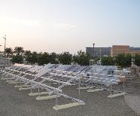
Global Energy Yield Rating of PV Modules.
Analysis of PV module performance behaviour under real operating conditions.
Tempe,
USA
Cologne, Germany
Thuwal,
Saudi Arabia
Chennai,
India
Inner Mongolia, China
Bwh
(Dry, sub-tropical desert)
Cfb
(Mild mid latitude, marine west coast)
Bwh
(Dry, sub-tropical desert), sandstorm impact
Aw
(Tropical humid, tropical savanna)
Dsa
(Dry, continental), significant temperature difference

Slide 55
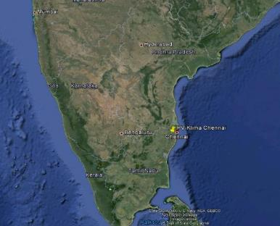
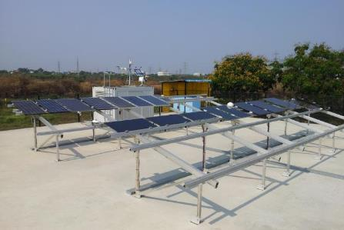
Global Energy Yield Rating of PV Modules.
Test location: Chennai, India
Geographical position: 13°N / 80°E
35 m above sea level
Climate conditions: Aw (Tropical humid, tropical savanna)

Slide 56
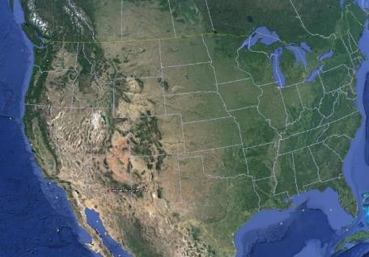
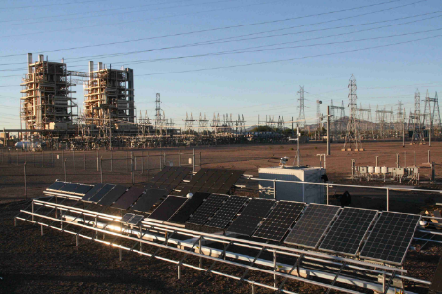
Global Energy Yield Rating of PV Modules.
Test location: Tempe, Arizona, USA
Geographical position: 33.4°N / 111.9°W
358 m above sea level
Climate conditions: Bwh (Dry, sub-tropical desert)

Slide 57
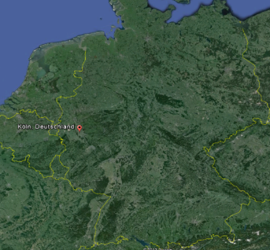
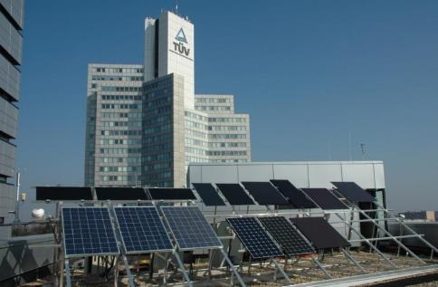
Global Energy Yield Rating of PV Modules.
Test location: Cologne, Germany
Geographical position: 50.6°N / 7.0°E
53 m above sea level
Climate conditions: Cfb (Mild mid latitude, marine west coast)

Slide 58
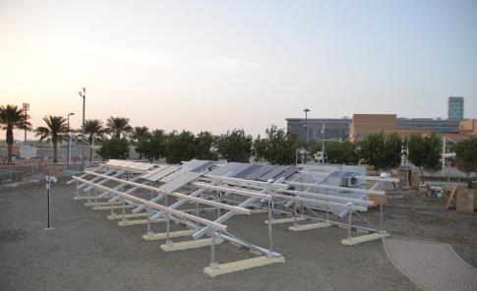
Global Energy Yield Rating of PV Modules.
Test location: Thuwal, Saudi Arabia
Geographical position: 22.304°N / 39.108°E
3 m above sea level
Climate conditions: Bwh (Dry, sub-tropical desert), sandstorm impact

Slide 59
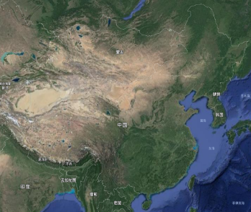
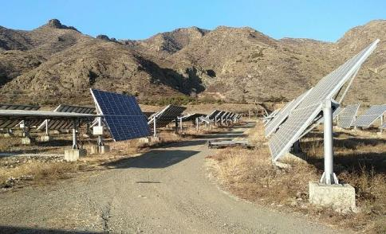
Global Energy Yield Rating of PV Modules.
Test location: Inner Mongolia, China
Geographical position: 40°N / 111°E
1094 m above sea level
Climate conditions: Dsa (Dry, continental), significant temperature
difference

Slide 60
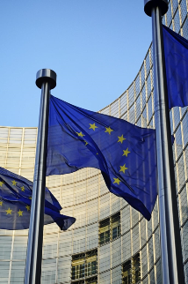
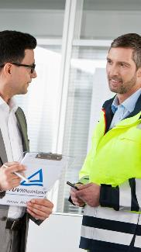
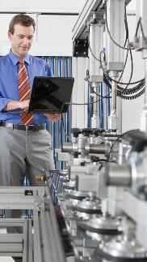
Certification & Compliance – Building Trust
Global Certification and Compliance Expertise
We meet international standards (IEC, UL) and local regulations to ensure projects are finance-ready.
Compliance boosts investor confidence by ensuring safety, quality, and regulatory approval.
Take advantage of our global test laboratory network, in which we use the latest measurement methods and procedures to ensure compliance of PV products.
TÜV Rheinland's Solar Business

Slide 61
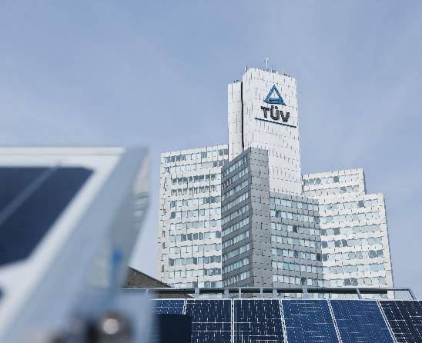
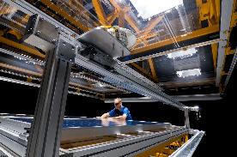
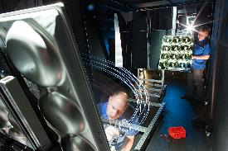
TÜV Rheinland Global PV Testing Network.
GERMANY
            1,500 m²
            Categories
            1982
            Accreditations
            Laboratory area
            PV modules, components, inverters, ESS
            Year established
ISO 17025, SRCC, VKF, CBTL, CEC, MCS, NRTL
Cologne

Slide 62
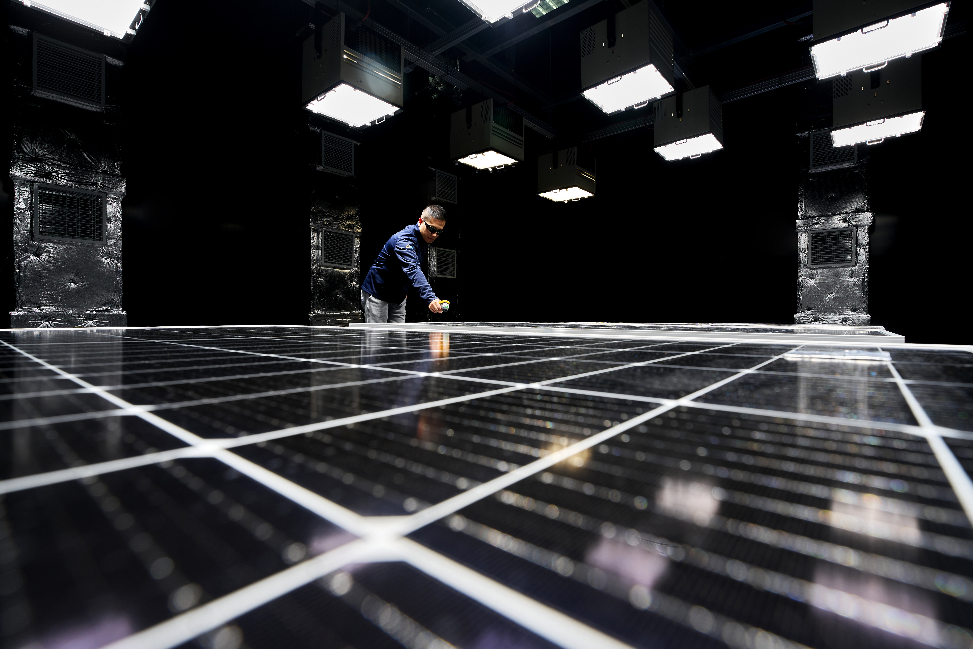
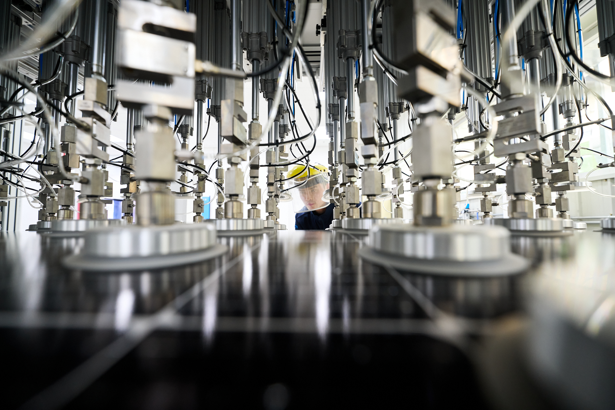
TÜV Rheinland Global PV Testing Network.
MAINLAND CHINA
            5,000 m²
            Categories
            2007
            Accreditation
            Testing area
            PV modules, components, inverters, ESS, PV trackers
            Year established( Year 2022 moved to Taicang)
            ISO 17025, CBTL, CEC, NRTL, MCS, UAE Civil Defense
Shanghai/Taicang
Notes:
.

Slide 63
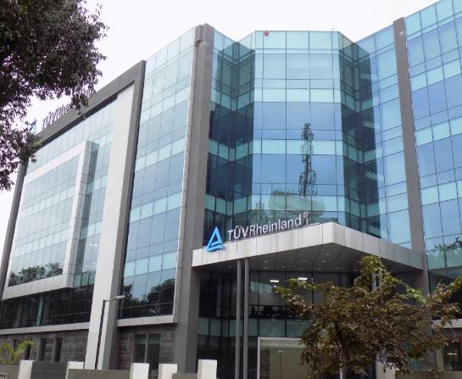
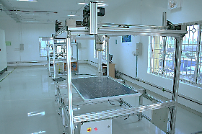



TÜV Rheinland Global PV Testing Network.
INDIA
            1,114 m²
            Categories
            2010
            Accreditations
            Laboratory area
            PV modules, inverters, solar pumping systems
            Year established
            ISO 17025, CBTL, MCS, NRTL, CEC
Bangalore

Slide 64

Lifecycle Management – Sustaining Your Asset Value
Ensuring Long-Term Asset Performance
Development
Engineering
Procurement
Construction
Commissioning
Acceptance
Operation
Feasibility study
Design review
Site evaluation
Energy yield assessment
Glare assessment
Technical requirements
Design optimization
Components check
Production estimate
EPC & O&M contract review
Product and vendor quality assurance
Factory audits
Purchase agreements review
Production inspection
Module and component tests
Inspection and construction monitoring
Quality control and conformity inspection of civil, mechanical, electrical engineering, technical execution and performance
Progress and critical milestone monitoring
Safety, quality and power control
Safety-related inspection
Functional check
Test protocol verification
Thermographic scans
On-site tests and measurements
Final acceptance and asset certification
Performance ratio (PR) assessment
Provisional and final acceptance certification
Technical documentation review
Regular monitoring
O&M report review
Refinancing due diligence
Periodic power and warranty inspections
Failure analysis
Technical due diligence
Power optimization
TÜV Rheinland's Solar Business

Slide 65


Supply Chain Validation – Secure Your Components
Validating Critical Components and Supply Chain
Further reading: tuev-rheinland-2024-05-supply-chain-brochure-en.pdf
TÜV Rheinland's Solar Business

Slide 66



PV Supply Chain Services
Our services can be used individually or combined in a package from pre-order to post-shipment.
Development
  - Assessment of the production facilities and manufacturers
  - Performance optimization with best practice experiences
Pre-production
  - Potential supplier auditing and selection
  - PV module and component quality and performance testing
Production
  - Inspection services along the production period
  - Spot-check testing during production
  - Quality assurance and control
Post-production
  - Pre-installation testing
  - Site acceptance testing
  - Failure analytics in the field

Slide 67


ESG and Sustainability – Aligning Investments with the Future
Sustainability and ESG Compliance
Sustainability reporting and ESG related disclosures are the key focus for businesses as regulators, investors, consumers and other stakeholders demand greater transparency and continuous improvement of sustainability performance.
Further reading: Sustainability and ESG Assurance | WO | TÜV Rheinland (tuv.com)
TÜV Rheinland's Solar Business

Slide 68

One-stop Solar Business Solutions.
EPCs & Manufacturers
Plant Owners
Finance Institutions
We support you with comprehensive solutions that can take you to a whole new level.
We offer all-round technical support over the entire value chain and throughout a PV plant’s lifetime.
We provide an independent perspective to help strengthen and reinforce solid investment decisions.
PV Product Lifecycle
PV Asset Lifecycle
Quality Assured
Bankability

Slide 69

Let's Discuss Your Next Solar Investment!
Contact Person: May Wang
E-mail: may.wang@tuv.com
Tel: +1 617 5130373
Linkedin: May Wang | LinkedIn
TÜV Rheinland's Solar Business

Slide 70
Please download and install the Slido app on all computers you use
Audience Q&A
ⓘ Start presenting to display the audience questions on this slide.

Slide 71


Slide 72

Please download and install the Slido app on all computers you use
What do you believe is the biggest challenger facing buyers/offtakers?
ⓘ Start presenting to display the poll results on this slide.

Slide 73
Please download and install the Slido app on all computers you use
If you could change one thing to make your participation in this market easier, what would it be?
ⓘ Start presenting to display the poll results on this slide.

Slide 74
Please download and install the Slido app on all computers you use
Audience Q&A
ⓘ Start presenting to display the audience questions on this slide.

Slide 75


Slide 76


Slide 77
Please download and install the Slido app on all computers you use
Audience Q&A
ⓘ Start presenting to display the audience questions on this slide.

Slide 78


Slide 79


Slide 80


Slide 81


Slide 82


Slide 83


