Slide 1


Slide 2


Slide 3


Slide 4



Please download and install the Slido app on all computers you use
Audience Q&A
ⓘ Start presenting to display the audience questions on this slide.

Slide 5


Slide 6
Please download and install the Slido app on all computers you use
Audience Q&A
ⓘ Start presenting to display the audience questions on this slide.

Slide 7
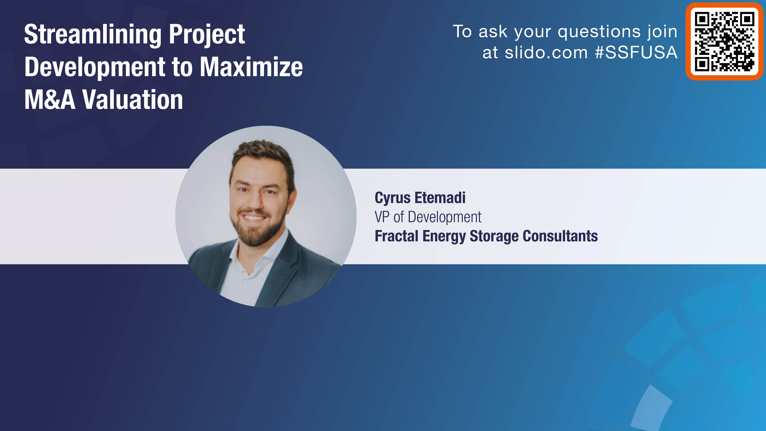

Slide 8


October 2024
Streamlining the Project Development Cycle
To Maximize Valuation

Slide 9

Current State of Market
Some developers unknowingly target ‘early’ project sales/exits while inherent development risks are still very much present.
These developers also expect high valuation levels and attractive payment terms at time of sale.
Prospective buyers on the other hand common seek a fully ‘de-risked’ project at the lowest valuation that the seller is willing to transact.
This structural mismatch in the M&A landscape is now increasingly common, causing delays to the overall sale process as well as frictions in the negotiation dynamics.
How Can We Reduce Risks AND Increase Valuation???

Slide 10
Development Milestones
What are the key development milestones and their underlying factors?
1. Early-Stage
Site Control (Lease or Purchase Option)
Foundational Documents
Development Budget
Prelim Project Financial Modeling
3. Late-Stage
IX Studies Complete
Interconnection Agreement < 6 months
Environmental / Permits Complete
Site Survey / ROW Easements Complete
Revenue / Offtake Strategy Complete
LMP Congestion / Curtailment Complete
10% Engineering
Long-Lead Procurement Analysis
Other Final Dev Work
NTP in < 12 months
4. Ready-to-Build
IA Executed
Equipment and EPC RFP Initiated
Draft IE Report Initiated
Revenue Final
Financing < 6 months
2. Mid-Stage
CIA / Permitting Matrix
Interconnection (IX) Application
IX Studies in Progress
Prelim Site Layout
NTP in < 36 months

Slide 11
Developer Target Exit
Some developers commonly make the mistake of starting project sale efforts following completion of the Early-Stage milestone.
Such an early exit translates to lengthy sale processes, heavily discounted project valuation levels, and overall lower interest from prospective buyers.
Furthermore, it is common for developers to believe that they’ve achieved the Mid-Stage milestone without necessarily having completed the underlying criteria.
The most common mistakes are the lack of a Dev Budget / Project Modeling and Permitting Matrix / CIA.
1. Early-Stage
Site Control (Lease or Purchase Option)
Foundational Documents
Development Budget
Prelim Project Financial Modeling
2. Mid-Stage
CIA / Permitting Matrix
Interconnection (IX) Application
IX Studies in Progress
Prelim Site Layout
NTP in < 36 months

Slide 12
Buyer Target Milestone
Although prospective buyers may seek projects at different development stages, the bulk of potential acquirors typically target the following two milestones.
Most buyers require clear line of sight on the interconnection studies (whether already completed or weeks away), as well as all matters pertaining to key permits and easements.
These buyers typically want to enter the project right before posting the Interconnection deposit and begin equipment / EPC procurement efforts.
Another subset of buyers may only target ready-to-build projects that have completed all the underlying criteria, while only having the EPC, Equipment and Financing outstanding.
3. Late-Stage
IX Studies Complete
Interconnection Agreement < 6 months
Environmental / Permits Complete
Site Survey / ROW Easements Complete
NTP in < 12 months
4. Ready-to-Build
IA Executed
Equipment and EPC RFP Initiated
Draft IE Report Initiated
Revenue Final
Financing < 6 months

Slide 13
Lessons Learned
Some developers may have a skewed perception of their project development stage.
Sale processes may be launched with the claim that the project is Late-Stage however some of the critical items of a Mid-Stage project have yet to be achieved. Therefore, the structural mismatch in valuation expectations versus market feedback becomes apparent throughout the process.
Prospective buyers also might have skewed perceptions of acquisition opportunities, seeking discounted valuations but without underwriting any development risk. This is also a structural gap that can complicate due diligence, negotiation dynamics and a successful transaction.
Developers should seek to streamline the development stage of the project by achieving the critical items required prior to a sale, while Buyer should be mindful that attractive valuations can only be successful with adequate development risk underwriting.

Slide 14
Valuation Spectrum
Early-Stage
Mid-Stage
Late-Stage
Ready-to-Build
Very high development risks
Very long development schedule
Heavily discounted valuation
Low interest in the broader Buyer pool
High development risks
Long development schedule (NTP <36 months)
Discounted valuation
High interest in the broader Buyer pool
Medium development risks
Short development schedule (NTP < 12 months)
‘Market’ valuation
Very High interest in the broader Buyer pool
Low development risks
RTB Ready (NTP < 6 months)
High valuation
Low/Medium interest in the broader Buyer pool

Slide 15

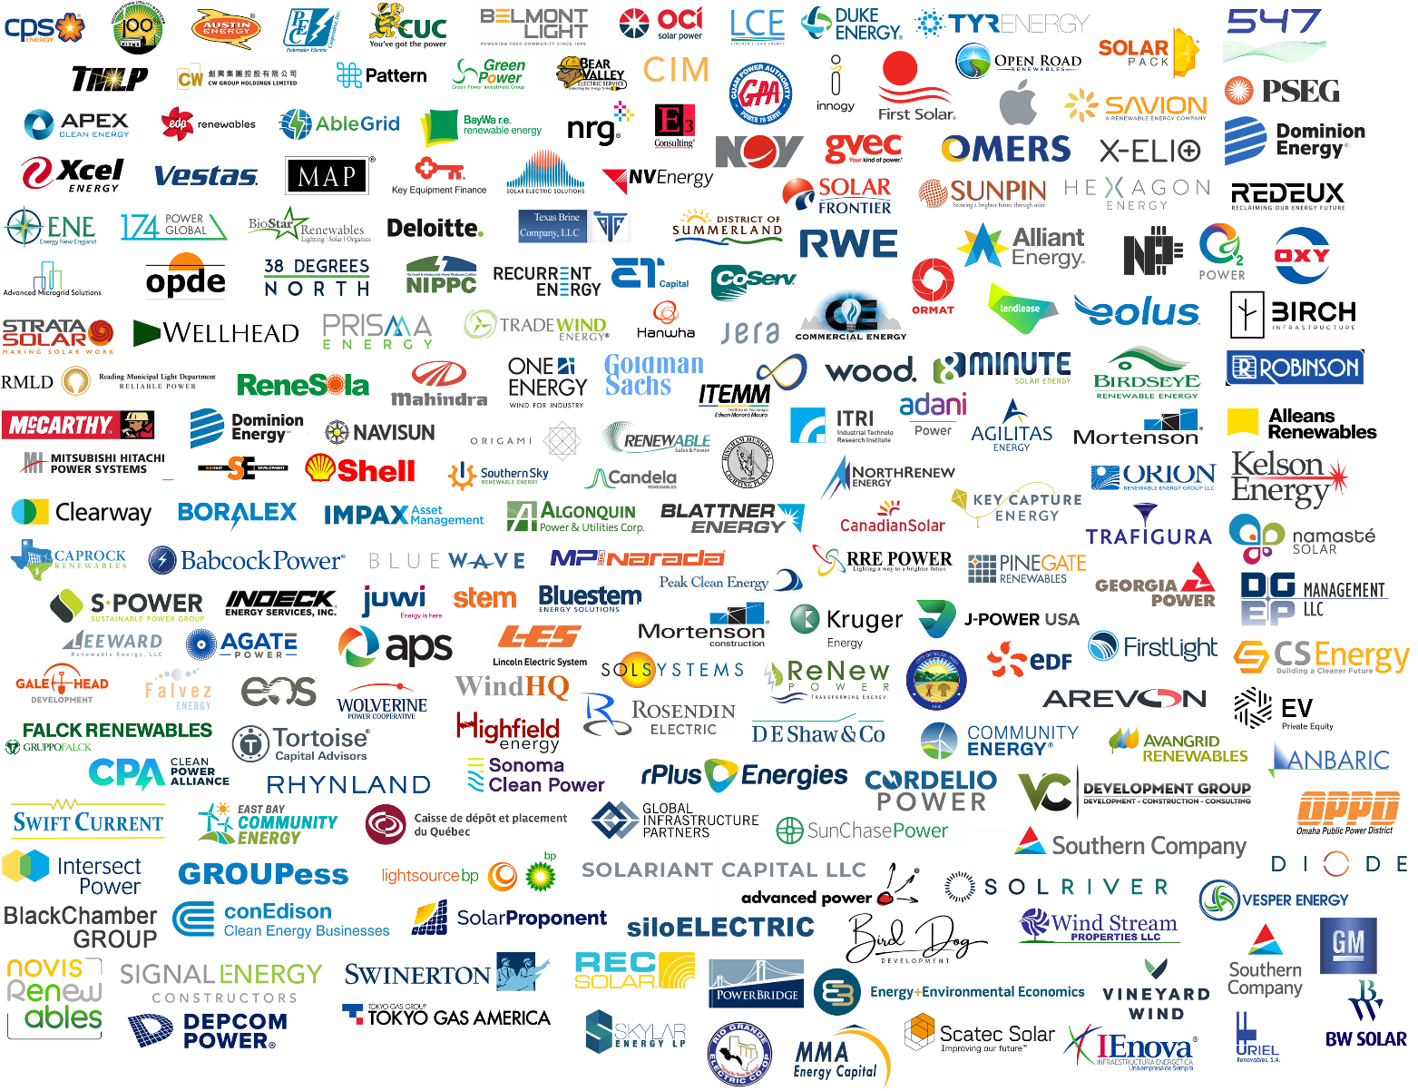
Unmatched Experience
VALUE STREAMS
Energy storage subject matter experts
Real hand-on experience, real-world analysis
First-class customer service
De-risk, optimize and accelerate projects
Full lifecycle support
800+
Engagements
8 GW
Design / Analysis
5 GWh
In Operations
1st Storage Consultant

Slide 16
Please download and install the Slido app on all computers you use
Audience Q&A
ⓘ Start presenting to display the audience questions on this slide.

Slide 17
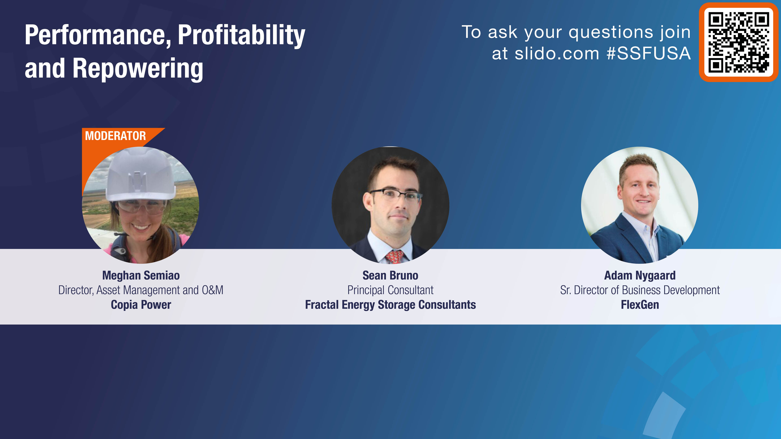

Slide 18
Please download and install the Slido app on all computers you use
Audience Q&A
ⓘ Start presenting to display the audience questions on this slide.

Slide 19


Slide 20
Please download and install the Slido app on all computers you use
Audience Q&A
ⓘ Start presenting to display the audience questions on this slide.

Slide 21


Slide 22

Please download and install the Slido app on all computers you use
Which regions are doing the best job with improving the interconnection process? - Elise
ⓘ Start presenting to display the poll results on this slide.

Slide 23
Please download and install the Slido app on all computers you use
What areas would you like to see improvements? - Elise
ⓘ Start presenting to display the poll results on this slide.

Slide 24
Please download and install the Slido app on all computers you use
Audience Q&A
ⓘ Start presenting to display the audience questions on this slide.

Slide 25


Slide 26


Slide 27


Slide 28


Slide 29


Slide 30


